Slide 1
Assessment 101
Making it meaningful and manageable!

Slide 2
Assessment 101: Today’s discussion
Why do we do Assessment?
Framing Assessment
Getting Started
Types of Assessment
Terms and Definitions
Keeping it Simple
Divisional Assessment Process
Resources
Q&A

Slide 3
WhY do we do assessment?
Cycle of Assessment
…with the goal of
CONTINUOUS IMPROVEMENT!!

Slide 4
Framing Assessment for our work
Comprehensive Model of Assessment
Barham & Scott (2006)
Service
Learning
Development

Slide 5
Getting Started
Ask yourself QUESTIONS:
What are you trying to accomplish?
How will you know if you achieve it?
Are there indicators along the way?
-- or --
What do you need to know?
How can you find out?
How can I keep this simple?

Slide 6
Types of Assessment
Tracking Usage
Needs
Satisfaction
Outcomes
Campus Climate
Program Review
Benchmarking
Resource effectiveness
Accreditation
National Instruments

Slide 7
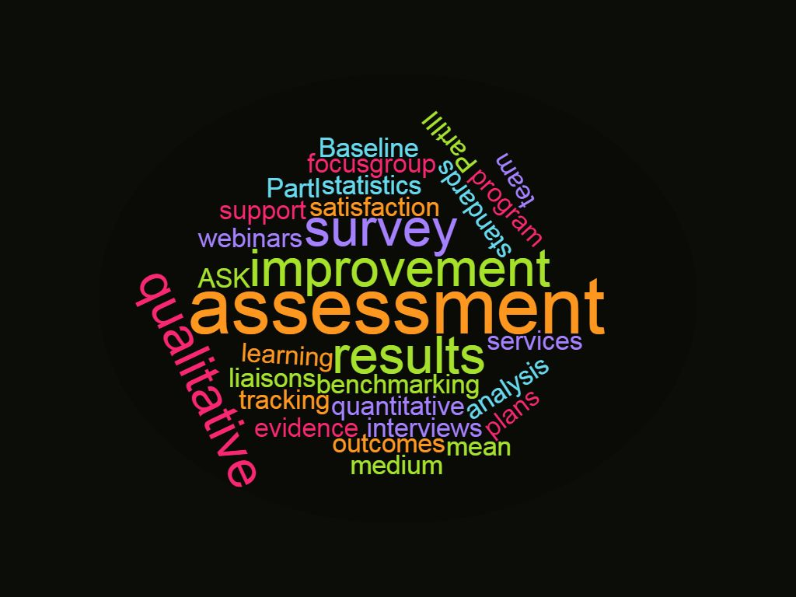
Terms and Definitions
Assessment: Any effort to gather, analyze, and interpret evidence which describes institutional, departmental, divisional effectiveness
Continuous Improvement: regularly using assessment results to improve programs and services
Closing the Loop: the process of utilizing data for improvement or modification of a program, service or department (ACPA)

Slide 8
Methods of assessment
Quantitative
Qualitative
To answer specific questions by gathering numerical data and analyzing using statistics.
Surveys
Experiments
Correlational
Data Analysis: Using statistics
To explore or understand an issue or problem by gathering data from participants and analyzing information for descriptions or themes.
Ethnographic
Narrative
Phenomenology
Case Study
Grounded Theory
Data Analysis: Coding to identify categories and themes

Slide 9
Keeping it Simple: Guiding principles
Consider assessment at the beginning!
Be committed
Practice, practice, practice (and expect failures)
Set aside time to analyze data
Use and SHARE results

Slide 10
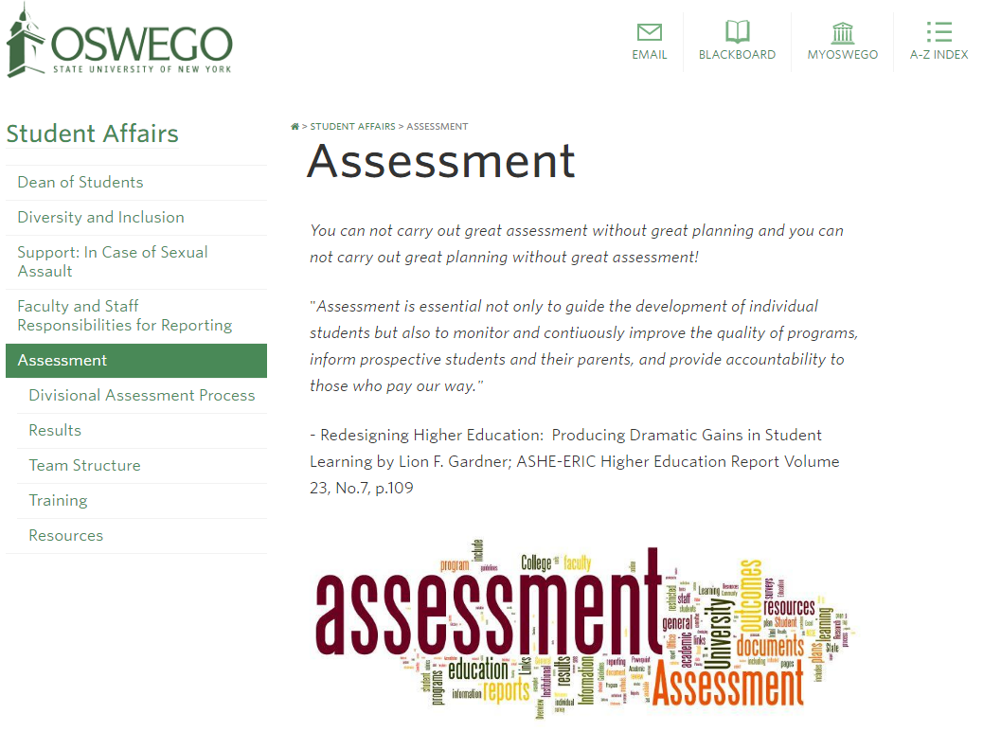
Divisional Assessment Process
2016-2017
Divisional Assessment Website
Part I Mission, Vision, Goals, Outcomes,
Objectives & Assessment Plan*
Part II: Three Year Assessment Plan
Part III: Assessment Project Request
Part IV: Executive Summary
*Assessment Project Request may be required

Slide 11
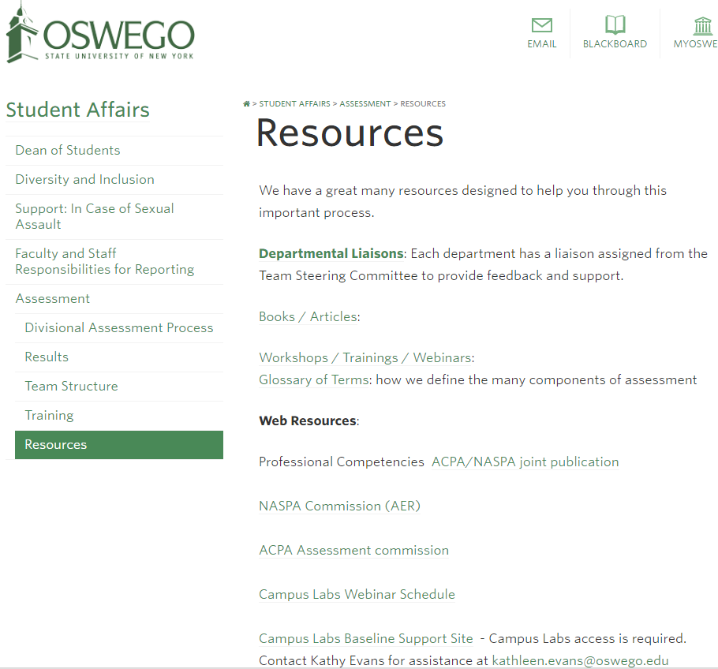
Resources
Divisional Assessment Website Resources
Divisional Assessment Team
Assessment Liaisons to departments/units
Baseline (Campus Labs)
Workshops/Brown Bag sessions
Webinars
Books, articles
Conferences (presentations at ACPA/NASPA; separate conferences)

Slide 12
Questions?
Assessment Steering Team:
Kathy Evans, chair
Christy Huynh
Sara Rebeor
Rick Kolenda
Michele May

