Slide 1

SEFA ePLEDGE https://www.givingnexus.org/_nyssefa/

Slide 2
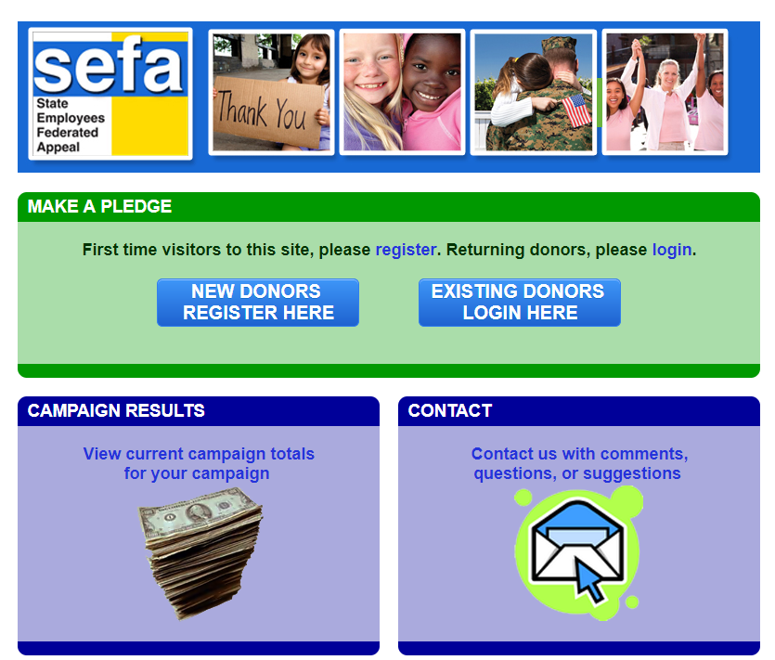
Home Page
Register or Login
Previous Users may Login with the credentials from a previous year. You can recover your credentials by clicking “recover my username/password” button under “Existing Donors Login Here”
Interested in viewing the results of the SEFA campaign, click the link under “Campaign Results”
Click the link under “Contact” to contact us.

Slide 3
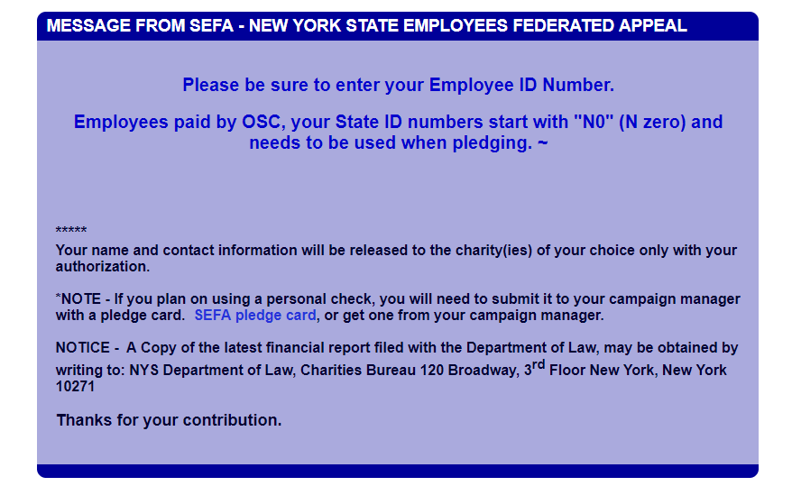
Home Page – Bottom
General Information

Slide 4
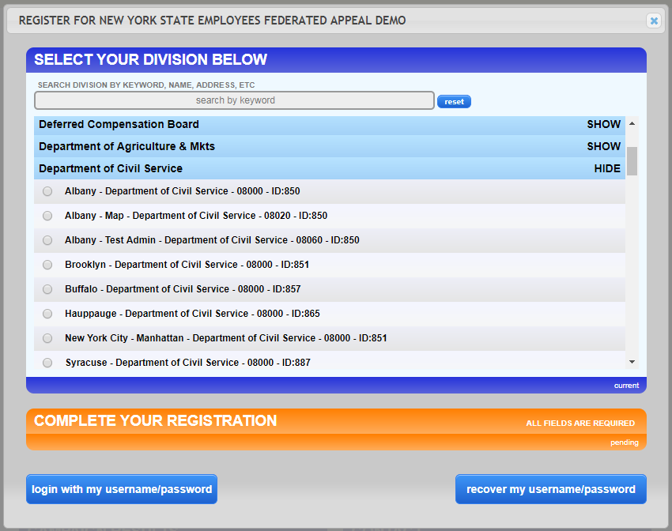
New people will need to register.
First, select your workplace. Read the descriptions carefully to ensure you choose the correct location and agency code you get paid under.
Previous users will be able to login with their existing username and password or recover them

Slide 5
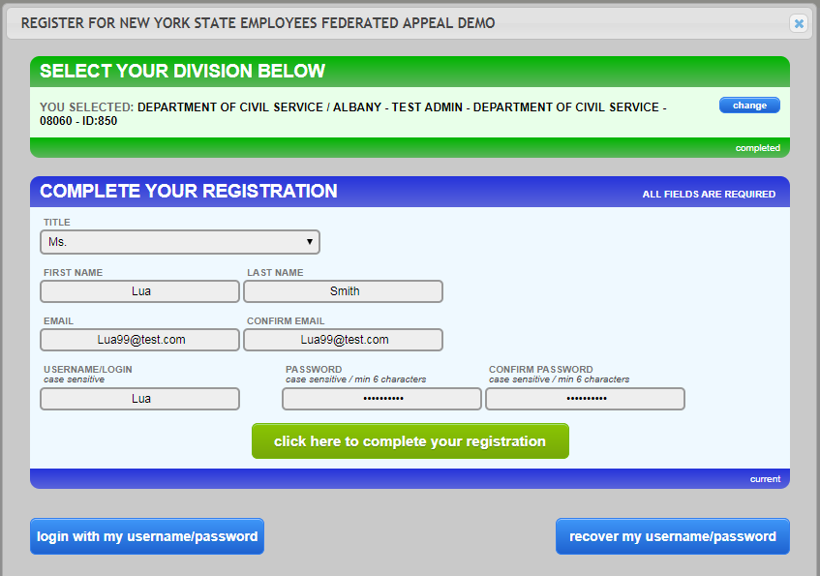
Critical! Before moving forward, confirm your “Division” is correct
Continue to complete the form with your personal data to complete the registration steps. Be sure to enter all fields.

Slide 6
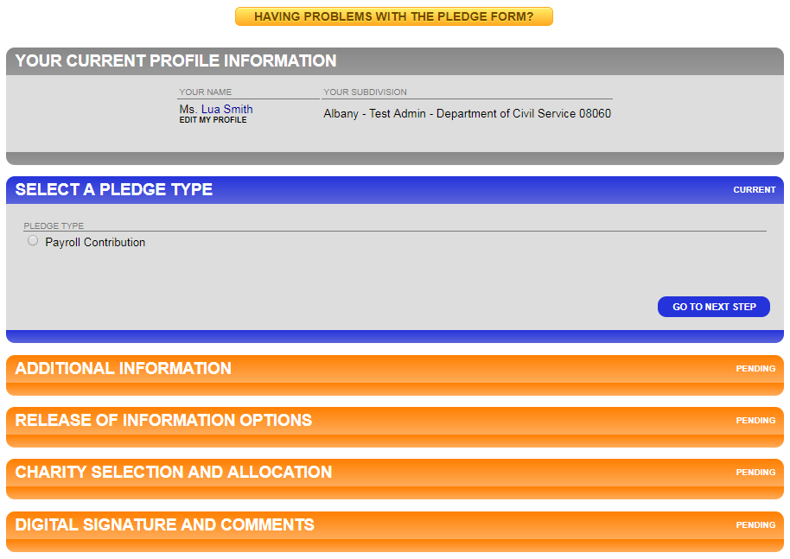
Currently we are only able to accept payroll contributions.
Click “Go To Next Step” after every step completed

Slide 7
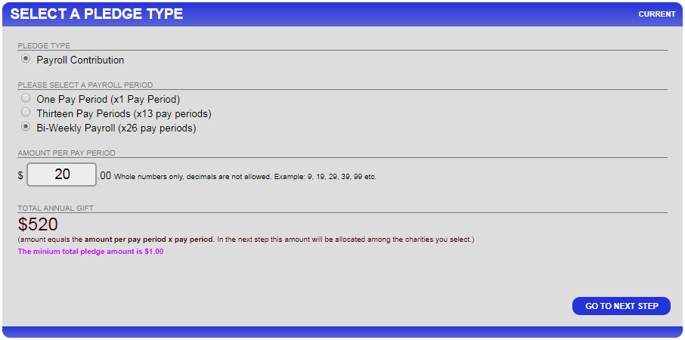
Select the number of pay periods and enter the amount PER PAY PERIOD. The TOTAL ANNUAL GIFT is automatically filled . Click “GO TO NEXT STEP”

Slide 8
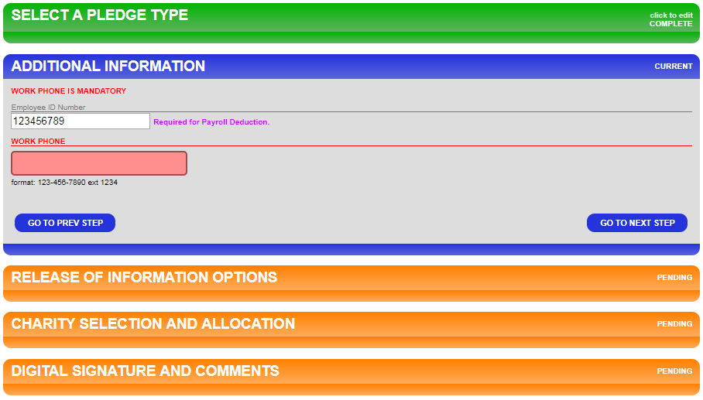
Enter your NYS Employee Identification Number. OSC employees identification numbers are N0&7 numbers. For most, numbers located on your paystub. THIS IS VERY IMPORTANT TO GET CORRECT. Click “GO TO NEXT STEP”
Work phone number is required. It will only be used if we have a question regarding the donors ID number, or another question regarding their pledge.

Slide 9
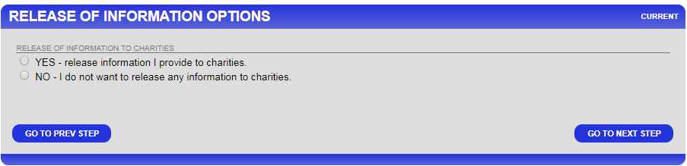
Select the Release of Information Options you choose. Click “GO TO NEXT STEP”

Slide 10
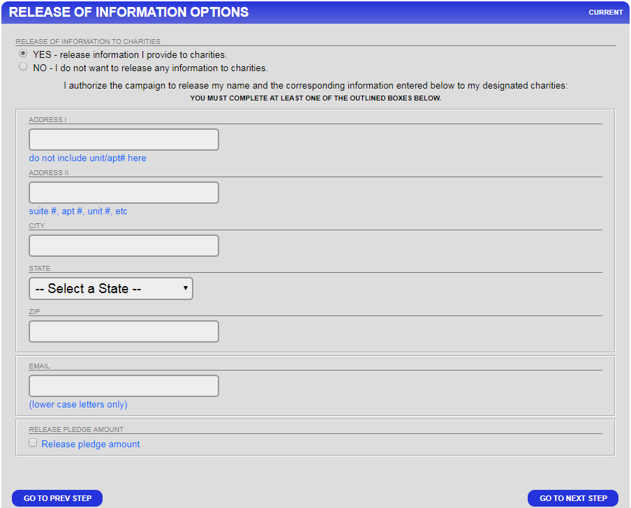
If you have chosen to release your information, an address and email form will open up. Fill in the proper contact information and select “Release Pledge Amount” if you choose to have the amount of your donation released to your designated charity(ies).
Note: For an acknowledgment, you must provide a personal email. Work emails will be deleted from the list.

Slide 11
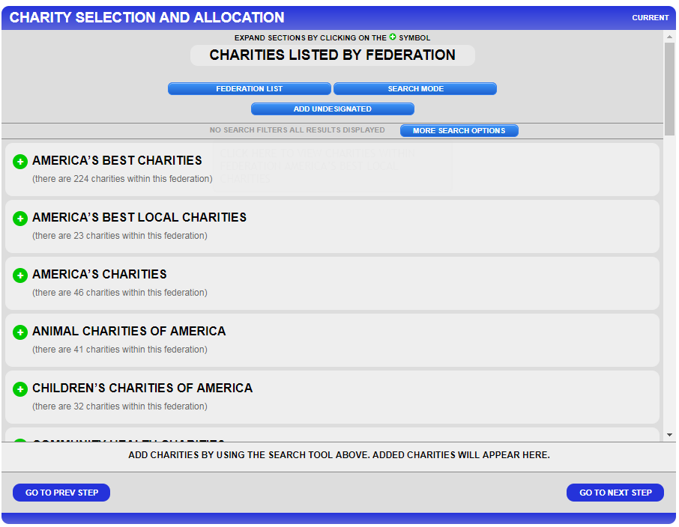
You will make your designation(s) if any here on the Charity Selection and Allocation Screen. There is not a limit to how many charities you can donate to.
You can use the “SEARCH MODE” to enter keywords
You may also opt to not designate your money or to split using the “ADD UNDESIGNATED” option.

Slide 12
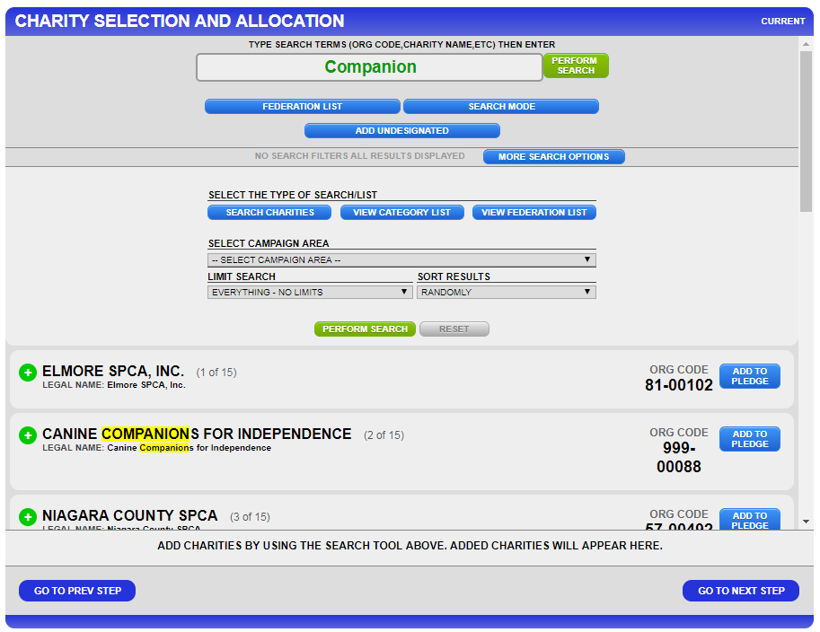
Using the “SEARCH MODE” you will pick from the search results from your keyword.
You can narrow your search and sort by many criteria. Click “More Search Options”
Click the “ADD TO PLEDGE” button near the charity of your choice

Slide 13
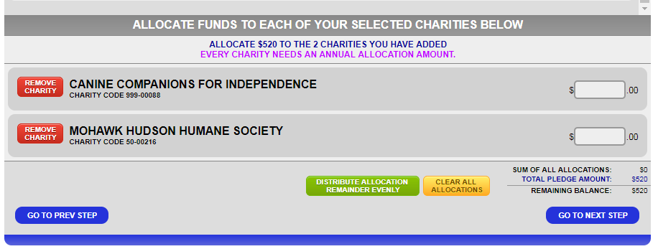
After you have added the charity(ies) that you want to pledge to, scroll to the bottom of the page.
Designate how much you want to go to each charity. It calculates how much you have designated and shows a remaining balance. You have to designate 100% in order to “Go To Next Step”

Slide 14
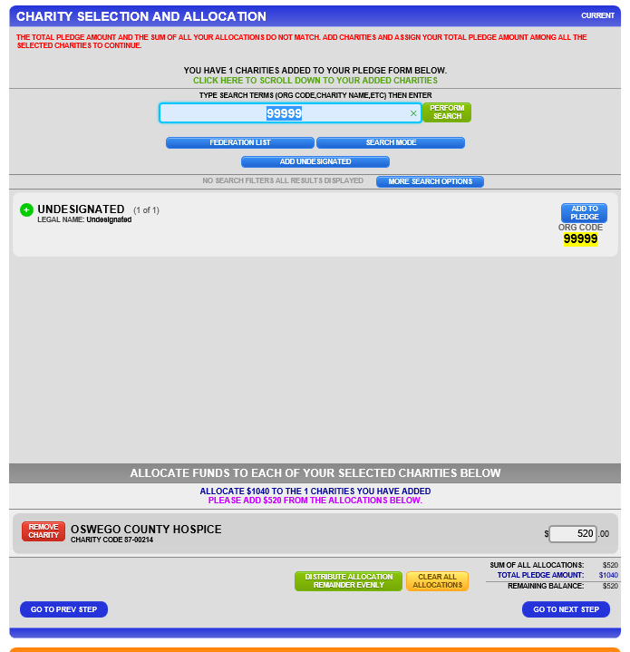
Your “REMAINING BALANCE” must be 0, so you will need to add the “UNDESIGNATED” if you do not wish to designate all of your money

Slide 15
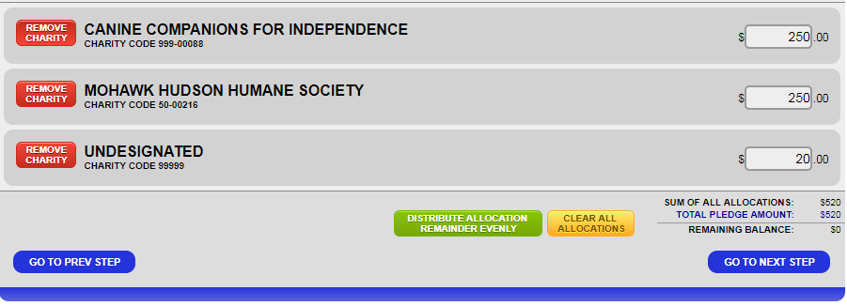
If you have chosen 1 or more agencies to designate to, ensure that the total donations total your pledge.

Slide 16
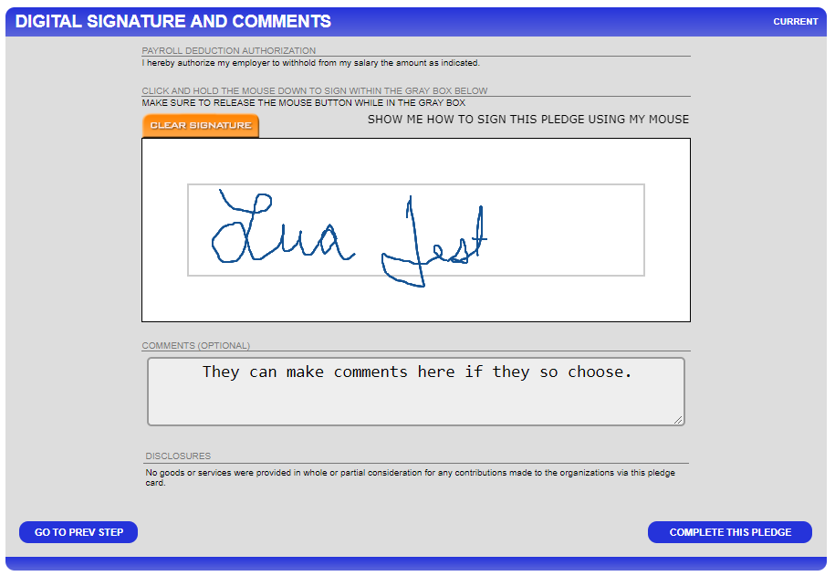
Add your digital signature using your mouse or other input device to do so. Do not worry about the neatness of the signature.

Slide 17
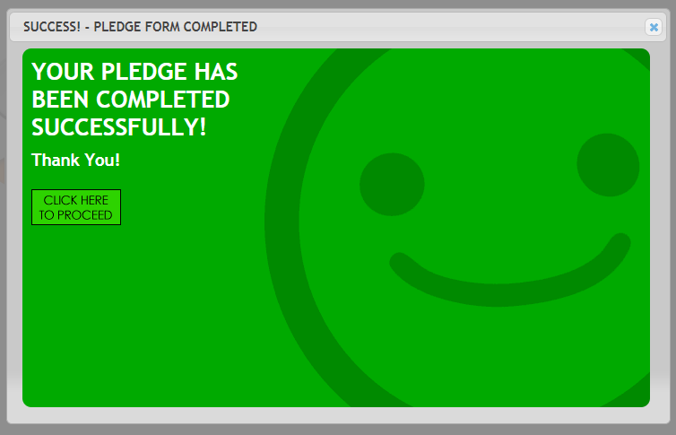
The donor has successfully submitted their pledge and they will receive a email confirmation.

