Slide 1
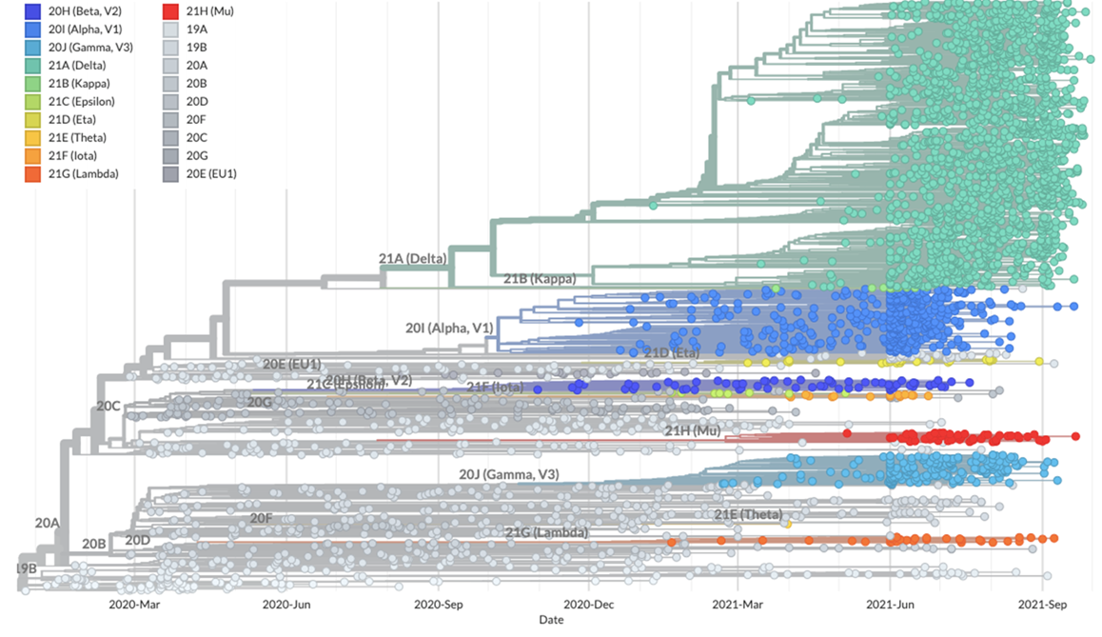
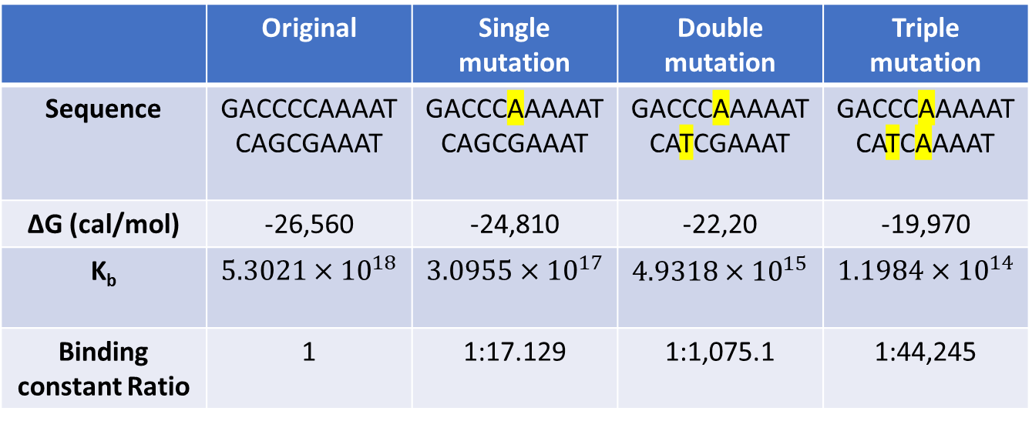
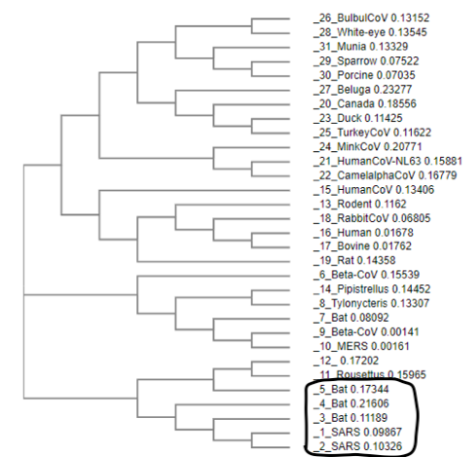
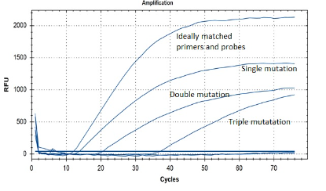
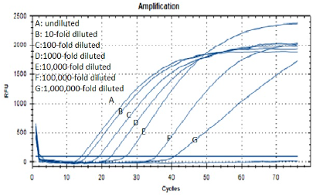
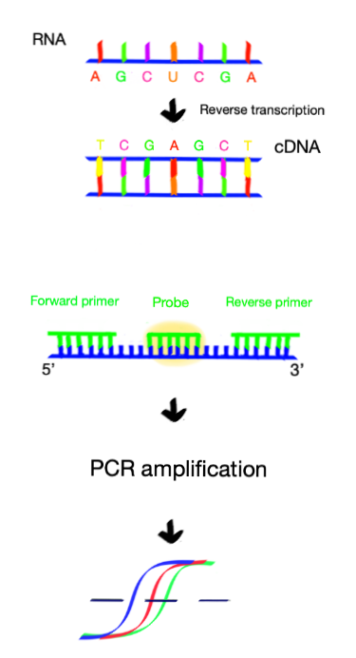
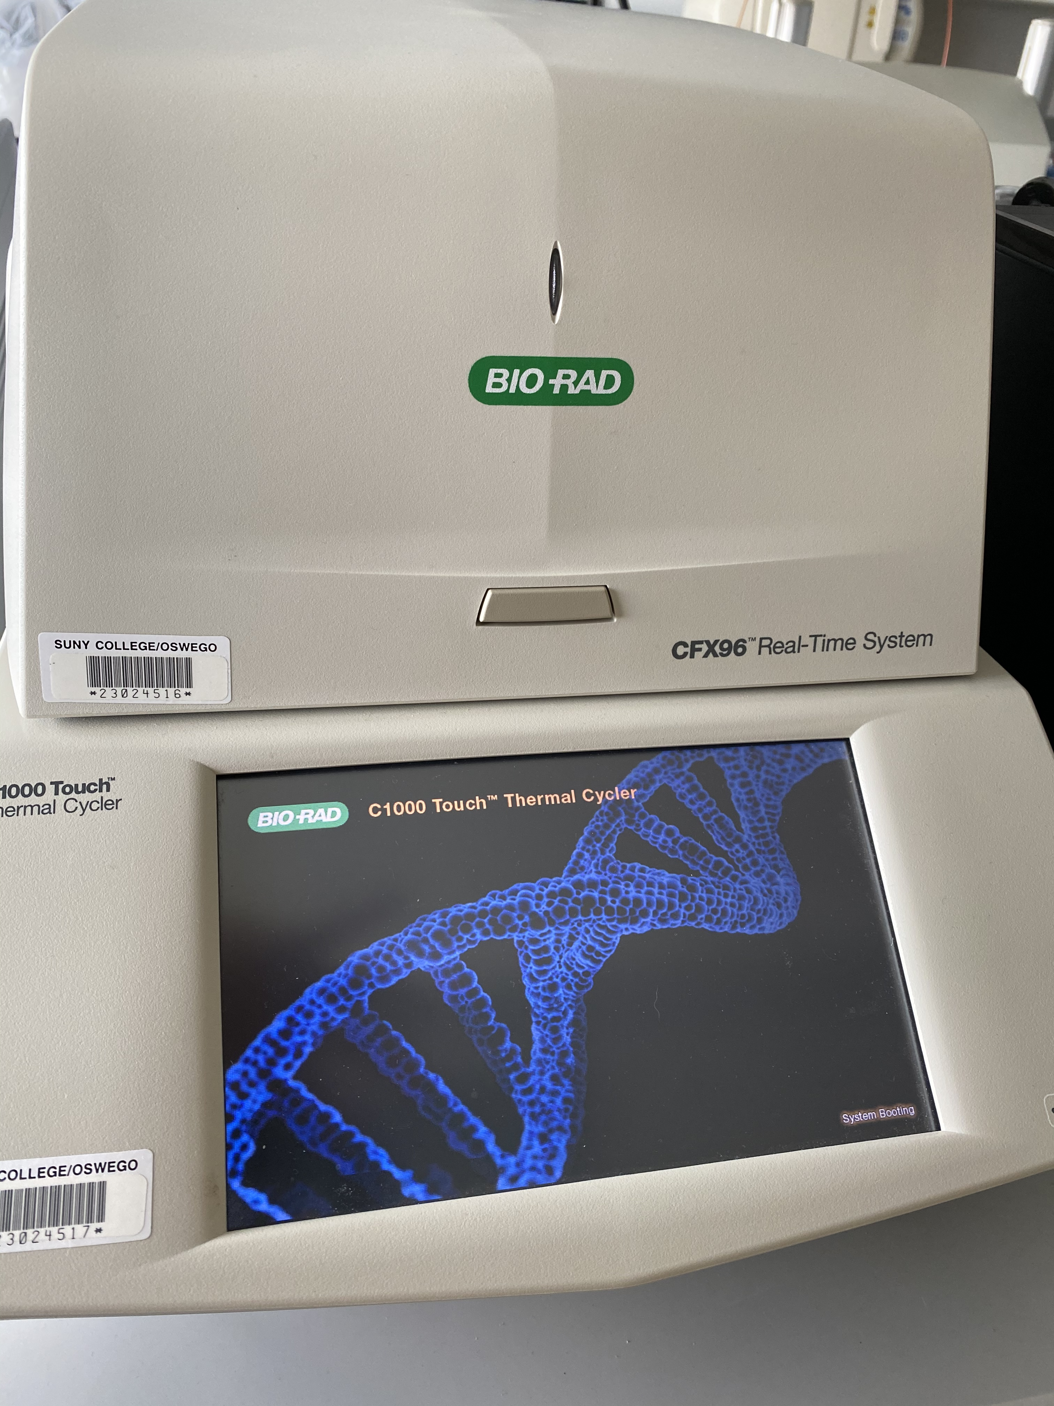
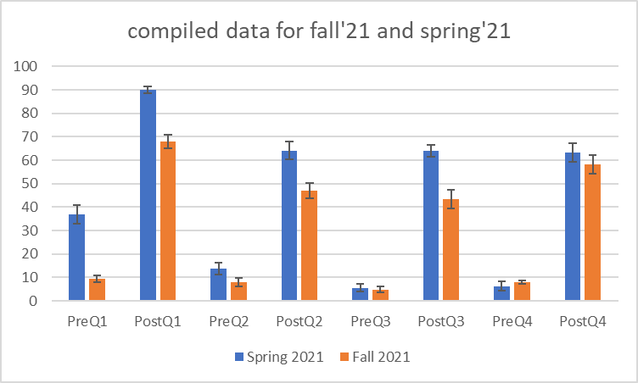
Improving SARS-CoV-2 Detection Methods Angela Wu, Vikrant Jandev, Julia Koeppe, Nicholas Sard, Kestutis Bendinskas
Departments of Chemistry and Biological Sciences, SUNY Oswego, NY
Abstract
Results
Table 2. Thermodynamic calculations
Reverse transcription- quantitative polymerase chain reaction (RT-qPCR) is a common test used in COVID-19 detection.
This project was designed to look for weaknesses in this detection method. We studied the forward and reverse primers and probes recommended by CDC to determine if the primers may be compromised by mutations.
We ordered primers containing impactful common mutations to run RT-PCR for the detection of synthetic SARS-CoV-2 RNA. This was done to see if primer mismatches affect the efficacy of RT-qPCR and RT-PCR+PAGE detection.
We also developed a teaching laboratory for biochemistry students.
1- Sars-Cov-2
2-Sars Tor2
3-Bat CoV
Note: Visit http://dnacalculator.pythonanywhere.com/ for thermodynamic calculations
Introduction
Conclusions
The two types of diagnostic tests for active coronavirus infection are molecular tests that mainly involve PCR to detect the virus’s genetic material and antigen tests that detect specific proteins from the virus. The COVID-19 rtRT-PCR test is a real-time reverse transcription-polymerase chain reaction test for the detection of ribonucleic acid from SARS-CoV-2.
The reaction converts the virus’s RNA into DNA then amplifies it for multiple cycles so that even low levels of viral genetic material can be detected. Primers are short fragments of DNA that are complementary to a specific region of the transcribed viral DNA transcription-polymerase initiate the polymerase chain reaction. Probes are the marker labels that bind to the region in-between the forward and reverse primers; when processed, they release a fluorescent dye quencher that allows fluorescence (proportional to made DNA) to be measured by the instrument. When a certain level of fluorescence level is surpassed, it confirms the presence of the virus.
Table 1 is a set of forward and reverse primers and probes recommended by the CDC. The primers and probes target the conserved nucleocapsid protein (N) gene of the virus. This set along with another set of primers (N2) are determined to show good specificity for virus detection. These sequences are subject to future changes as the virus evolves.
Figure 1- Phylogenetic tree of coronaviruses
Figure 2- Phylogenetic tree for mutations and evolution of SARS CoV-2
Multiple mutations cause an undesirable change in the ΔG value for primer binding, indicating that they can affect the binding between the target strand and primers used in RT‐PCR.
In Figures 3 & 4, the C_{q} value increases as the number of mutations increases. This means that a virus containing mutations requires a higher number of cycles of RT-qPCR in order to successfully detect it. The same is true for the target dilution experiment. The C_{q} value for the triple mutation indicates that its effect on virus detection is the same as when the virus is diluted 100,000 fold. This result matches closely to the effect predicted by the ΔG calculator we developed.
Figures 5 and 6 show agarose gels with all the target bands located at around 75 bp. The negative control contains no band due to the absence of the target RNA and the positive control has the darkest band. The bands on the gel are increasingly more faded with the addition of mutations or increased dilutions; non-specific bands appear in the case of mutations; the effect of a triple mutation is like when the target RNA is diluted 100,000-fold.
Students of Biochemistry I and II tried this laboratory in the Spring and Fall of 2021; we documented a significant positive impact on learning; students recommended continuing this laboratory experiment in future years; we plan to submit this work for publication in JChemEd.
Figure 3- Amplification results for detecting the mutations for 70 cycles
Figure 4- Amplification results for dilution experiment for 70 cycles
MW ladder
Ideal primers
References
Single mutation
Double mutation
[1] Laboratory testing for coronavirus disease 2019 (COVID-19) in suspected human cases: interim guidance, 2 March 2020. World Health Organization. https://apps.who.int/iris/bitstream/handle/10665/331329/WHO-COVID-19-laboratory-2020.4- eng.pdf (accessed Dec 26, 2020).
[2] Shereen MA; Khan S; Kazmi A; Bashir N; Siddique R. COVID-19 infection: Origin,
transmission, and characteristics of human coronaviruses. Journal of Advanced Research. 2020, 24, 91-98.
[3] Boni MF; Lemey P; Jiang X; Lam TT; Perry B; Castoe T; Rambaut A; Robertson DL. Evolutionary origins of the SARS-CoV-2 sarbecovirus lineage responsible for the COVID-19 pandemic. Nat Microbiol. 2020, 5, 1408–1417.
[4] COVID-19 Dashboard, 2020. John Hopkins University &amp; Medicine: Coronavirus Resource Center. https://coronavirus.jhu.edu/map.html
Triple mutation
Figure 5- Gel electrophoresis for mutated primer
Figure 6- Gel electrophoresis for diluted synthetic RNA
Methodology
Table 1. 2019- Novel Coronavirus (2019-nCoV) Real- Time RT-PCR Panel Primer and Probes [Ref. 1]
Phylogenetic tree of viruses in different species that are related to SARS-CoV-2, was designed using https://www.ebi.ac.uk/Tools/msa/clustalo/
Global variants of SARS-CoV-2 were analyzed using https://nextstrain.org/
RT-PCR primers and probe were designed using https://www.ncbi.nlm.nih.gov/nuccore/NC_045512.2?report=fasta
Multiple mutations located in the binding region of the N1 primers were identified using BLAST.
T_{m}, ΔG, and K_{b} of the different mutations were calculated using http://dnacalculator.pythonanywhere.com/
Master mixes were prepared with different primers (original, single mutated, double mutated, triple mutated) and samples were analyzed using RT-qPCR.
Amplified samples were also analyzed using agarose gel electrophoresis.
Acknowledgment
We thank SUNY Covid-19 Preparedness Innovation and Internship Seed Grant for funding this research.
Figure 7- Student Evaluations of a Teaching Laboratory

