Slide 1
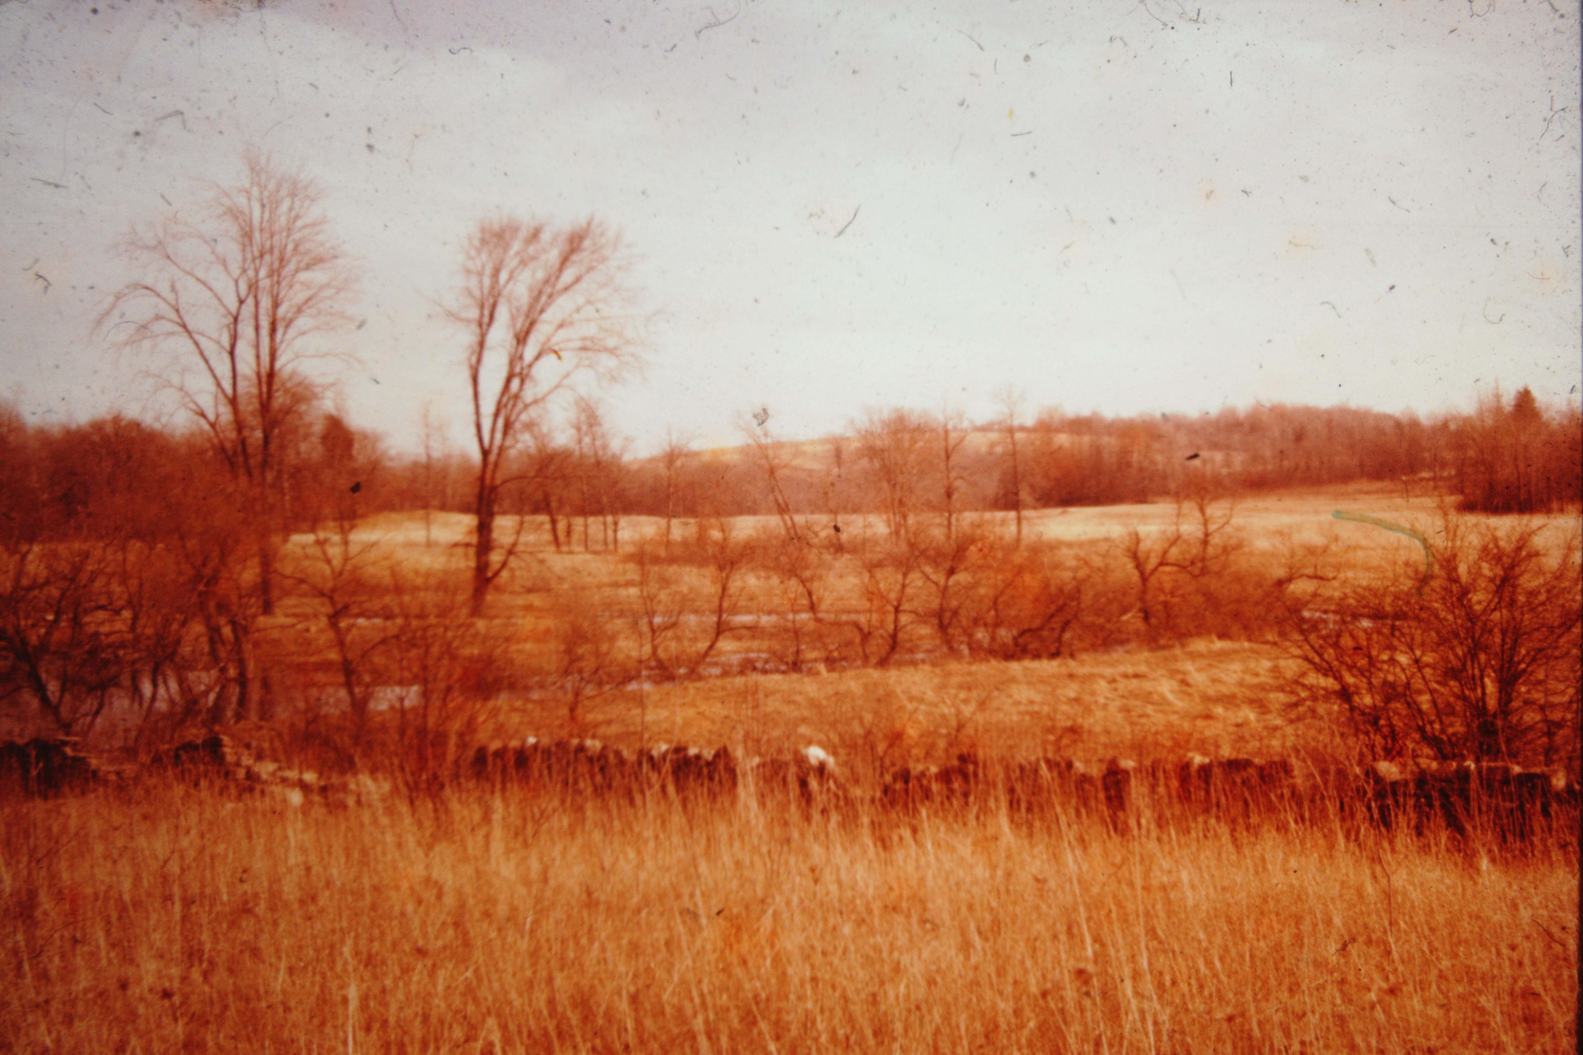
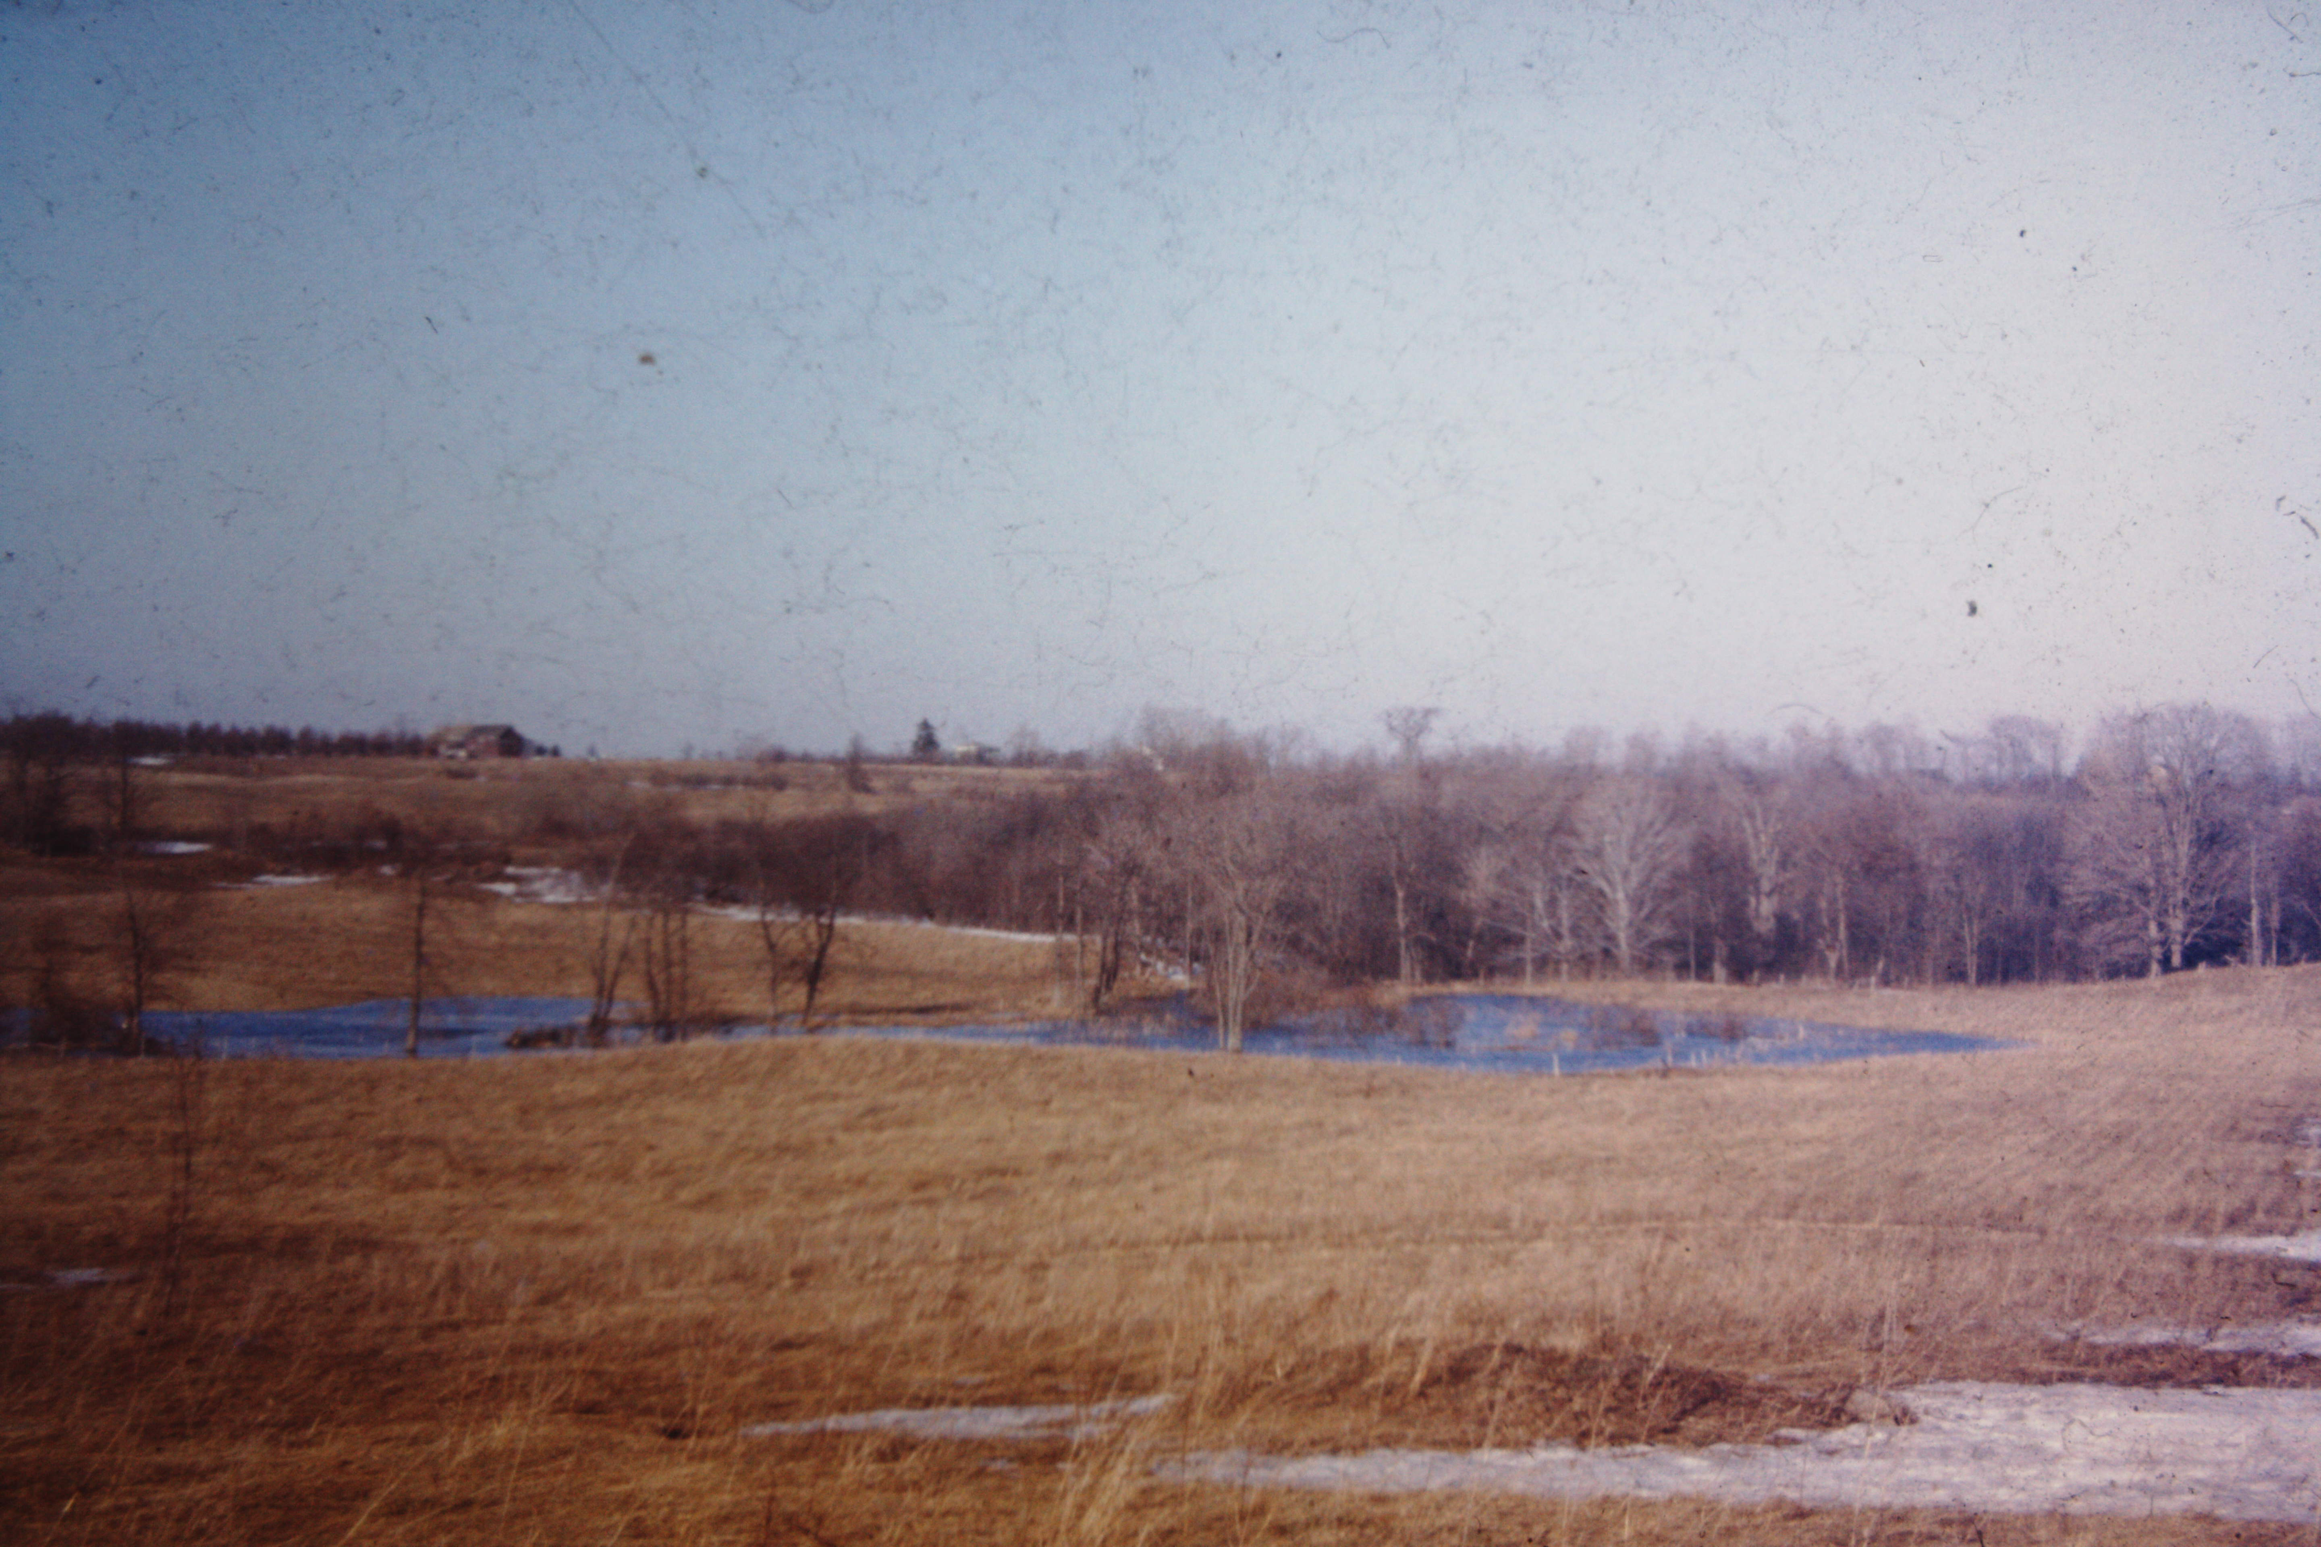
The Developement Of
The Rice Creek Field Station
John Weeks Sept 2014
Notes:
1
1
The early days with the Conservation Dept.

Slide 2
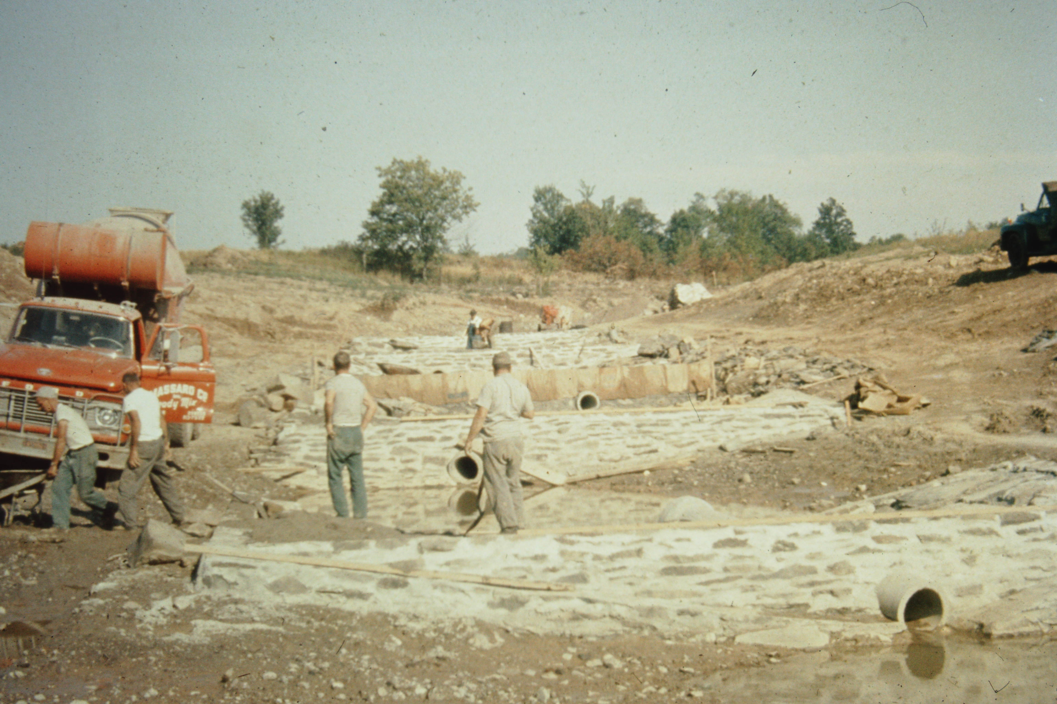
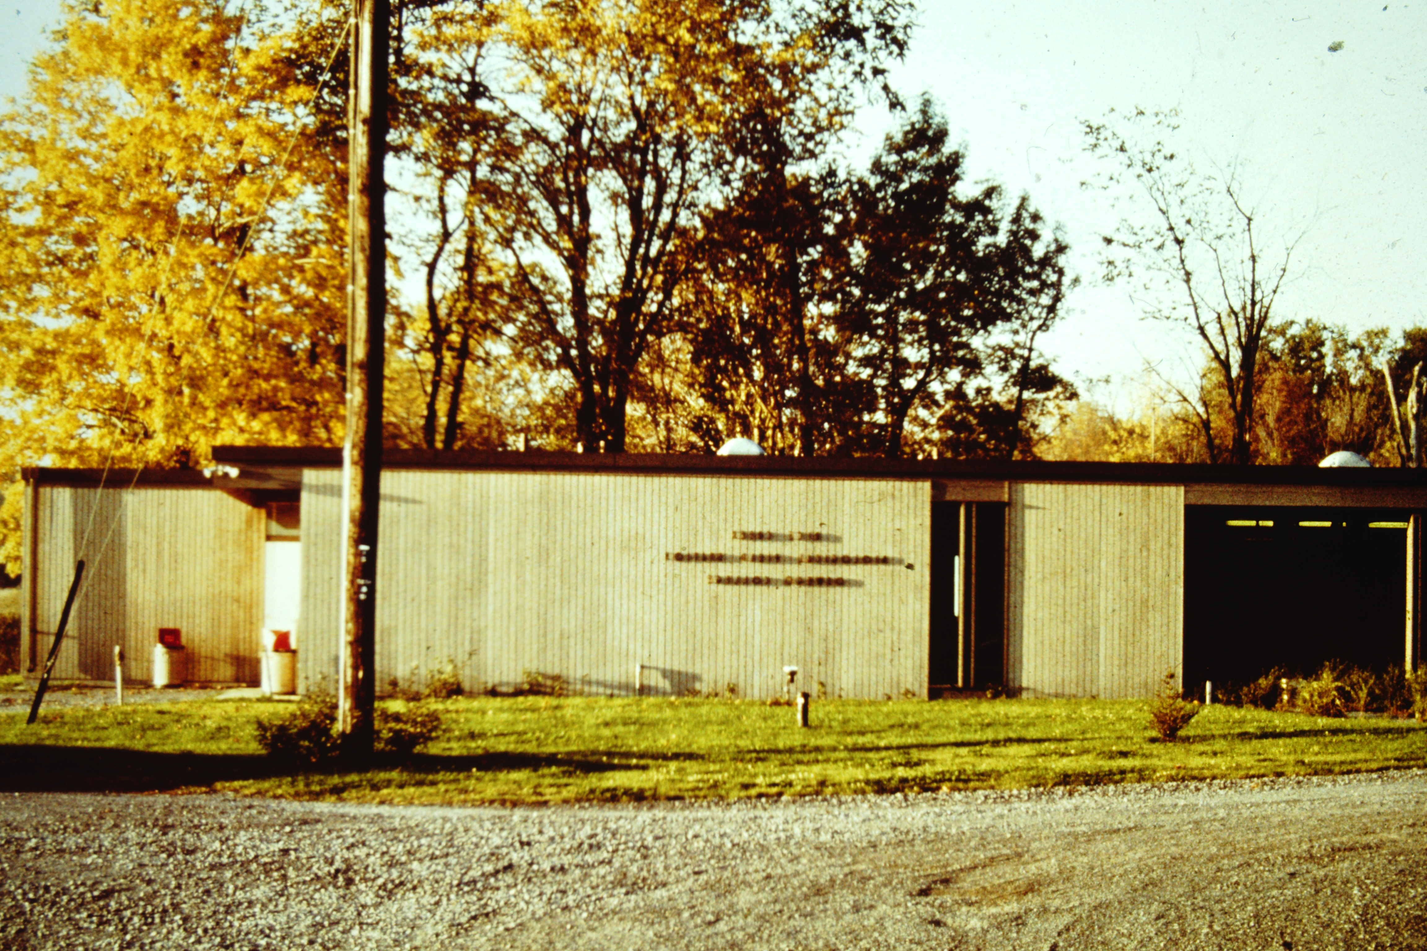

Slide 3
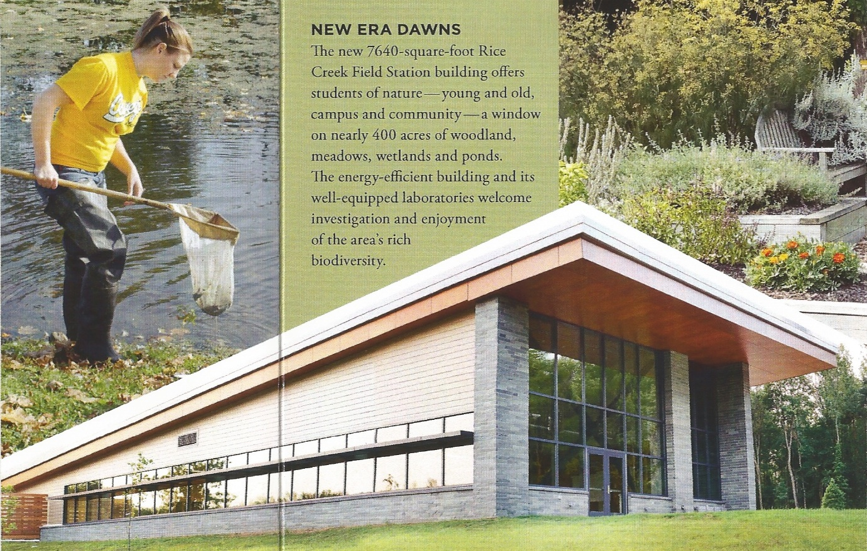

Slide 5
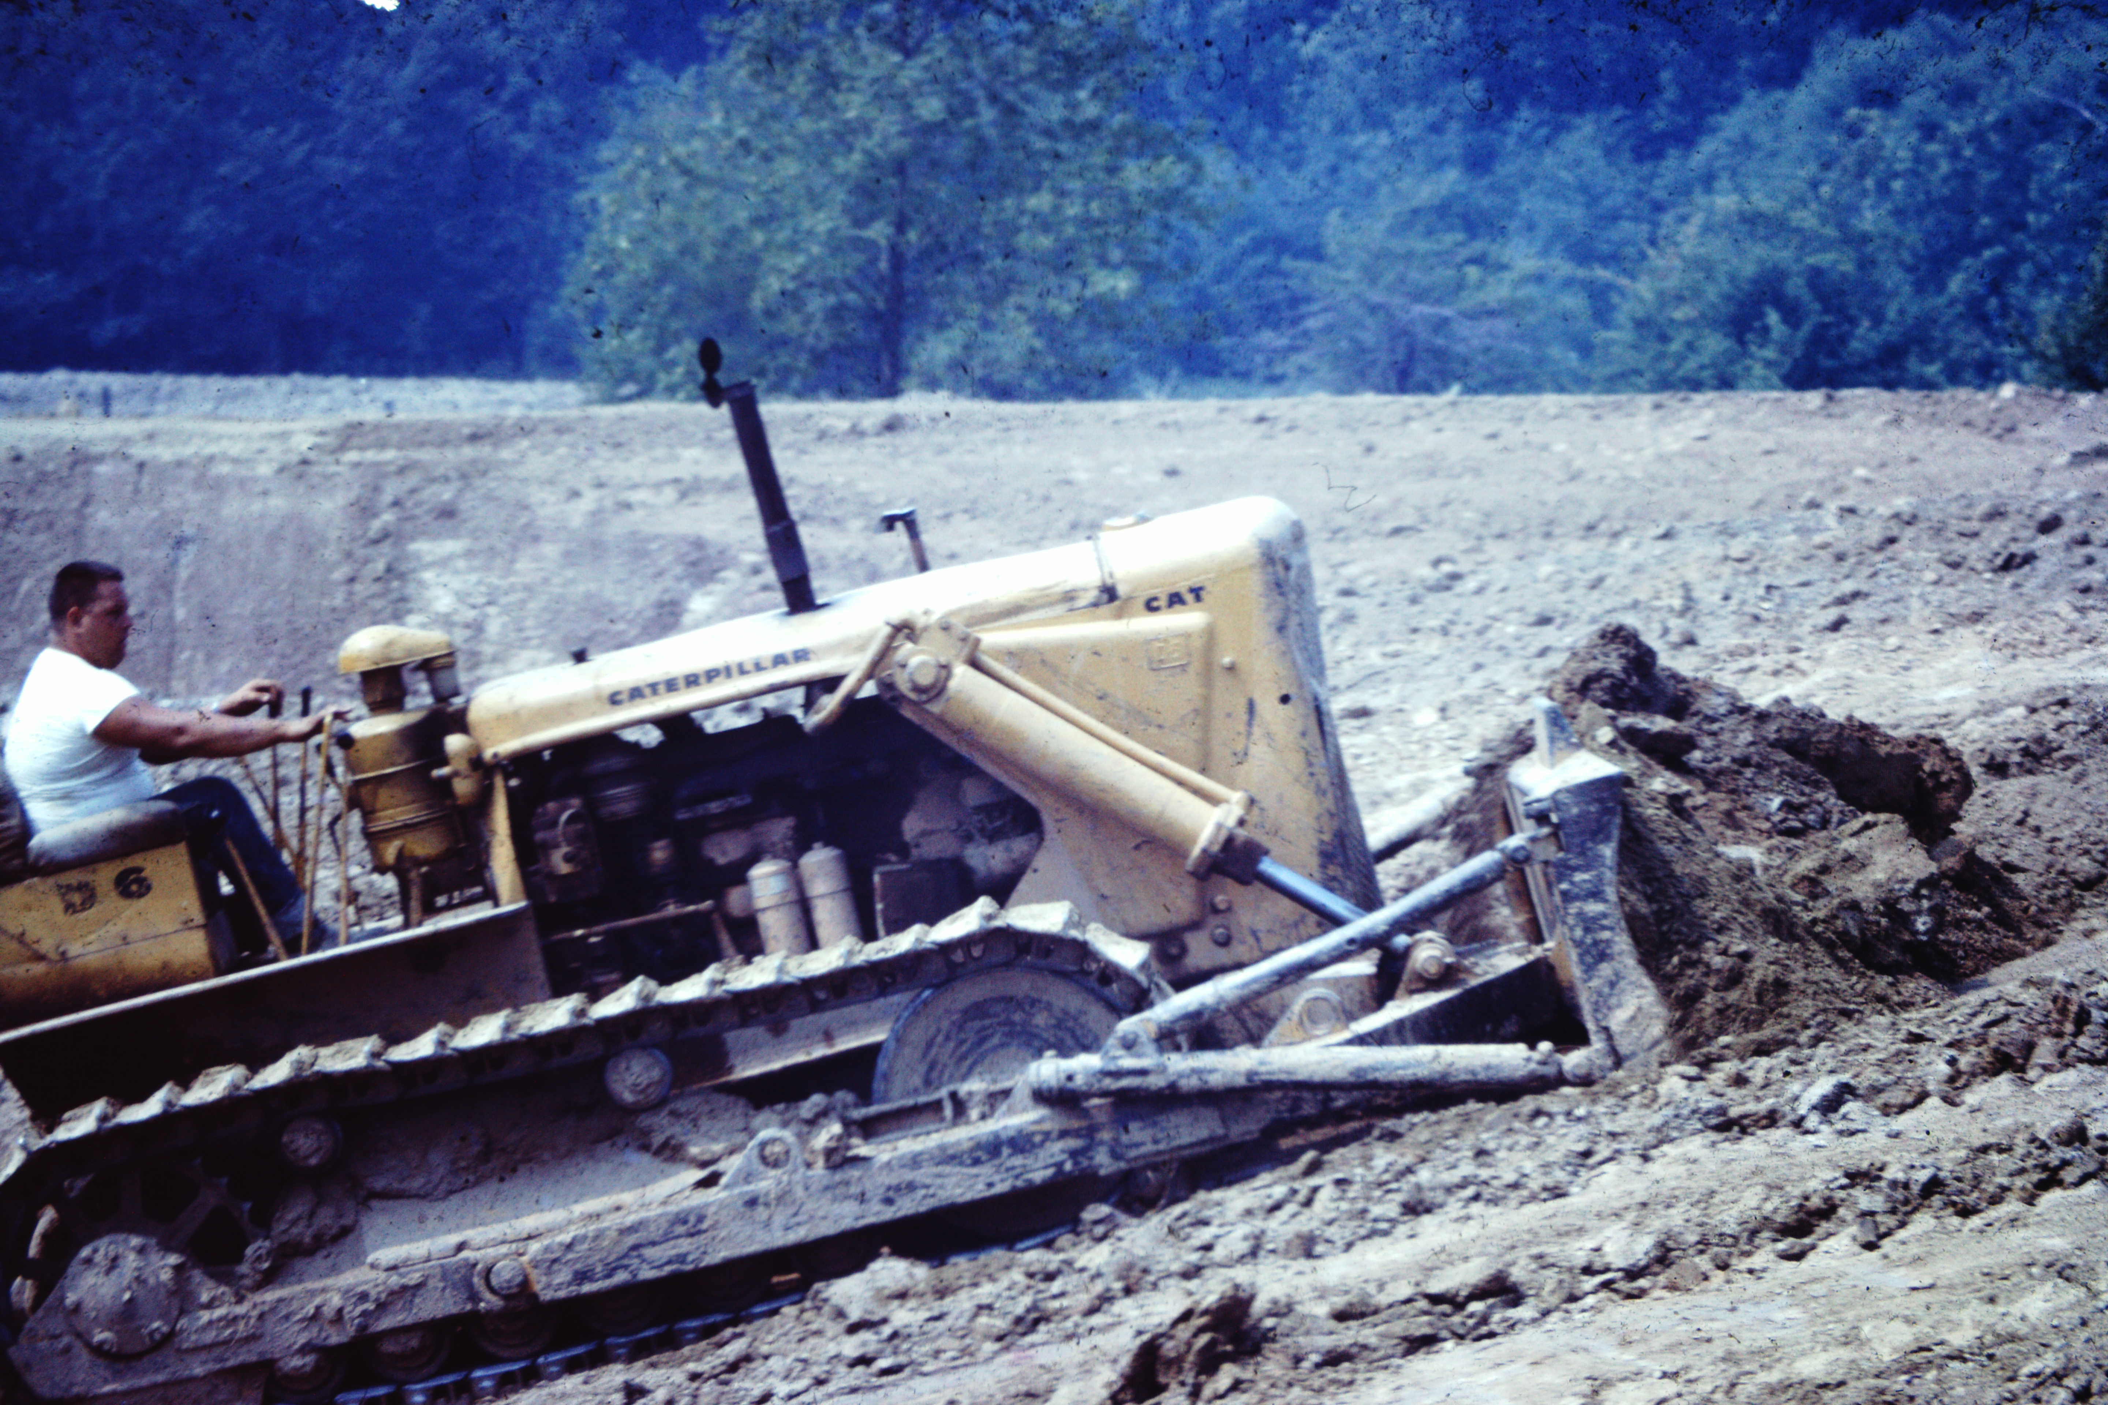

Slide 6
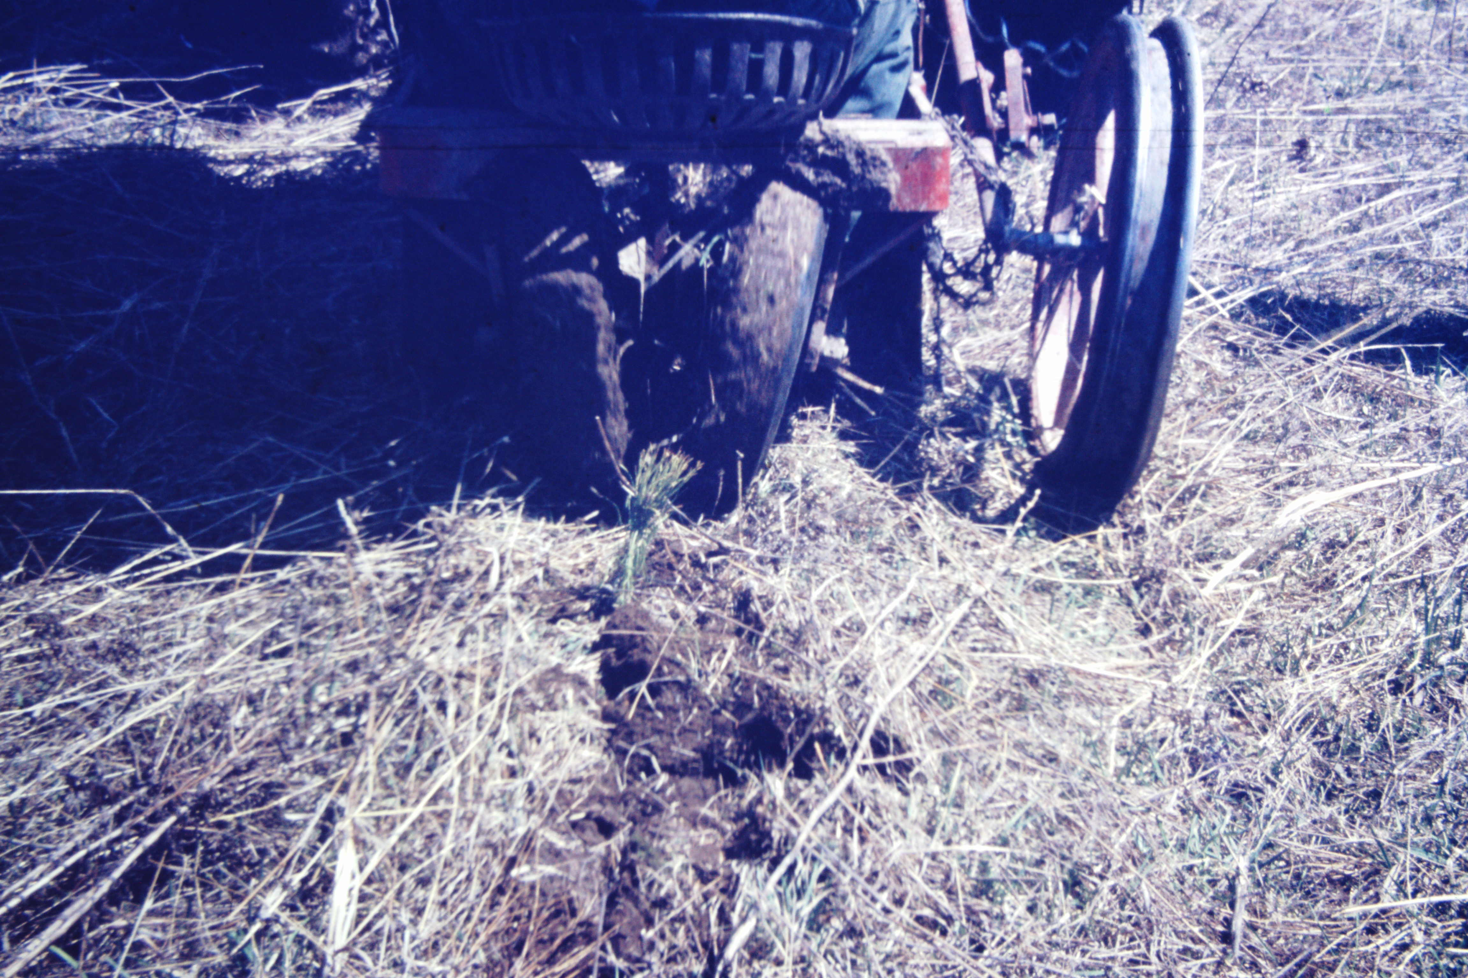

Slide 7
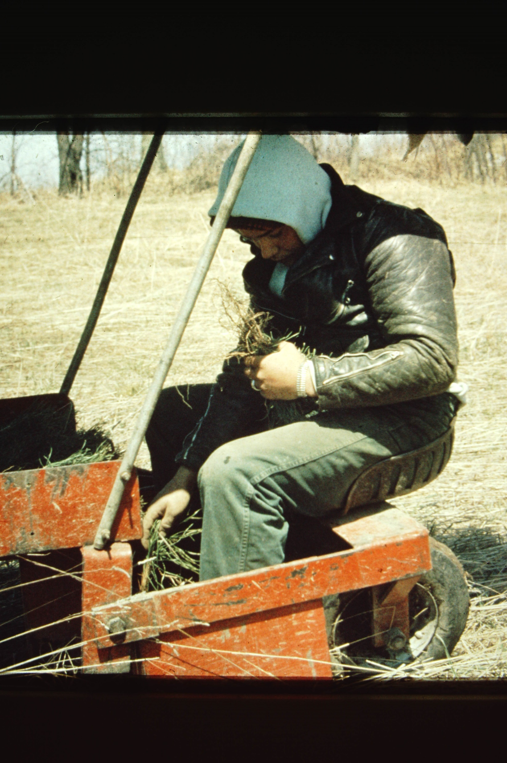

Slide 8
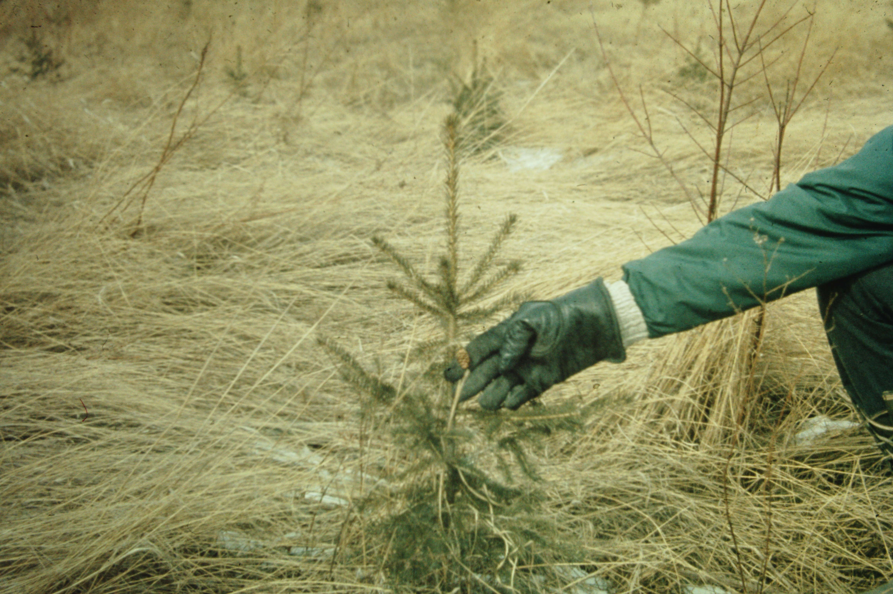

Slide 9
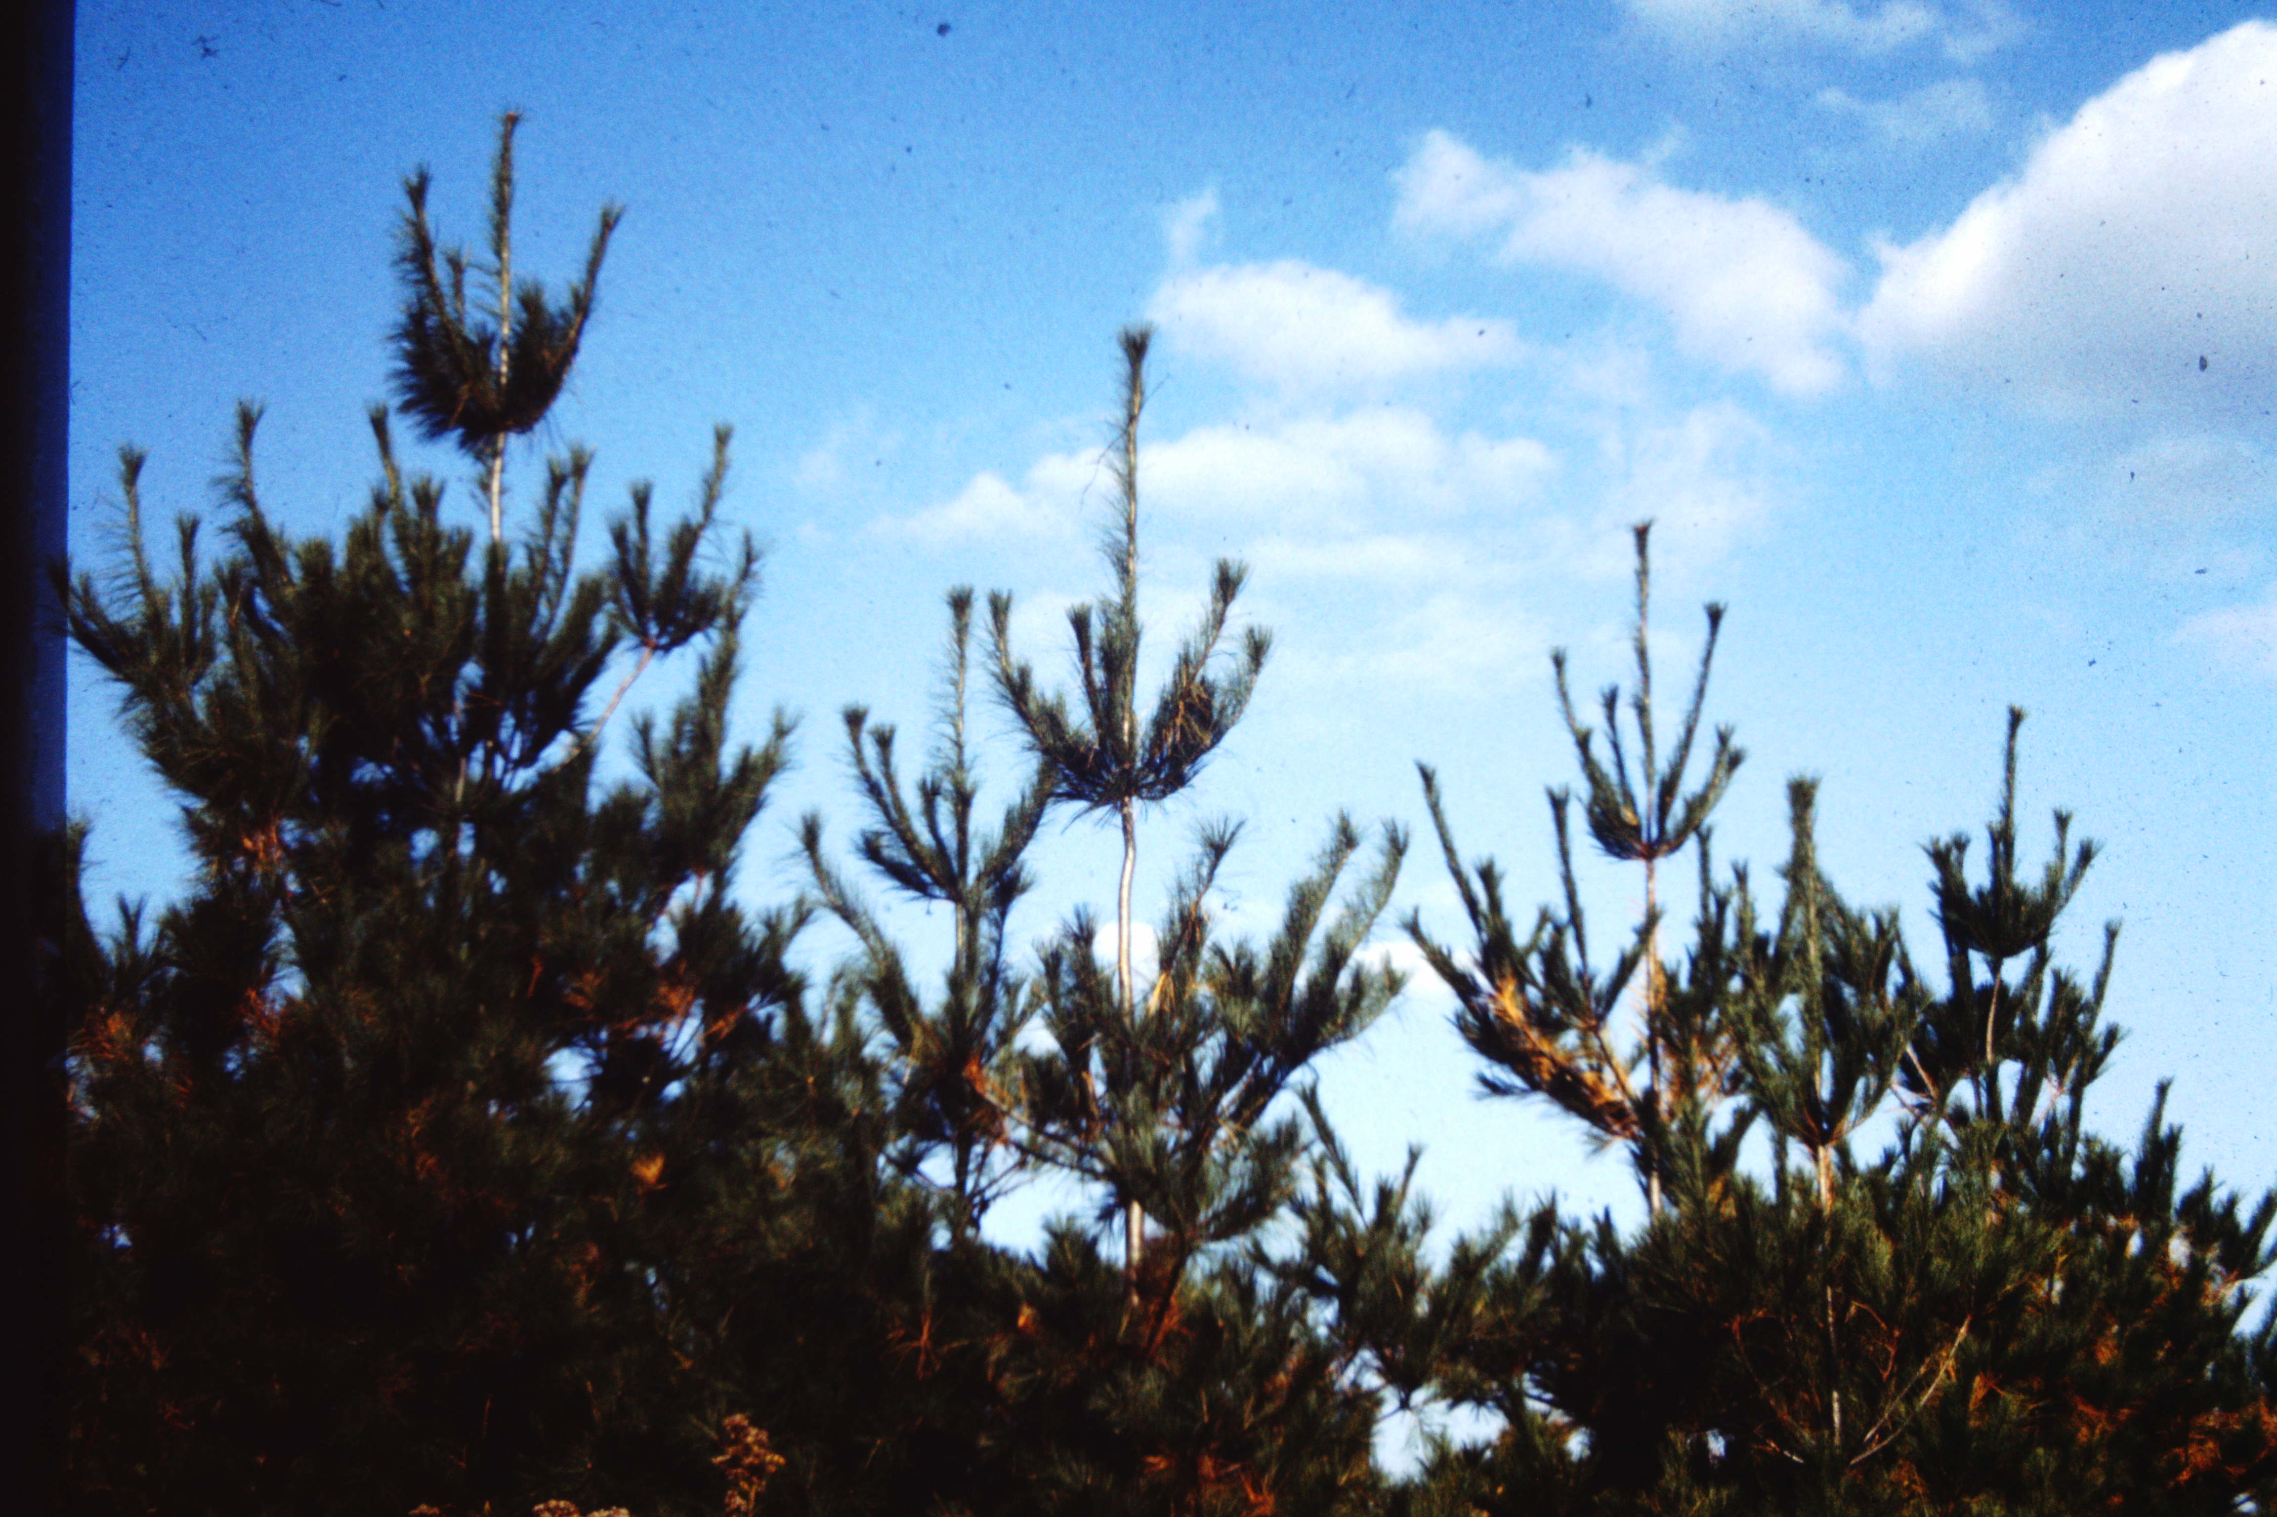

Slide 10
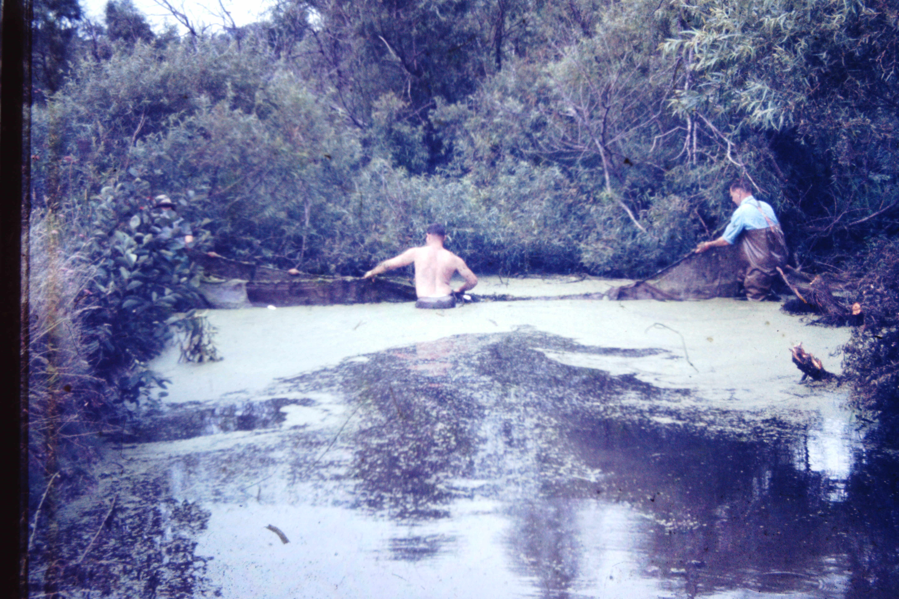

Slide 11
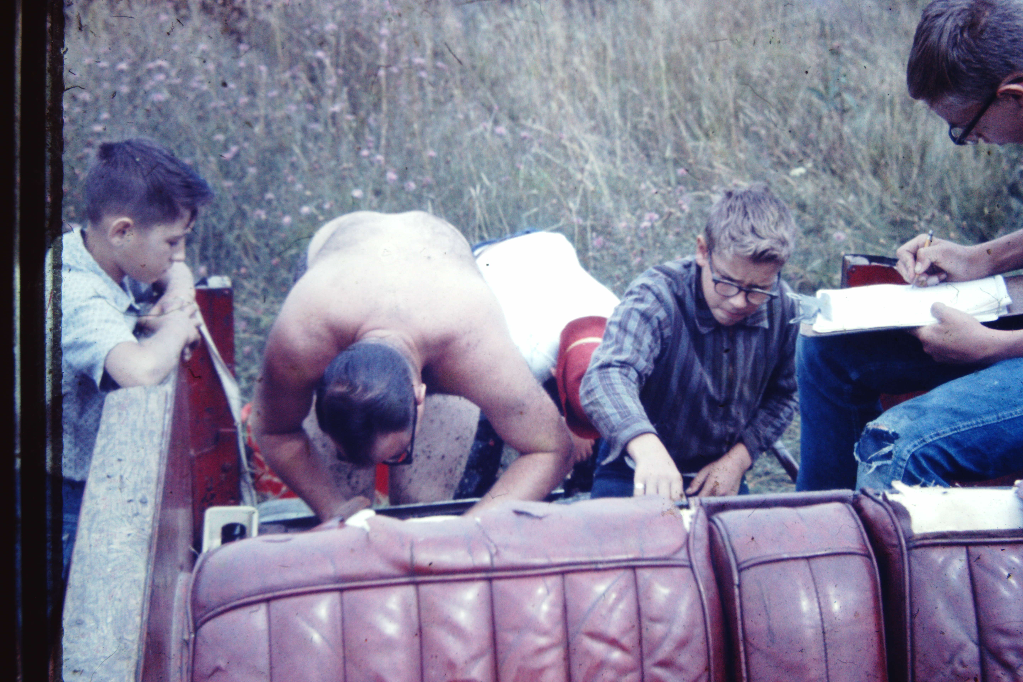

Slide 12
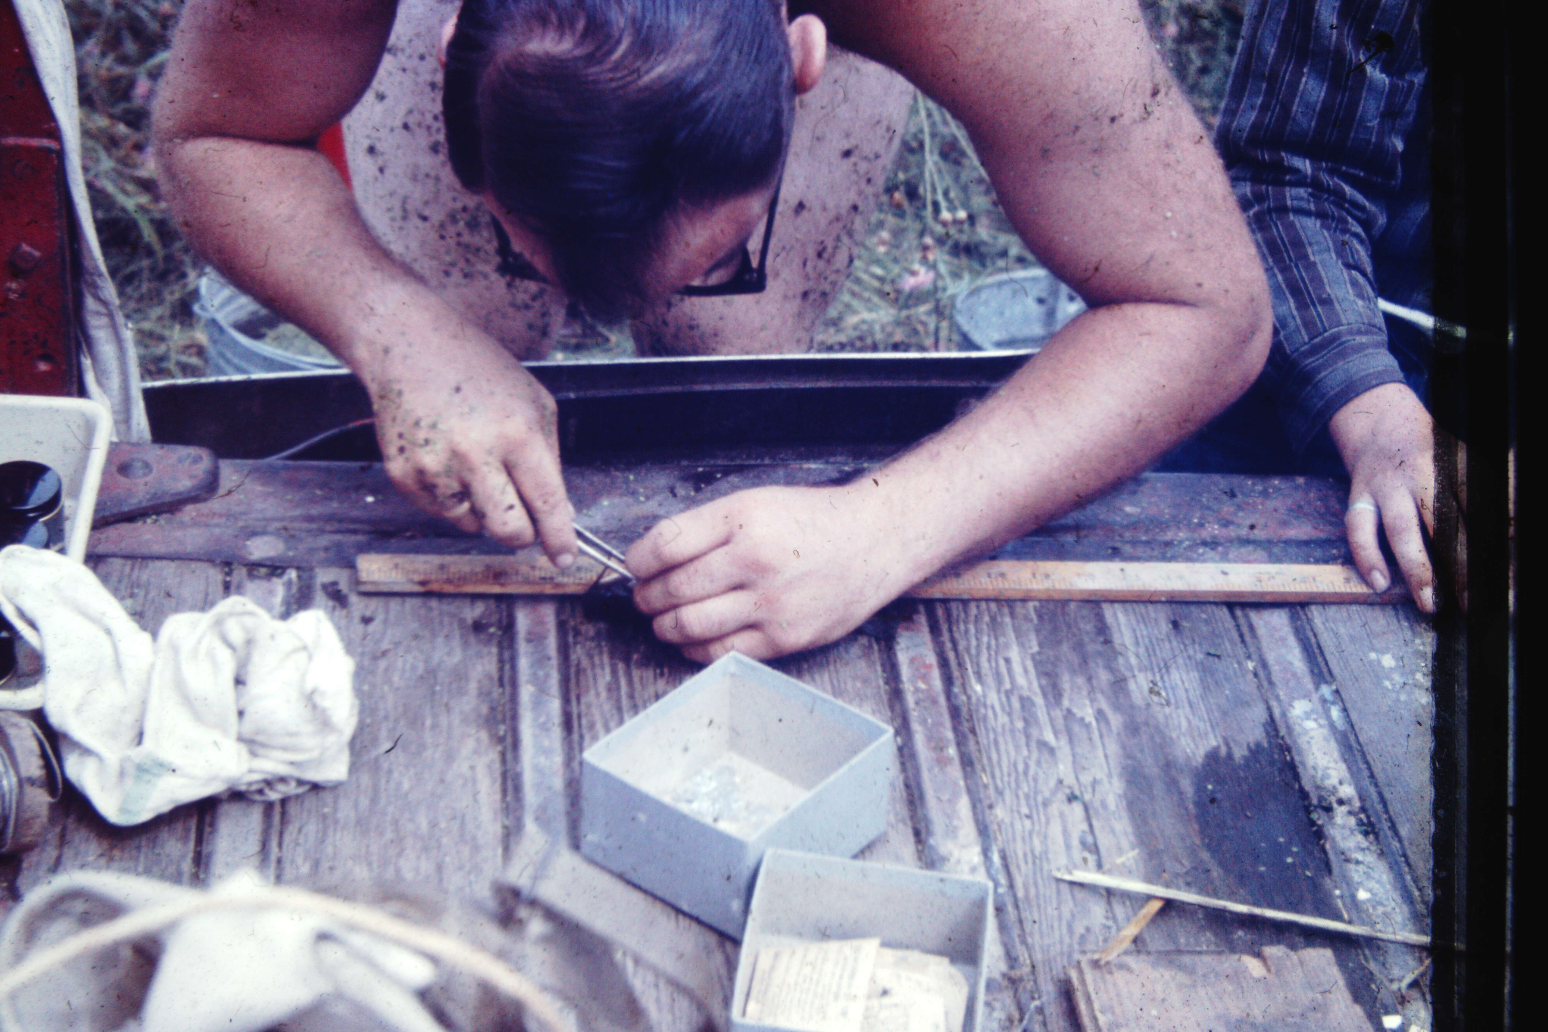

Slide 13
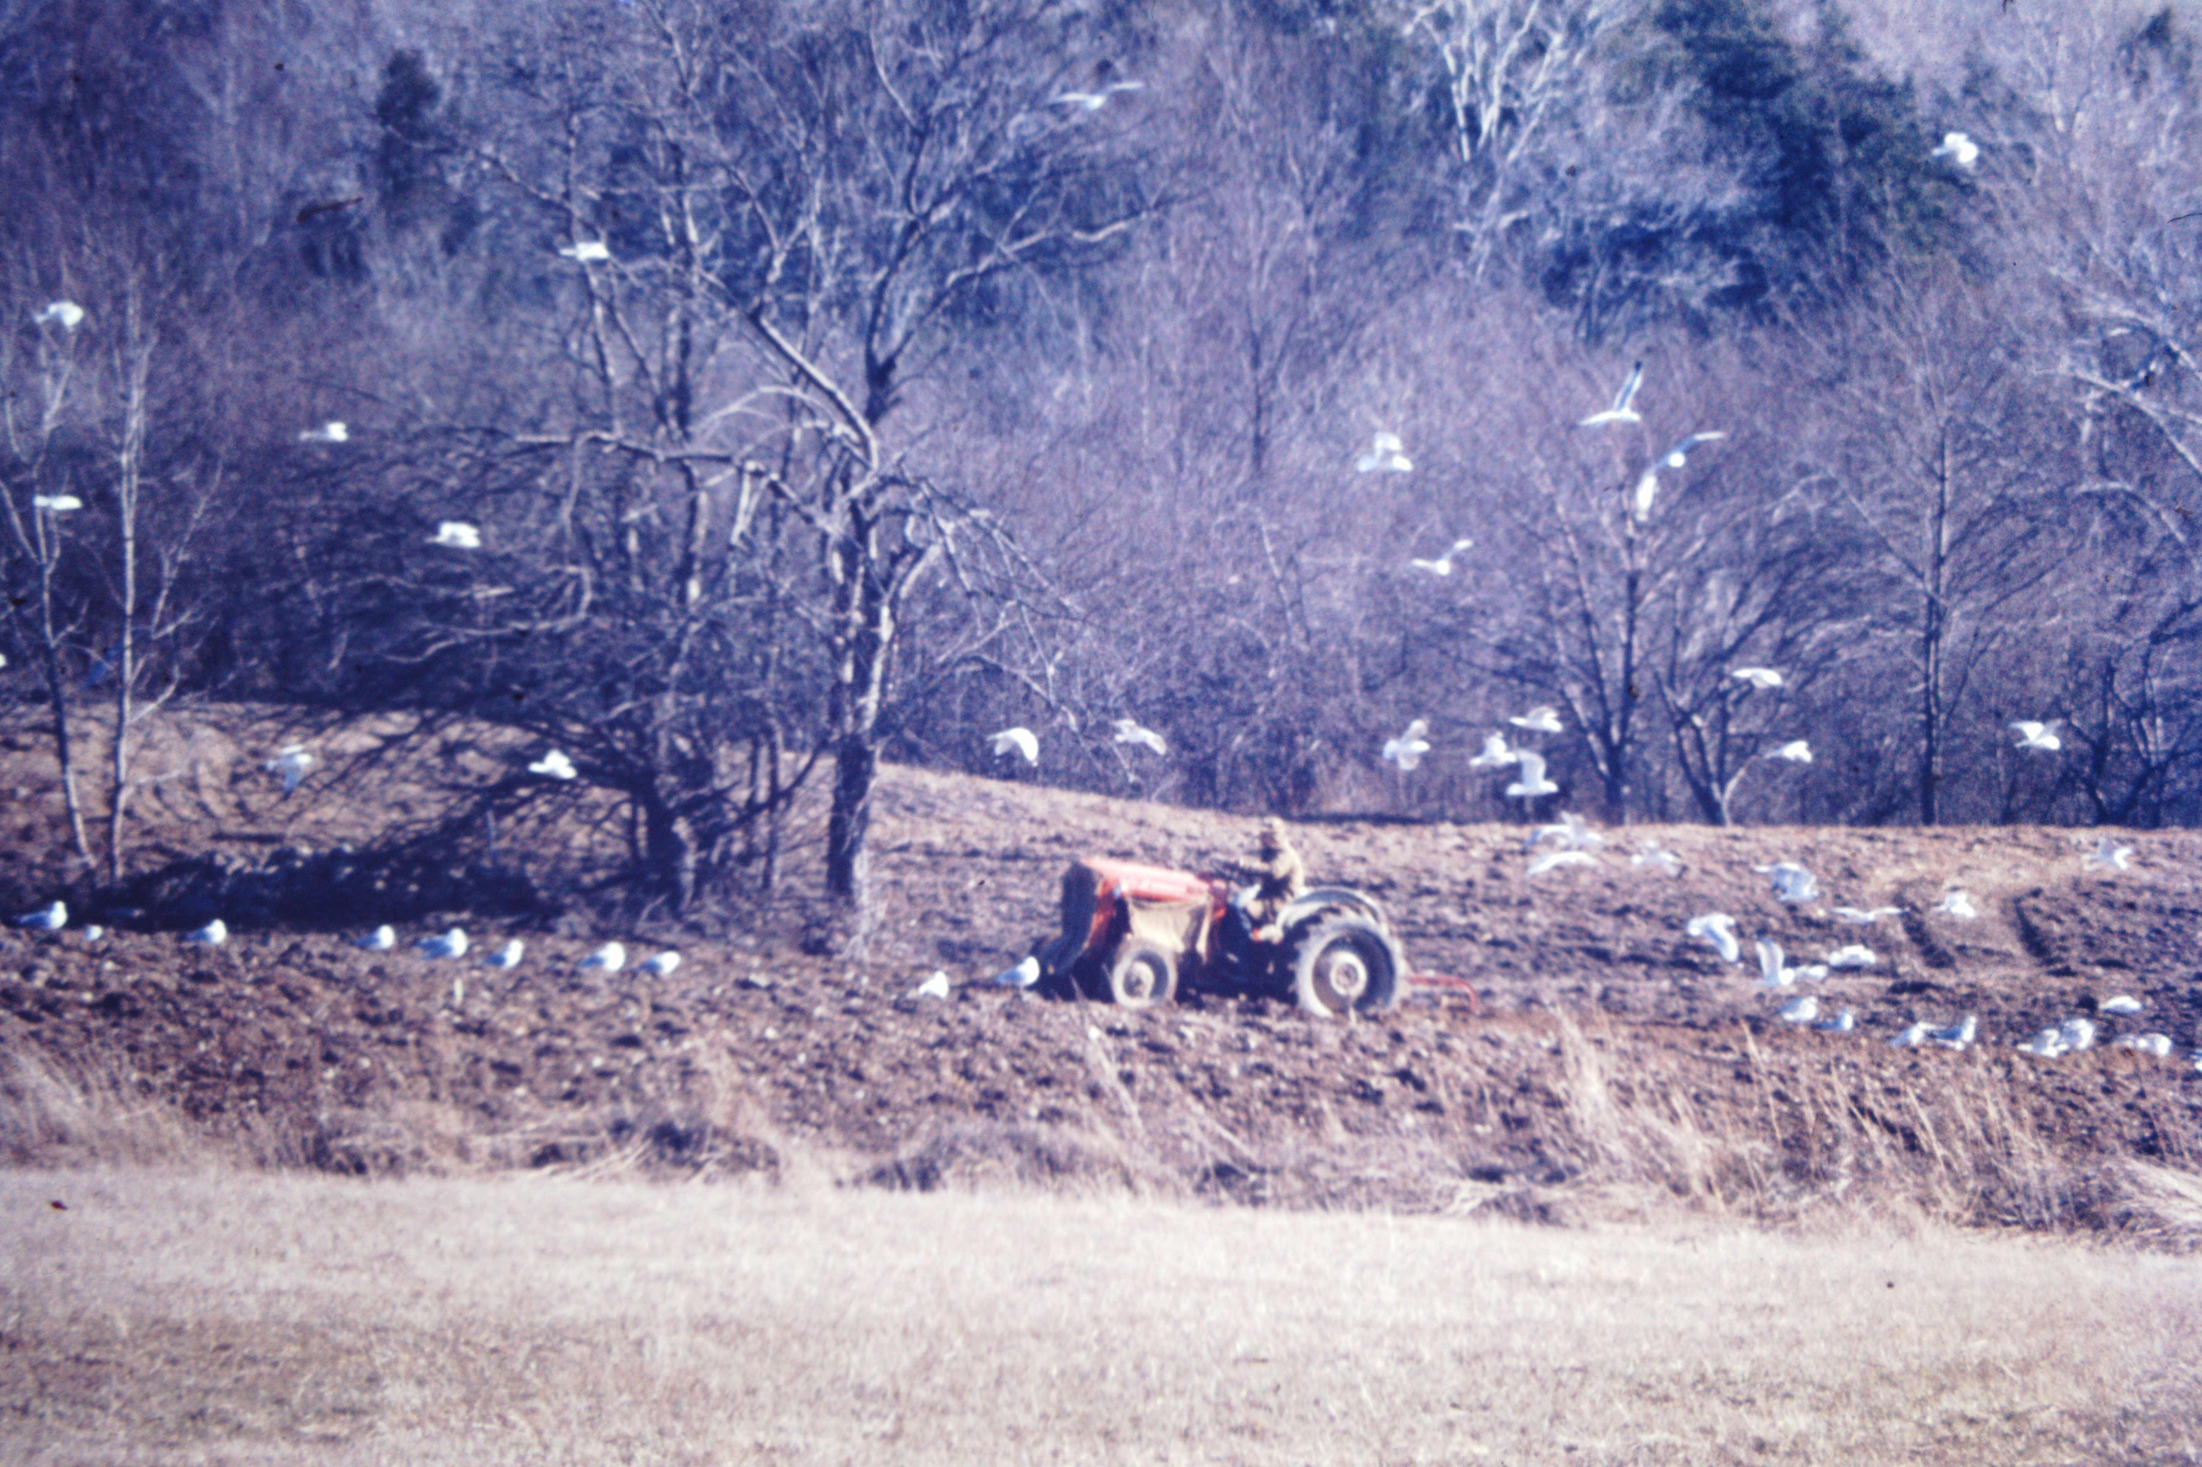
I
CCLI License No. 743067

Slide 14
CCLI License No. 743067

Slide 15
CCLI License No. 743067

Slide 16
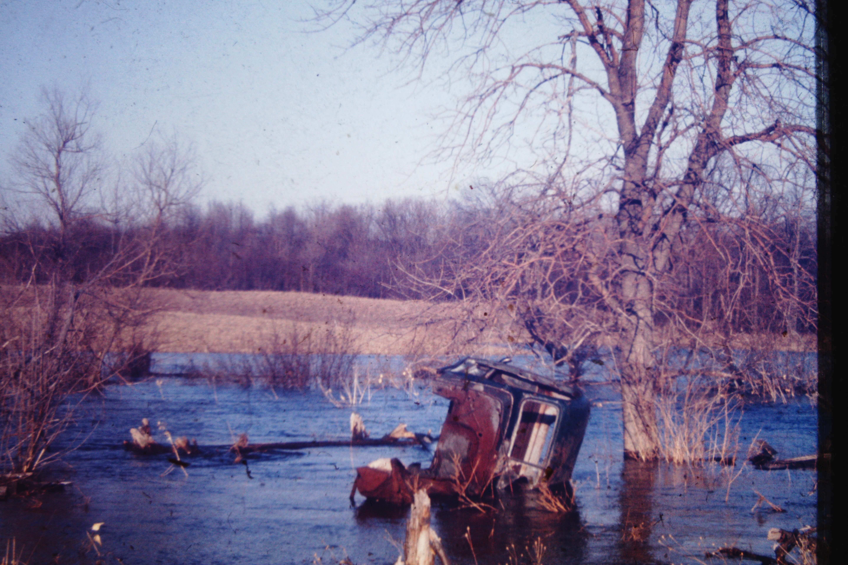
CCLI License No. 743067

Slide 17
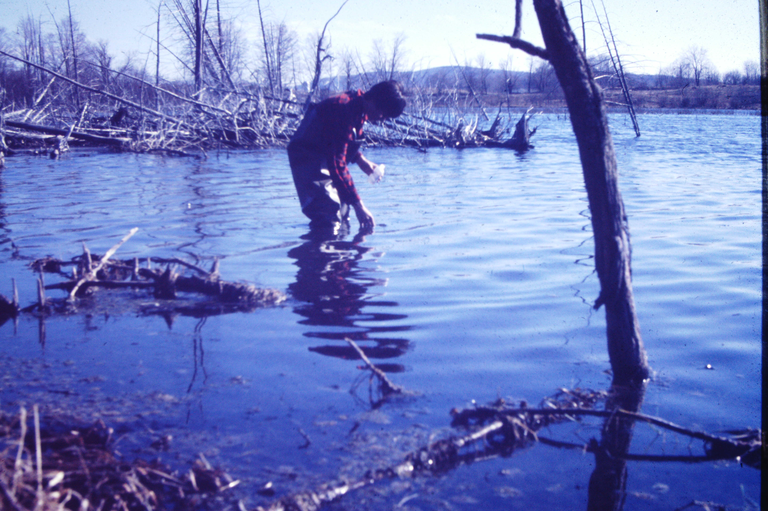
CCLI License No. 743067

Slide 18
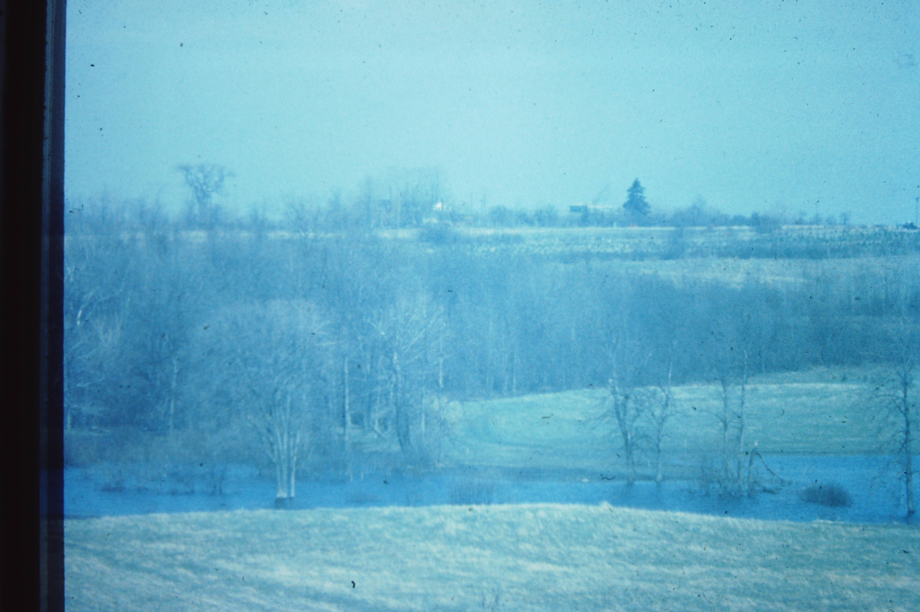
CCLI License No. 743067

Slide 19
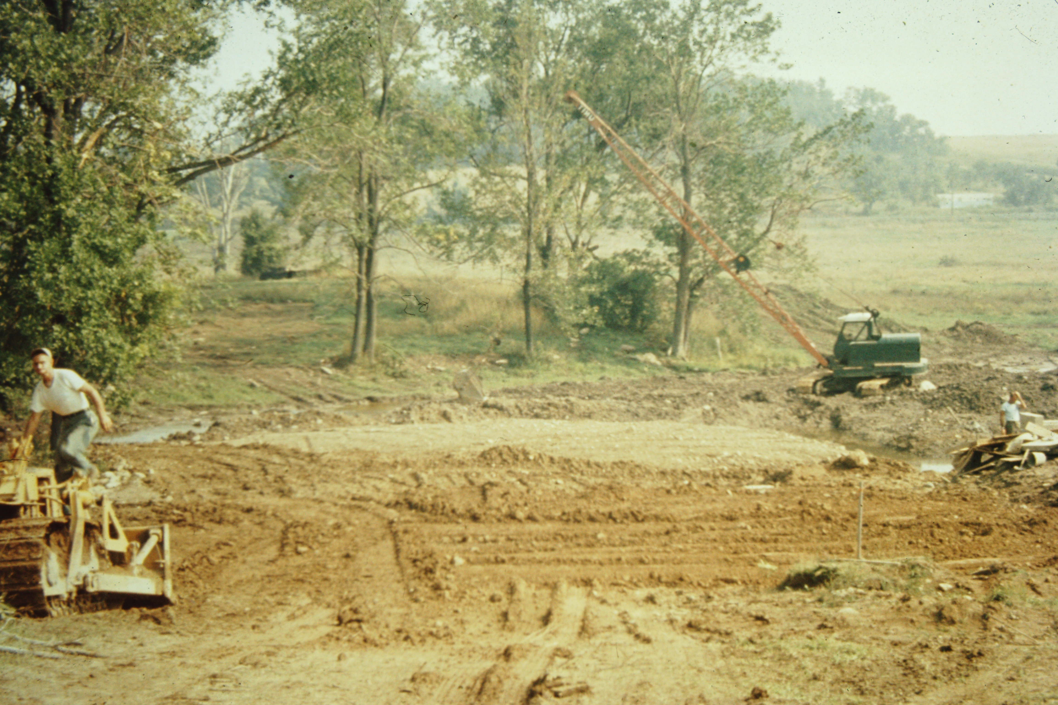
CCLI License No. 743067

Slide 20
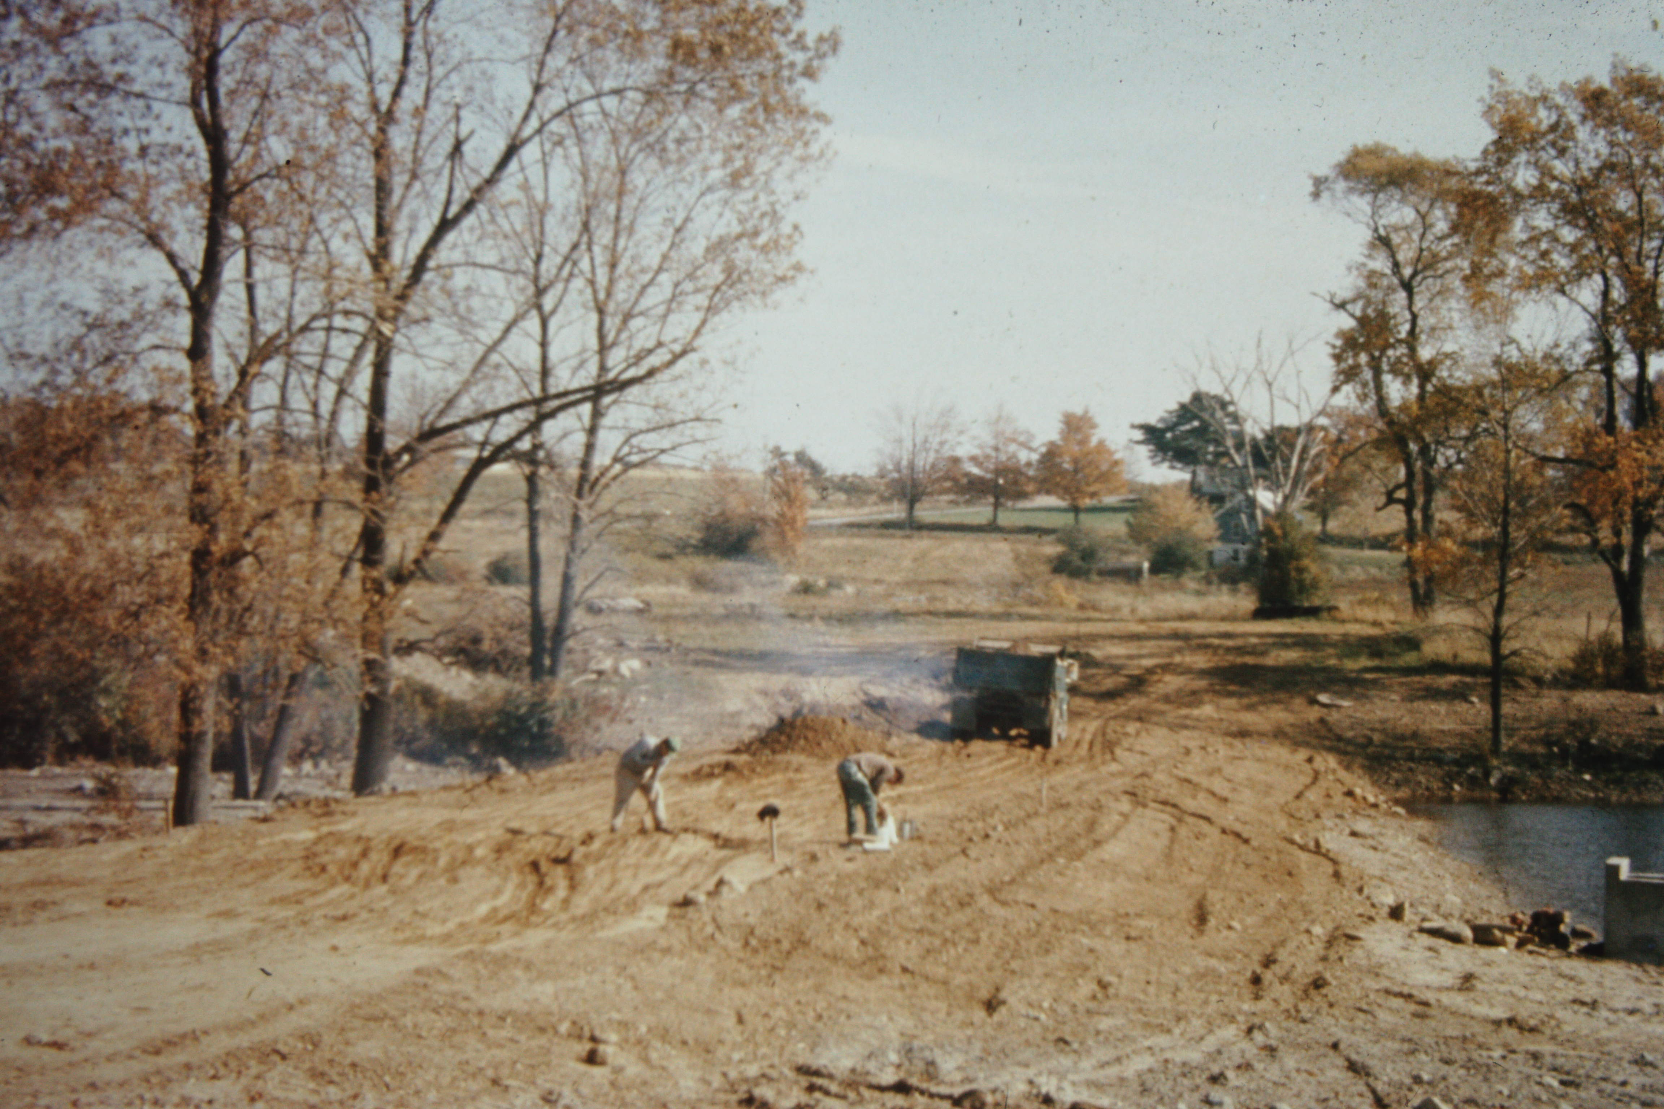
CCLI License No. 743067

Slide 21
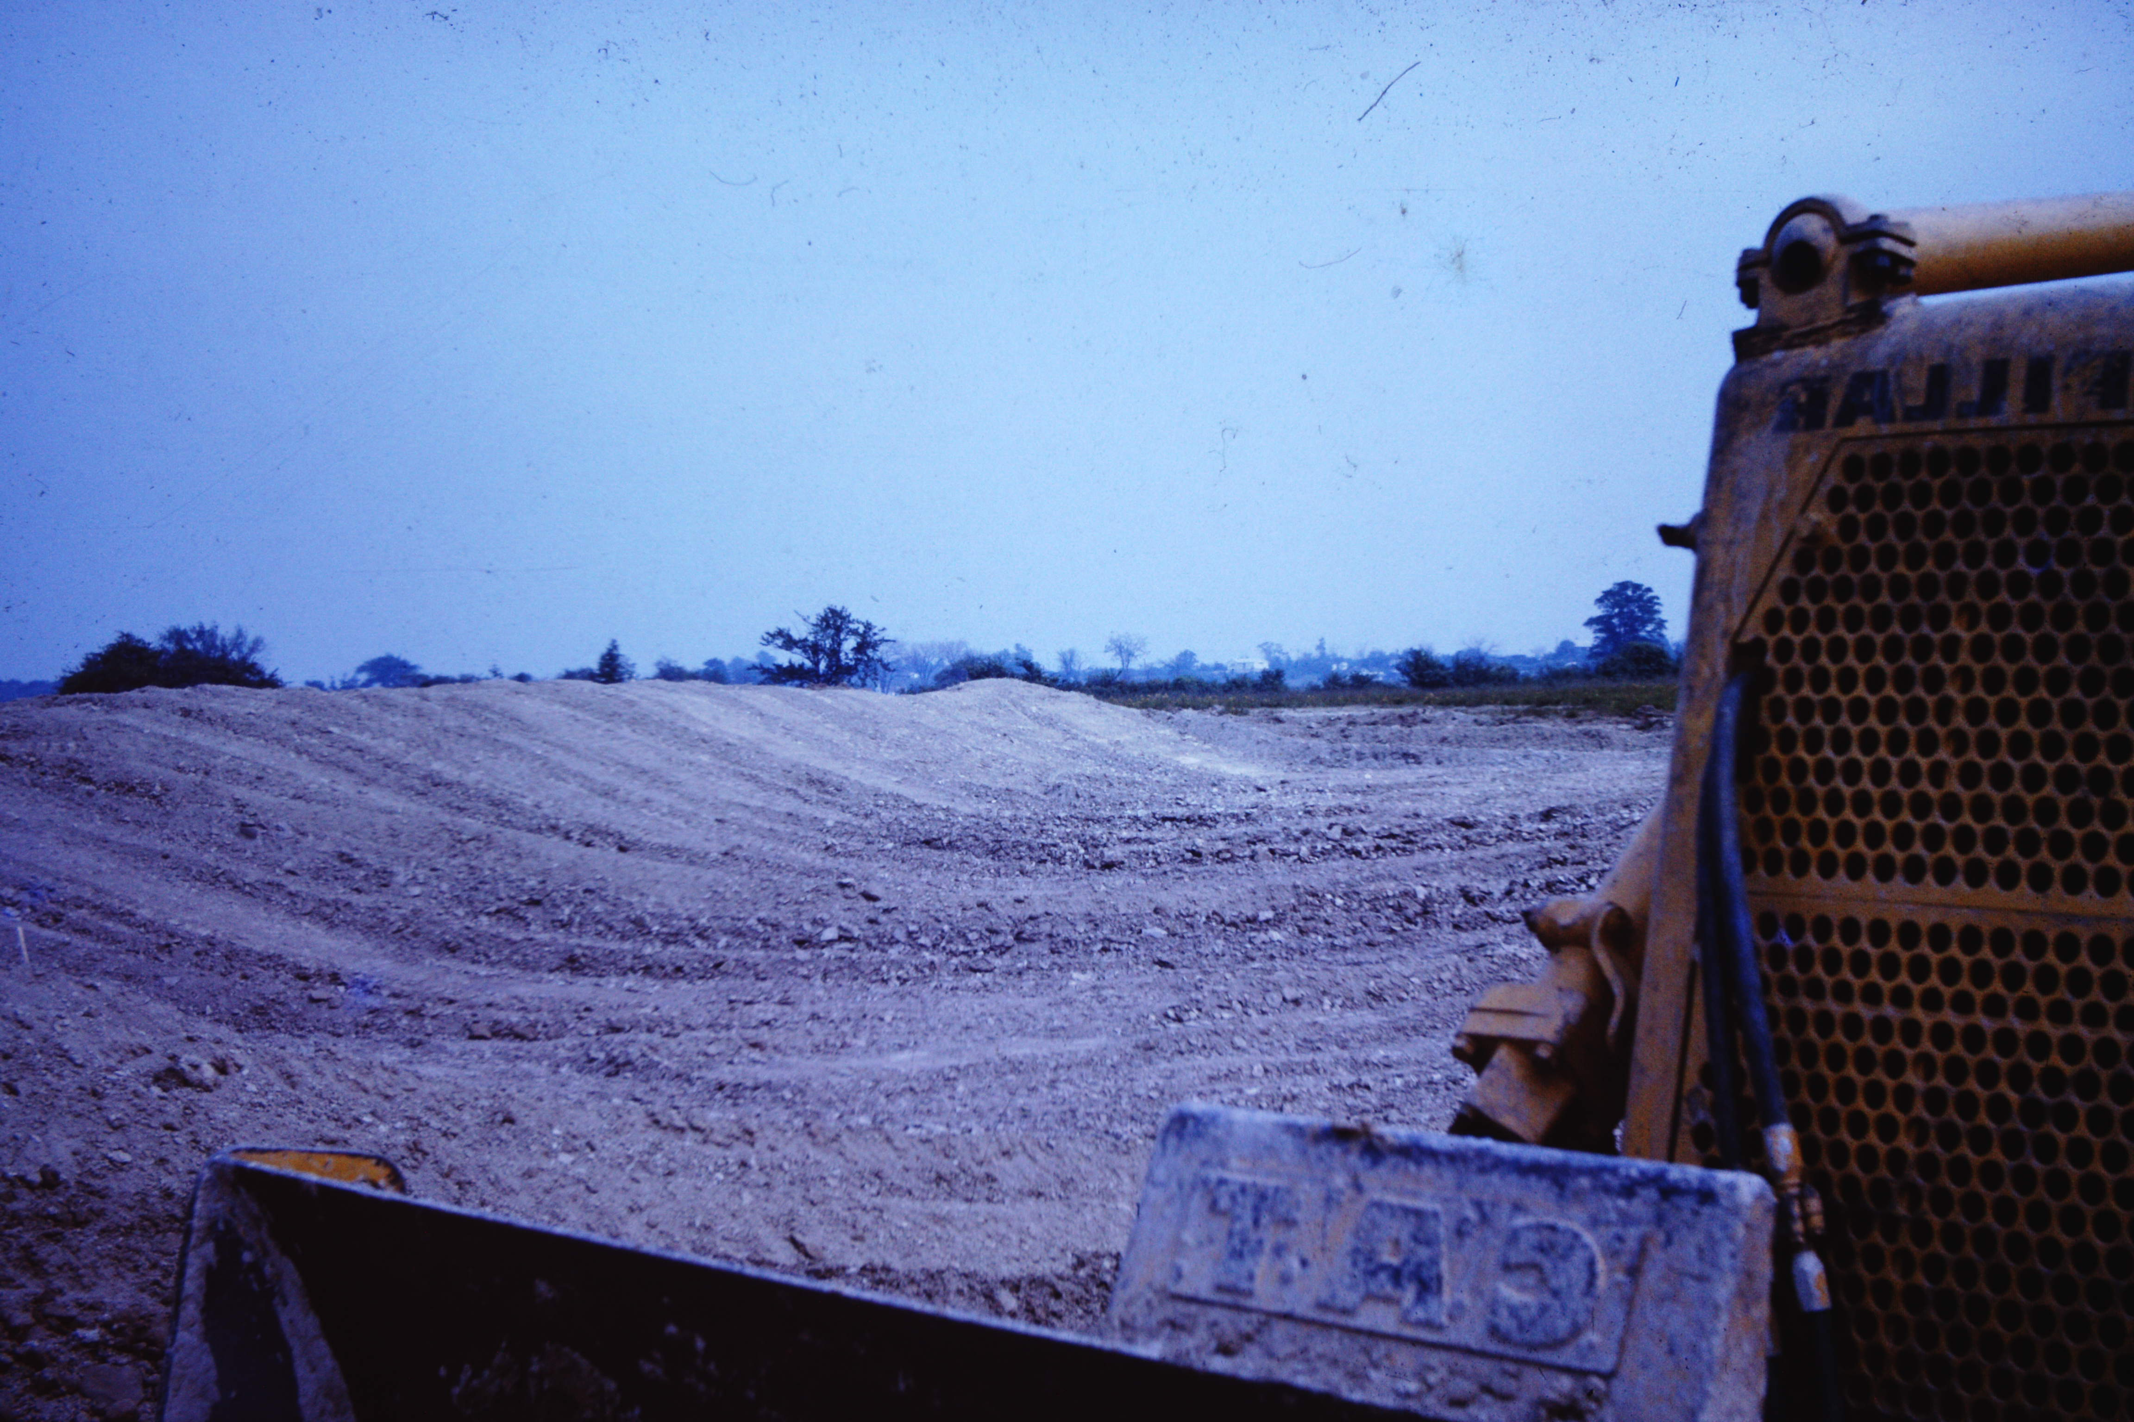
CCLI License No. 743067

Slide 22
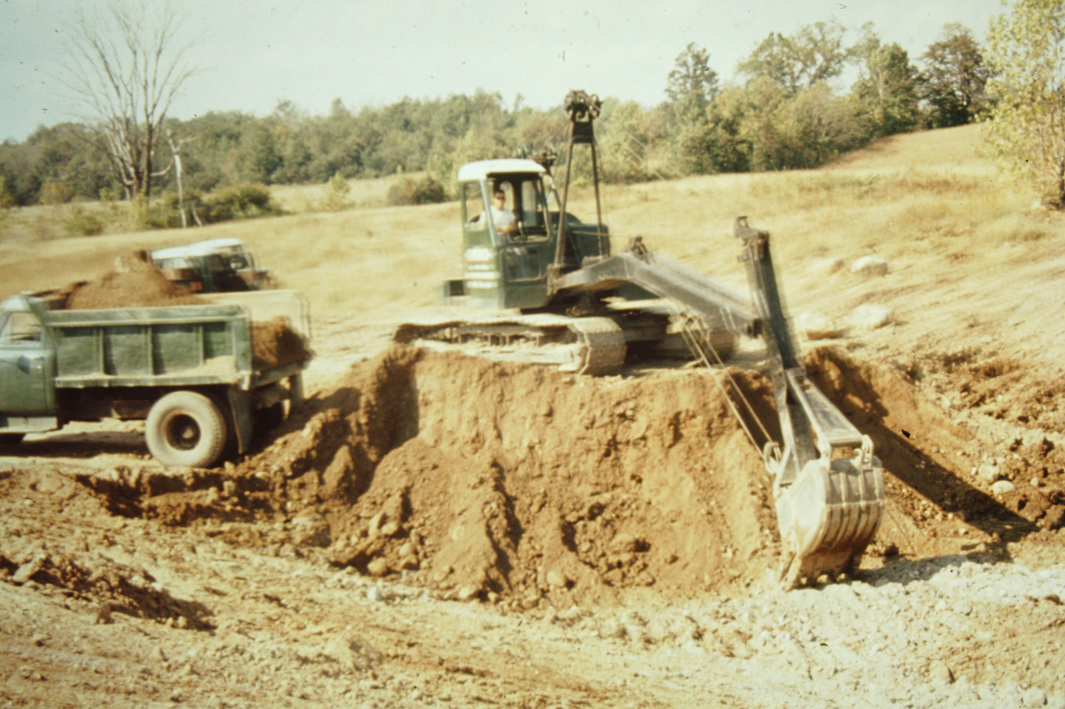
CCLI License No. 743067

Slide 23
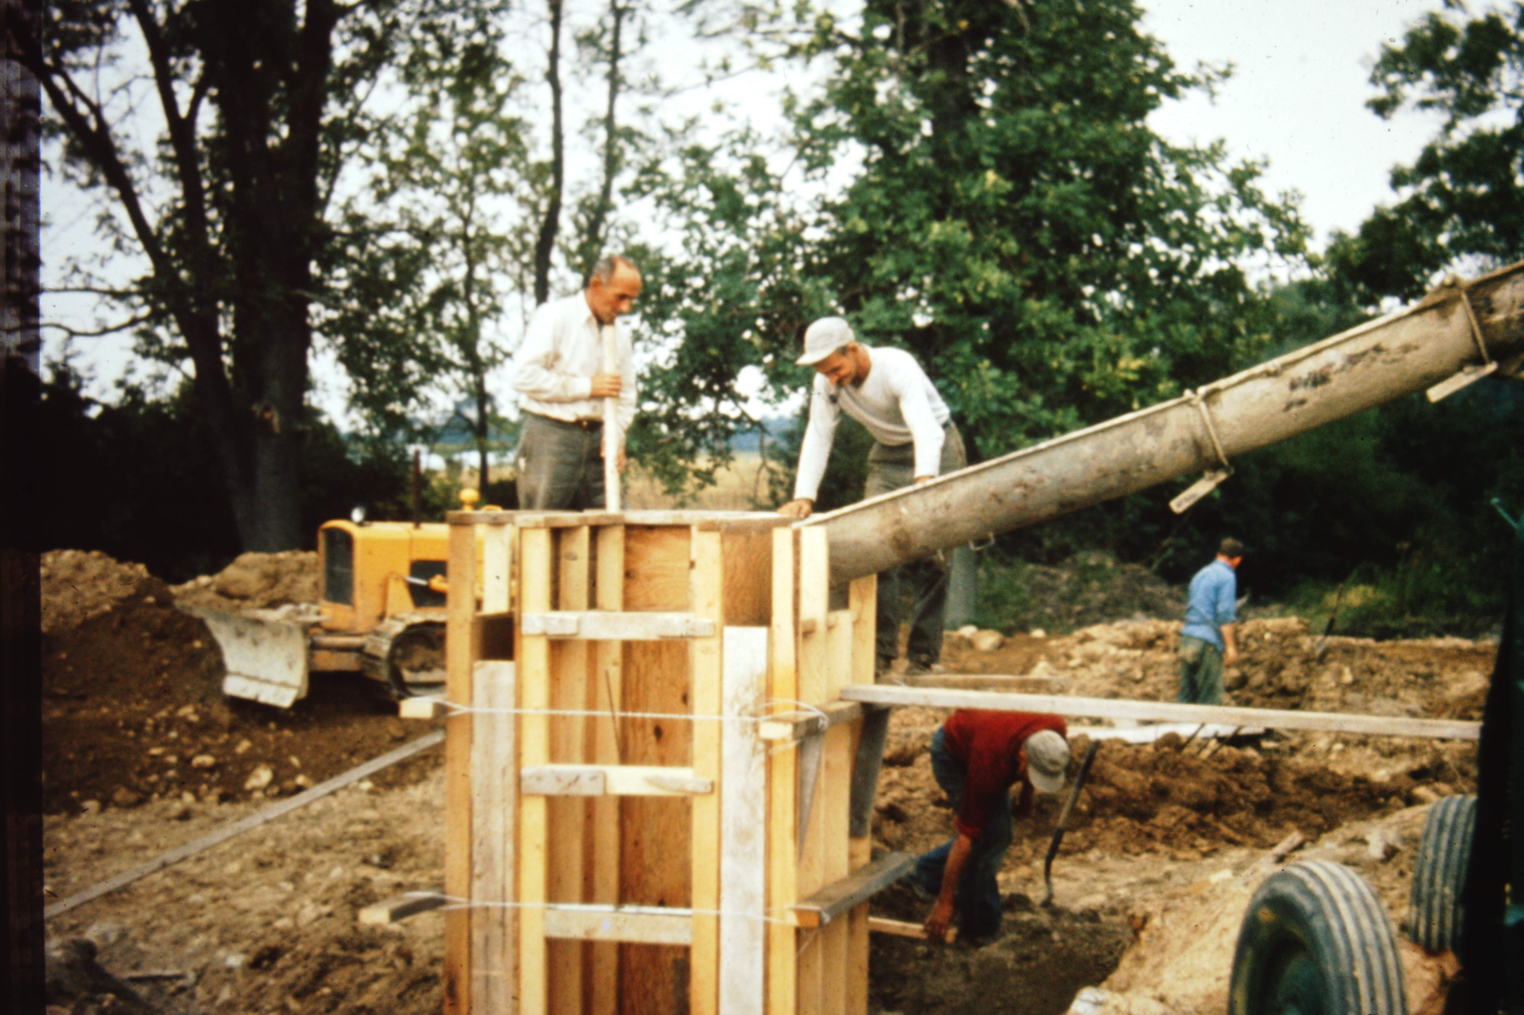
CCLI License No. 743067

Slide 24
CCLI License No. 743067

Slide 25
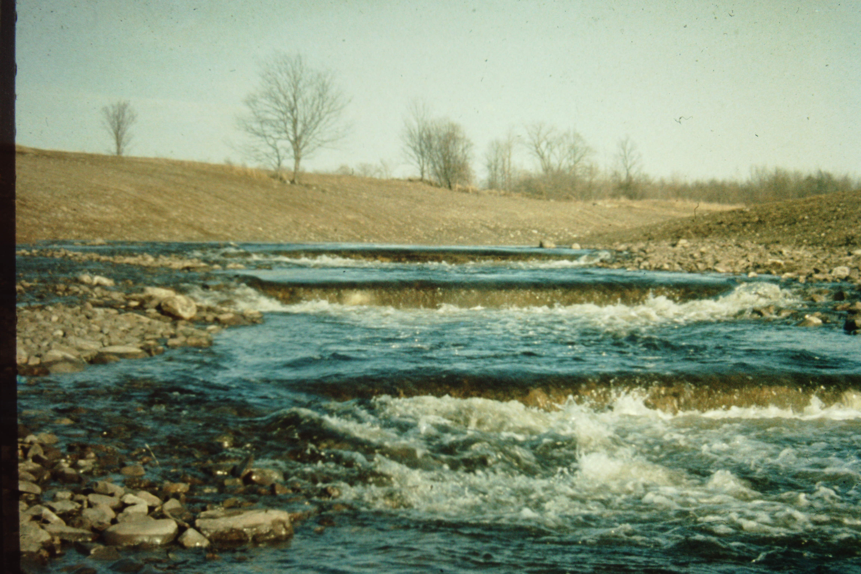
CCLI License No. 743067

Slide 26
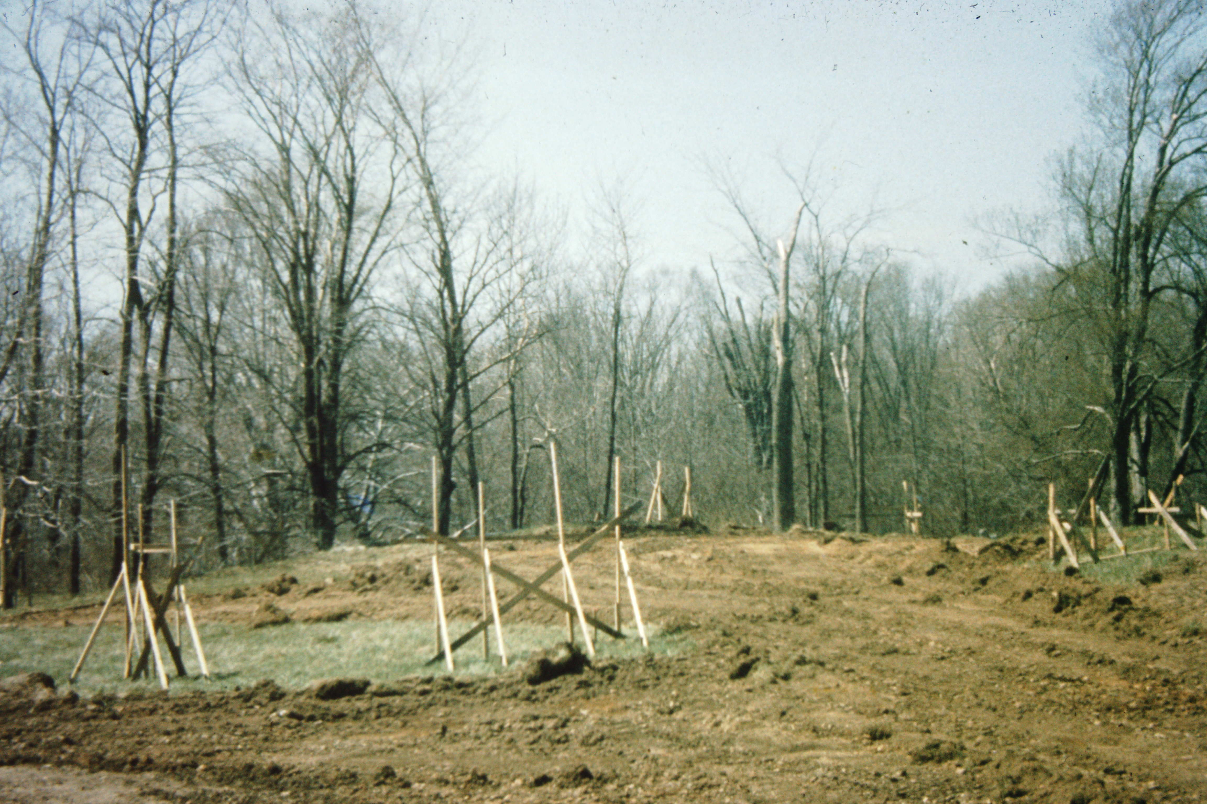
CCLI License No. 743067

Slide 27
CCLI License No. 743067

Slide 28
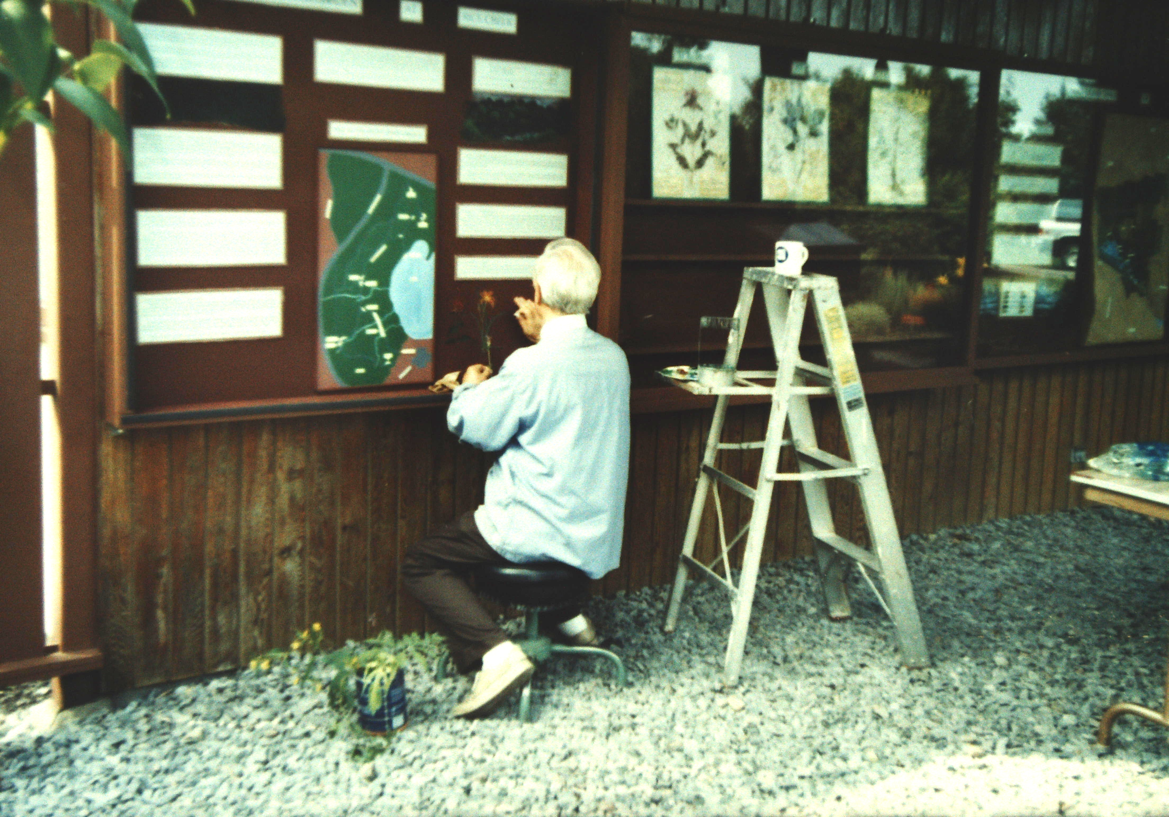
CCLI License No. 743067

Slide 29
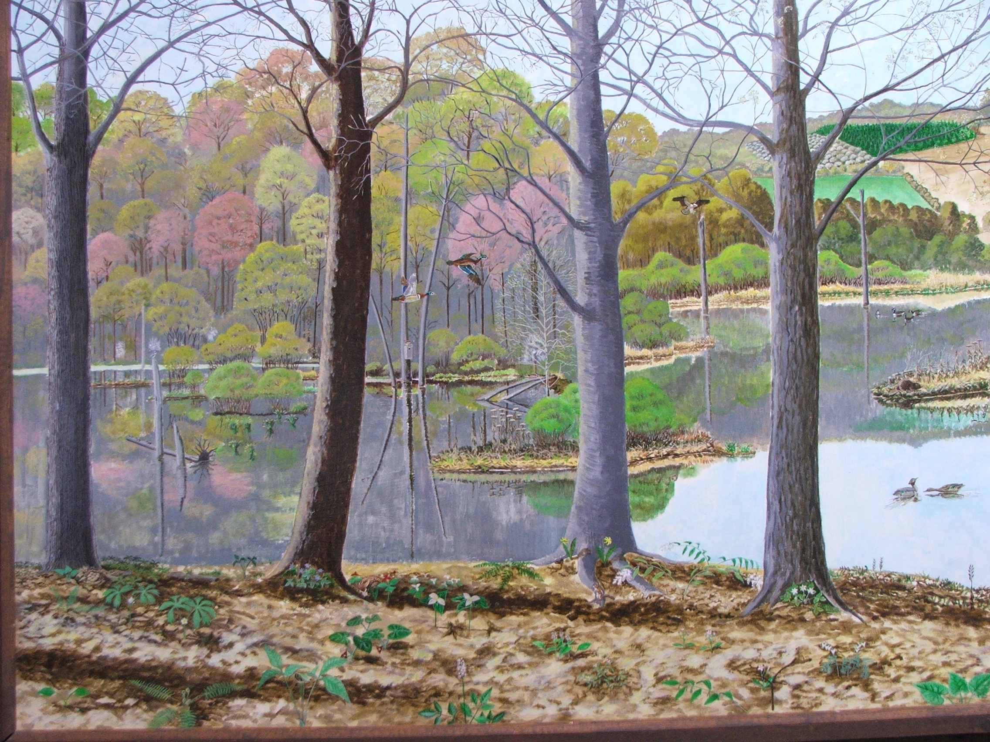
CCLI License No. 743067

Slide 30
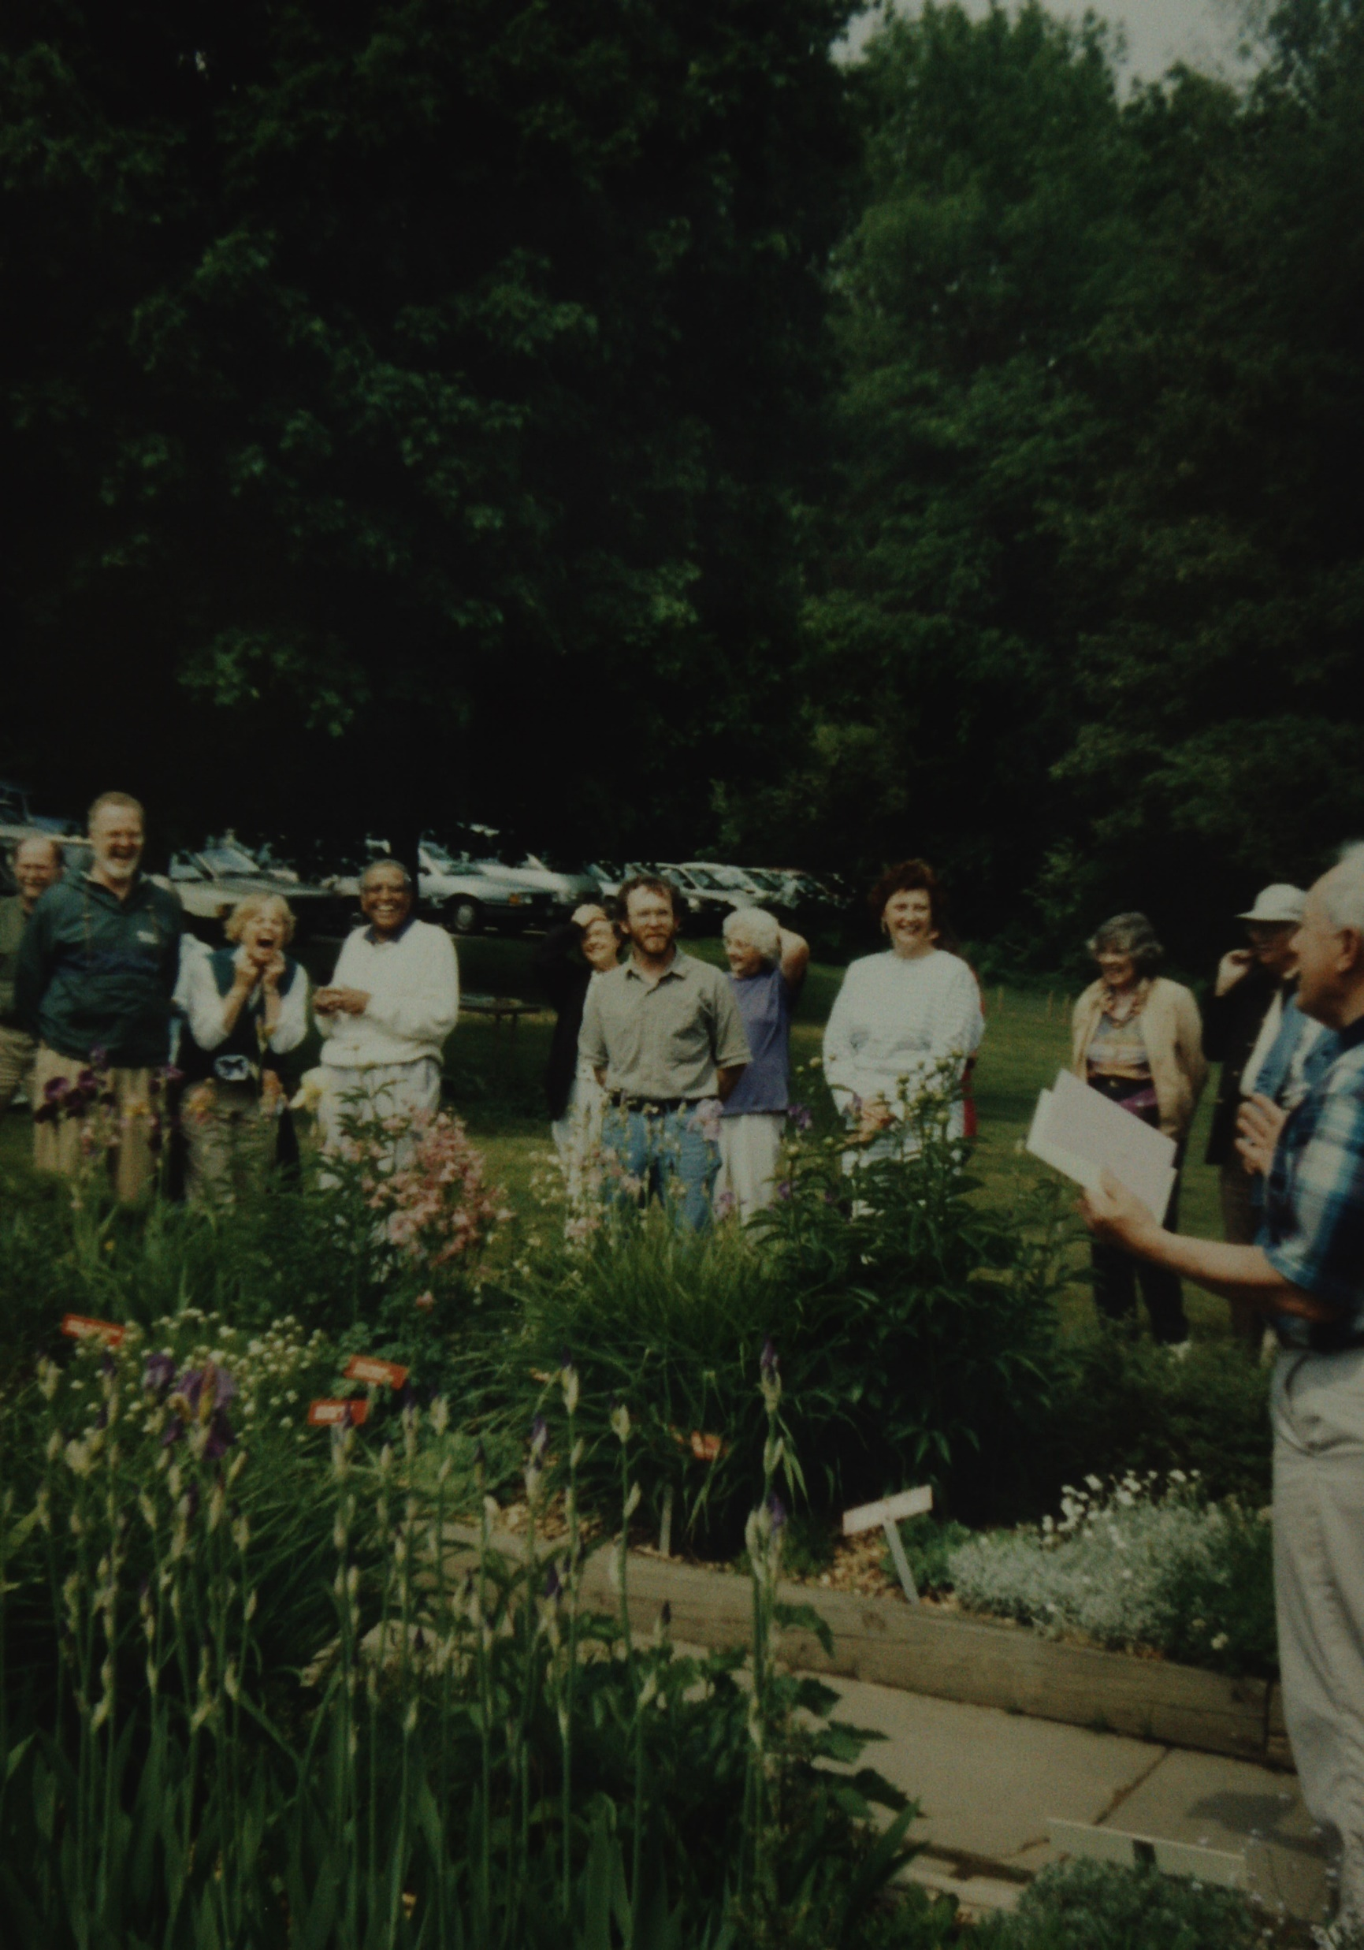
CCLI License No. 743067

Slide 31
CCLI License No. 743067

Slide 32
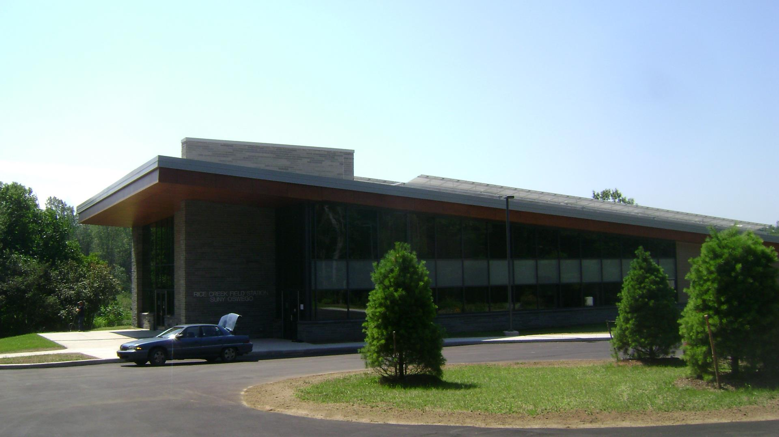
CCLI License No. 743067

Slide 33
CCLI License No. 743067

