Slide 1
New York State Department of Taxation and Finance

Slide 2
New York State (NYS) Income Taxes
If you did not have income and only need to send Form 8843 to the IRS ……
then, you do not need to file a New York State income tax return.

Slide 3
NYS Conforms with Internal Revenue Service
New York State (NYS) complies with ALL tax treaties that the Internal Revenue Service uses.
Your Federal (IRS) Adjusted Gross Income (Form 1040NR-EZ, line 10 or Form 1040NR, line 35) is the starting point in computing your New York State income tax.
New York State-source income for nonresidents is the Federal (IRS) Income that you earned in New York State.
New York State income for residents is the TOTAL Federal Income that you earned.
Note: If you earned income in any other state in the U.S., please consult that state for income tax filing requirements

Slide 4
Filing a NYS Income Tax Return
You must first determine if you are considered a NYS resident or a NYS nonresident for income tax purposes.
New York State residency rules differ from those of the Internal Revenue Service.
Once you determine residency status for NYS income tax purposes, then you must determine if you are required to file a NYS income tax return.

Slide 5
CHANGES IN 2009
In 2009, New York State regulations changed for undergraduate students regarding whether they are residents or nonresidents for NYS income tax purposes.
Undergraduate full-time students, whose permanent home is not New York, would be considered NYS nonresidents for income tax purposes.
Note: If you are an undergraduate and filed a NYS income tax return for tax year 2008, you may be required to complete a different NYS income tax form for tax year 2009.

Slide 6
If you are not a full-time undergraduate student, are you a resident or nonresident for NYS income tax purposes?
If your domicile (permanent home) is NOT New York State, but you maintained a permanent place of abode (on-campus or off-campus apartment, house) for more than eleven months during 2009 and spent more than 183 days in New York, you are a resident for NYS income tax purposes.

Slide 7
If you are NOT a full-time undergraduate student, answering these questions will help determine whether or not you are a NYS resident for NYS income tax purposes.
 | Yes | No
Did you live in an on-campus apartment or an apartment or house off campus?
If yes, did you maintain it (rent) for more than 11 months in the calendar year 2009?
Did you spend more than 183 days in New York State during the calendar year 2009?
If you answered YES to ALL of the above, you are considered a resident for NYS income tax purposes.

Slide 8
CHANGES IN 2009
This year, the New York State Department of Taxation and Finance will not mail Form 1099-G, which reports to you the amount of the tax refund you received in 2009 from the State of New York. You may obtain that information by calling the 1099-G Hotline at 518-485-0799 or 866-698-2946 (free phone call) and speaking with a department representative.
Note: If you took an itemized deduction on your federal income tax return for state and local income taxes and received an income tax refund from the state, the Internal Revenue Service will require you to include the refund amount as income on your federal (IRS) income tax return.

Slide 9
Which Tax Forms Should I Complete?
Note:
Forms requirements differ for
NYS residents and nonresidents

Slide 10
Which NYS tax forms should I file?
If you are a nonresident for NYS income tax purposes and are required to file an income tax return, you will need to file:
Form IT-203, “Nonresident and Part-year Resident Income Tax Return”
Form IT-203-B to report where you live in NYS, and
Form IT-2 for wages (if W-2 received)
If you are a resident for NYS income tax purposes and are required to file an income tax return, you will need to file:
Form IT-150 “Resident Income Tax Return (short form)” or IT-201 (long form) in limited cases and
Form IT-2 for wages (if W-2 received)

Slide 11
Who Must File a NYS Income Tax Return?
Note:
Filing requirements differ for
NYS residents and nonresidents

Slide 12
If I am a nonresident , do I need to file a NYS income tax return?
Yes, if you meet any of the following conditions::
You had New York-source income and your New York adjusted gross income (Federal amount column) is more than: $7,500 for single individuals
$3,000 if single & can be claimed on another taxpayer’s IRS tax return
$7,500 if married & filing separate tax returns
You want to claim a refund.

Slide 13
If I am a resident , do I need to file a NYS income tax return?
Yes, if you meet any of the following conditions::
You are required to file a federal (IRS) income tax return.
If your federal income is more than: $4,000 for single and married
$3,000 if single & can be claimed on another taxpayer’s IRS tax return
You want to claim a refund.

Slide 14
General NYS Income Tax Filing Guidelines

Slide 15
Filing Status Guidelines
If you checked “single” on your federal (IRS) income tax return and are required to file a NYS income tax return, you MUST check “single” as your filing status on your NYS income tax return.
If you checked “married” on your federal (IRS) income tax return, you must check “married” on your NYS income tax return.
If you are married and filing federal Forms 1040-NR or 1040-NR-EZ, you must check “married filing separate” as your filing status on your NYS income tax return.

Slide 16
General Guidelines
Unlike the federal (IRS) income tax return, NO PERSONAL EXEMPTION is allowed for you or your spouse on the NYS income tax return.
You are allowed the SAME number of DEPENDENT EXEMPTIONS as claimed on your federal (IRS) income tax return. The New York State Dependent Exemption is $1000.
Unlike the federal (IRS) income tax return, EVERYONE filing a NYS income tax return may claim a New York STANDARD DEDUCTION.

Slide 17
NYS 2009 Standard Deduction Amount
Filing Status
Standard Deduction
Single
can be claimed on another person's income tax return
$3,000
Single
cannot be claimed on another ‘s income tax return
$7,500
Married Filing Jointly
$15,000
Married Filing Separately
$7,500
Head of Household
with qualifying person
$10,500
Qualifying Widow(er)
with dependent child
$15,000

Slide 18
General Guidelines
If any part or your scholarship or fellowship was included as INCOME on your federal (IRS) income tax return, then enter it on the line for ”OTHER INCOME” on your NYS income tax return.
If you included the 2008 State income tax refund you received in 2009 as income on your federal (IRS) income tax return, you can subtract it on your NYS income tax return because it is not taxable income for NYS tax purposes.

Slide 19
New York State and Local Sales and Use Tax
You owe a sales and use tax if:
You purchase property or a service delivered to YOU in New York State without payment of sales and use tax (Ex. Internet, catalog purchases).
Most tangible personal property is subject to New York and Local Sales tax.
Examples: clothing, jewelry, electronic equipment, furniture, prewritten software, books (excluding textbooks), compact disks, videos, etc.
IF YOU DO NOT OWE NYS SALES TAX, ENTER A ZERO IN THE SALES TAX LINE. DO NOT LEAVE THE LINE BLANK.

Slide 20
Who is entitled to a NYS household credit?
Individuals who:
Cannot be claimed on another person’s federal income tax return AND
Whose tax filing status and income on the NYS income tax return are:
Single and federal adjusted gross income is $28,000 or less (Form IT-203, federal amount column, line 18)
Married and federal adjusted gross income is $32,000 or less (Form IT-203, federal amount column, line 18)
The household credit is NOT refundable and will only reduce your NYS tax.
See Instructions booklet for household credit chart.
Page 39 in IT-203 instruction booklet

Slide 21
How do I Prepare a NYS Nonresident Income Tax Return?
We will use the example from the IRS Income Tax Workshop.

Slide 22
If you are considered a resident for NYS income tax purposes, then you should attend this workshop to learn how to file a NYS resident income tax return: “Income Tax Workshop” (for resident filers) Friday, March 5 3:00-5:00 Clemens Hall 120, North Campus

Slide 23
You must complete your Federal Income Tax Return before completing your NYS Income Tax Return. Do NOT include on your NYS Income Tax Return any income that is exempt because of your country’s treaty with the U.S.

Slide 24
Joy Kim is attending the University of New York. She received her undergraduate degree from the University of California. She moved to New York from California on May 16, 2009 and, since then, has been living in an apartment in Buffalo. She has been in the United States for five years or less and filed a nonresident (1040NR-EZ) federal income tax return. What NYS income tax return does she file?

Slide 25
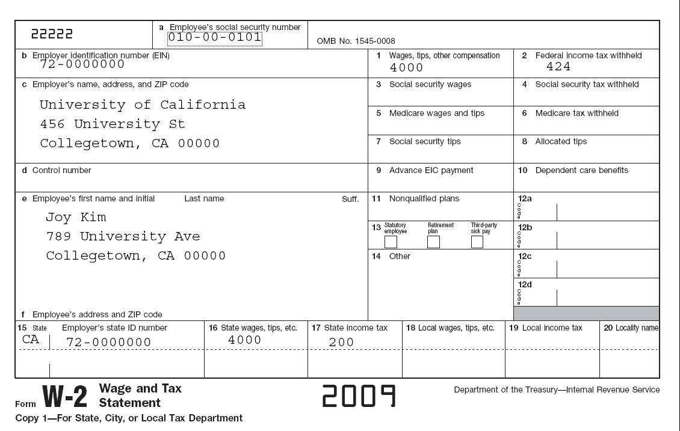
W-2 from California
96-0000001
45-60000000 4000.00 420.00
2009

Slide 26
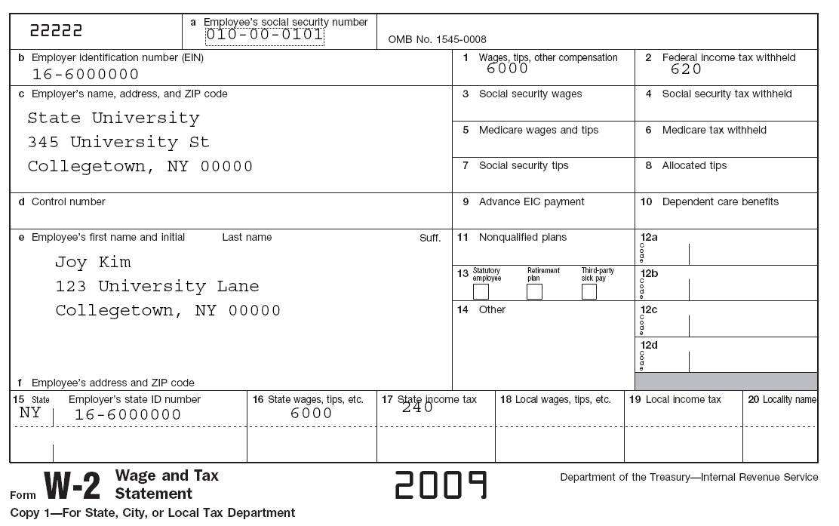
W-2 from New York
010-00-0101
16-0000001
6000.00 600.00
University of Rochester
School of Medicine and Dentistry
Rochester NY 14604
Joy Kim
1577 Elmwood Ave
Rochester NY 14620
NY 16-0000001 6000.00 240.00
2008

Slide 27
What do I do with the state copy of the W-2?
If you are filing a NYS income tax return and have a W-2, transfer your W-2 information onto NYS Form IT-2.
DO NOT forget to complete the NYS withholding information on Form IT-2.
Attach Form IT-2 to your NYS income tax return (Form IT-203).
DO NOT attach a W-2 to your NYS income tax return (Form IT-203). Keep the state copy for your records.
Note: Obtain Form IT-2 from www.nystax.gov

Slide 28
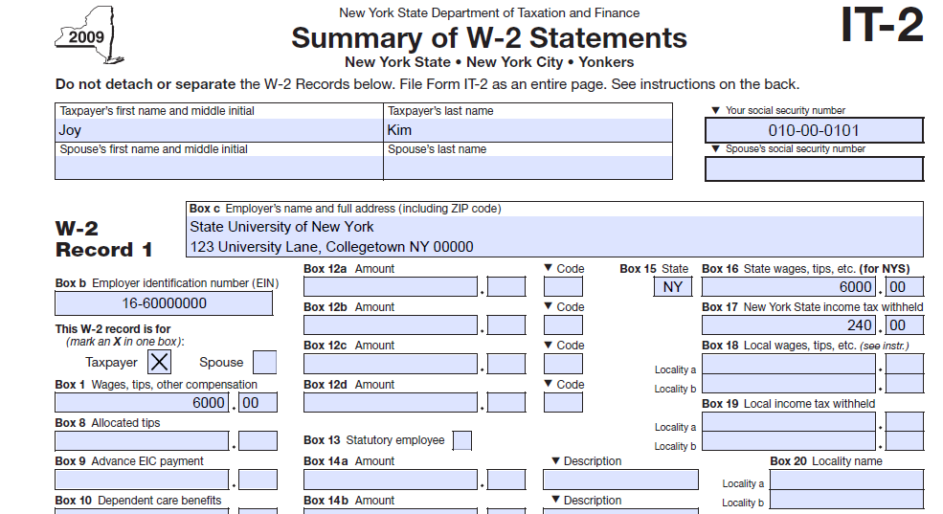
Transfer ALL W-2 Information to Form IT-2

Slide 29
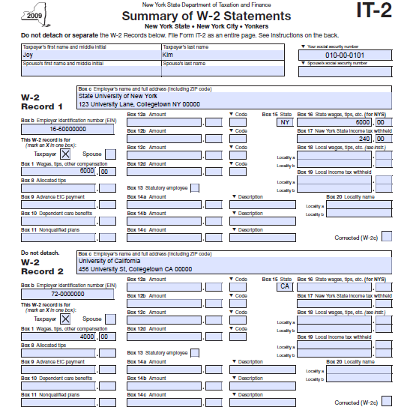
The information from all W-2’s received must be transferred to Form IT-2 even if the amount is NOT taxable income in New York State.

Slide 30
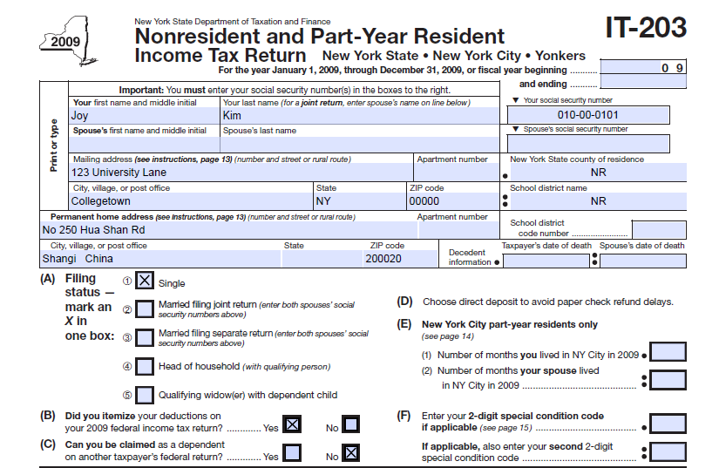
Completing IT-203

Slide 31
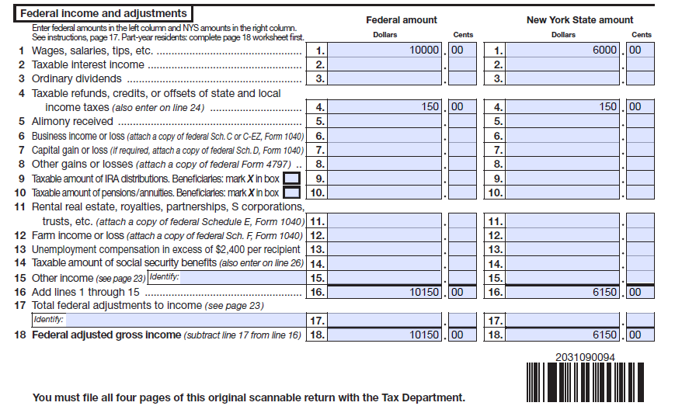
Complete Lines 1 through 18. Transfer the amounts from your federal income tax return to the Federal Amount column and income you earned in New York State (New York-source income) to the NYS amount column.

Slide 32
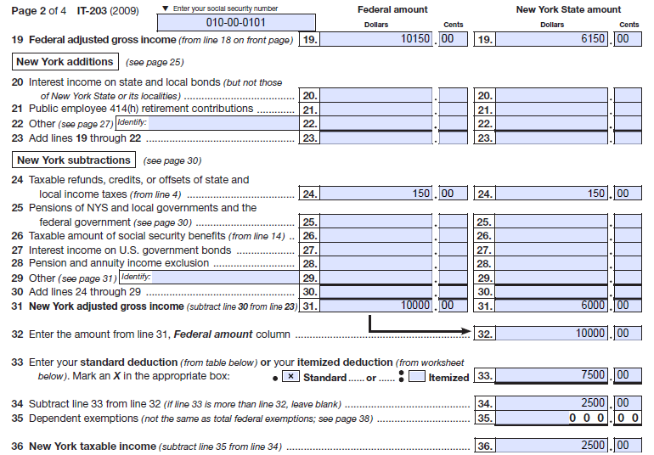
Start with your Federal Adjusted Gross Income. Then determine your NYS Adjusted Gross Income. If you included the state refund that you received in 2009 as income on your federal income tax return, subtract it on line 24 to arrive at your NYS Adjusted Gross Income. __________________________________________________________________________

Slide 33
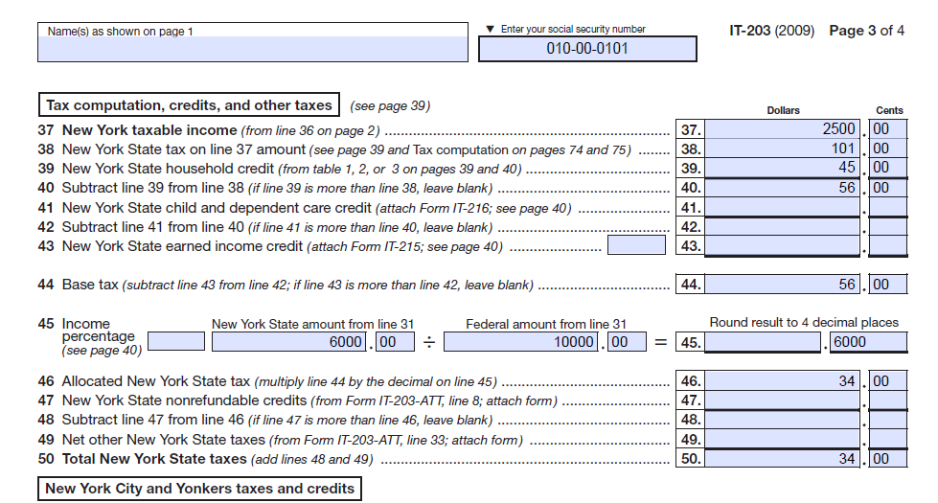
Line 38 NYS taxes– see next slide for Tax Chart

Slide 34
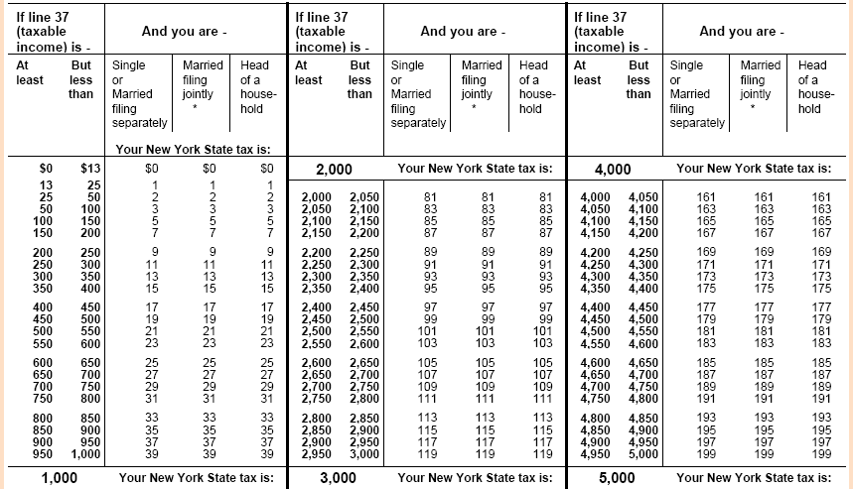
If you have a dollar amount on line 37 (NYS taxable income), find your income tax in the tables beginning on page 65 of the IT-203 instructions

Slide 35
NYS household credit chart for a single person who CANNOT be claimed on another taxpayer’s federal income tax return

Slide 36
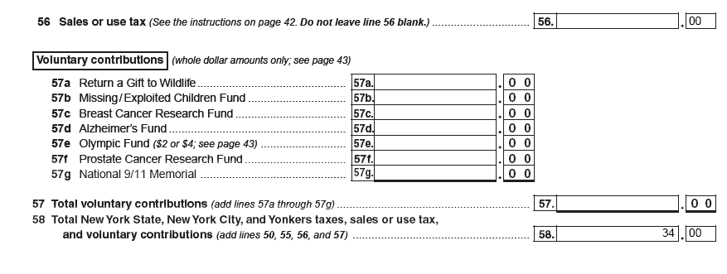
Line 56 (IT-203) is used to report the amount of sales tax you owe. If you do not owe sales tax, enter “0” on Line 56. On page 42 of the IT-203 Instructions booklet, there are instructions for computing the amount of tax due if you owe. If you DO NOT owe Sales and Use tax, enter a ZERO on Line 56. DO NOT leave Line 56 blank.

Slide 37
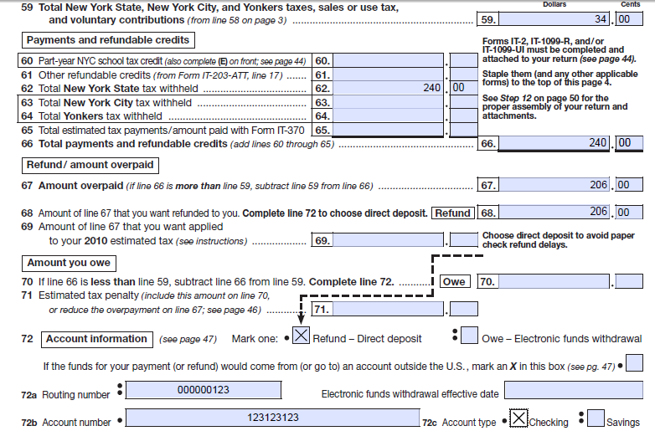
Page 4 of IT-203 – Line 62 is from IT-2

Slide 38
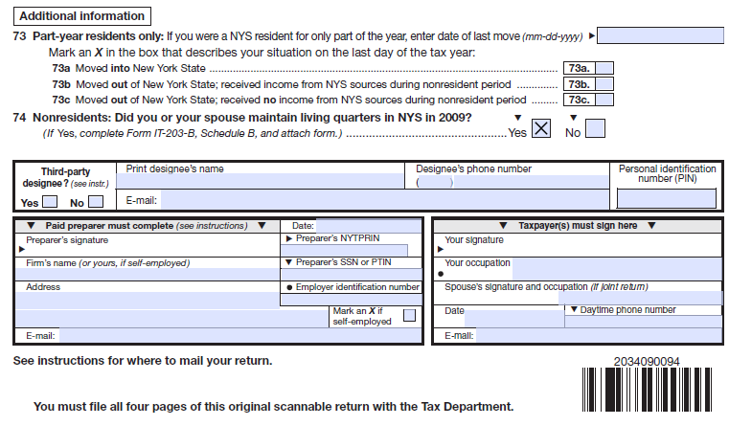
Sign and Date NYS Income Tax Return
JOY KIM
Student
2/19/10

Slide 39
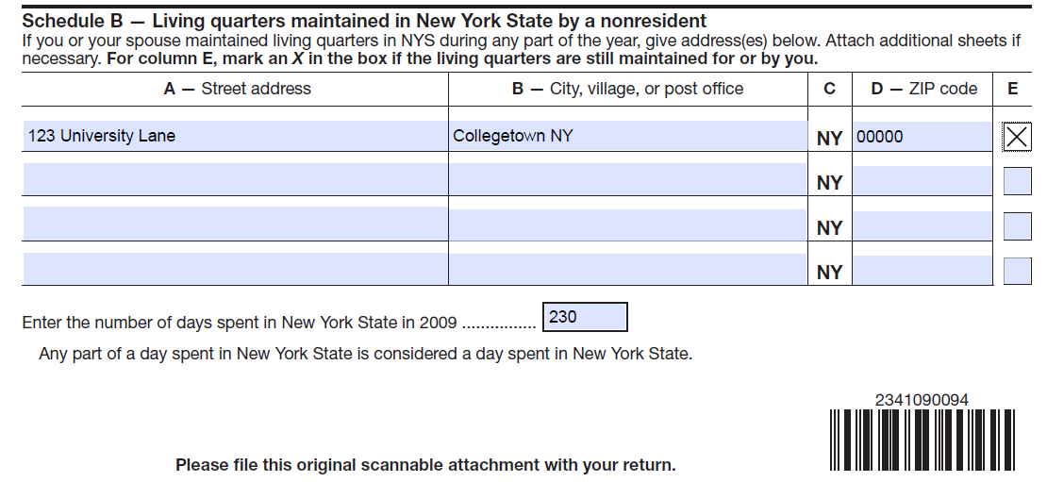
If you maintain living quarters in NYS, complete section B on Form IT-203-B only if you are required to complete Form IT-203.

Slide 40
General Guidelines
DO NOT attach ANY of the federal (IRS) forms unless you carried on a trade or business in New York State for which special rules may apply.
DO NOT Send any Federal income tax returns to New York State.
Do NOT send any copies of W-2’s or 1042-S’s to New York State.
DO NOT send any other federal forms to New York State.

Slide 41
Where to File PAPER Income Tax Returns
New Mailing Address
If enclosing a payment (check or money order), mail your NYS income tax return to:
STATE PROCESSING CENTER
PO BOX 15555
ALBANY, NY 12212-5555
If not enclosing a payment, mail your NYS income tax return to:
STATE PROCESSING CENTER
PO BOX 61000
ALBANY, NY 12261-0001

Slide 42
Due Date of NYS Income Tax Return
Filing due dates for your 2009 NYS Income Tax Return
Income tax return: April 15, 2010
Request for extension of time to file: April 15, 2010

Slide 43
Extensions
Form IT-370 will extend the due date by 6 months.
You may e-file extensions using your e-file software or directly on our website.
You can file Form IT-370 on-line on at www.nystax.gov. Payment options for on-line extensions include ACH debit, credit card and checks.
No signature requirement if no tax due

Slide 44
Income Tax Filing Tips
Remember to:
Sign your income tax return.
Enter your Social Security Number on your income tax return.
Complete Form IT-2 from your W-2 information and attach the IT-2.

Slide 45
Toll Free Tax Information 1-800-225-5829 (foreign language assistance is available)
VISIT OUR WEB SITE www.nystax.gov

Slide 46
QUIZ TIME!

Slide 47
Resident or Nonresident for New York State Income Tax Purposes?
Question: You are a graduate student who moved to New York from your home country in August 2009 to attend the university. You reside in apartment style housing on campus.
Answer: You are considered a nonresident for NYS income tax purposes because your permanent home is in your home country and you did not maintain an apartment in NYS for eleven months. If you are required to file a NYS income tax return, you will file Form IT-203.

Slide 48
Resident or Nonresident for New York State Income Tax Purposes?
Question: Your permanent home is in your home country. You moved to New York in January 2009. You reside in an apartment off campus. You signed a one-year lease, but returned to your country in May and came back to NYS in August.
Answer: You are considered a resident for NYS income tax purposes because you maintained an apartment in NYS for more than eleven months and spent more than 183 days in NYS. If you are required to file a NYS income tax return, you will file Form IT-150 or, in a few cases, Form IT-201.

Slide 49
Resident or Nonresident for New York State Income Tax Purposes?
Question: Your permanent home is in your home country. You moved to NYS in January 2009. You resided in apartment style housing (either on or off campus) until May 2009, when you returned to your home country. You came back to NYS in August and rented another apartment (either on or off campus) for the remainder of tax year 2009.
Answer: You are considered a nonresident for NYS income tax purposes because your permanent home is in your home country and you did not maintain an apartment in NYS for more than eleven months. You rented it for five months (January-May) and then four months (September-December). If you are required to file a NYS income tax return, you will file Form IT-203.

Slide 50
The material included in this slide show is intended only to highlight NYS tax issues as of the date presented. For more comprehensive information, please refer to our TSB-M’s, forms, instructions and publications.
QUESTIONS?
THANK YOU

