Slide 1
SUNY Oswego
Human Subjects Committee
2012
Last Revised 10/28/2011

Slide 2
Our Purpose
Overview researchers’ responsibilities and procedures when conducting research with human subjects.
Our Mission
Protect all subjects- especially students and vulnerable populations.
e.g., children, pregnant females, prisoners, impaired individuals.

Slide 3
A systematic investigation, including research development, testing and evaluation, designed to develop or contribute to generalizable knowledge.

Slide 4
Interview
Survey
Collecting information…
to be shared with others
Document Records
Case Studies
Observation
Conferences
Journals
Books
Publications

Slide 5
Description
Prediction
Improvement
Explanation
Theory Testing

Slide 6
Data that is collected as part of the instructor’s class for the purpose of evaluating students’ performance in the class
Data that is collected as part of the instructor’s class for the purpose of assessing the instructor’s performance
Data that is collected as part of the instructor’s class for the purpose of an internal assessment of the (school’s or department’s) program
Data that is collected as part of a cooperating teacher’s class for the purpose of assessing a student teacher

Slide 7
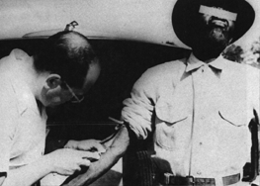
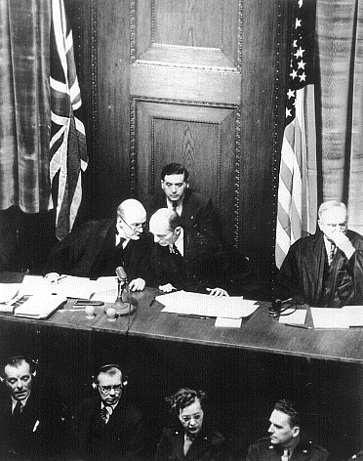
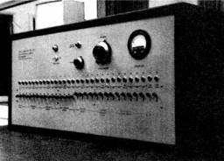
Tuskeegee Syphillis Study (1932-1972)
WWII Concentration Camp Studies (1933-1945)
Milgram Studies of obedience and authority (1963)
Notes:
History of Research Ethics http://research.unlv.edu/ORI-HSR/history-ethics.htm
Prior to 1906, when the Pure Food and Drug Act was passed, there were no regulations regarding the ethical use of human subjects in research. There were no consumer regulations, no Food and Drug Administration (FDA), no Common Rule, and no Institutional Review Board (IRB). What follows is a brief discussion of why federal rules and regulations were established and why the IRB became a necessity.
Tuskegee Syphilis Study (1932-1972). An equally well known chapter in history occurred during a research project conducted by the U.S. Public Health Service. Six hundred low-income African-American males, 400 of whom were infected with syphilis, were monitored for 40 years. Free medical examinations were given; however, subjects were not told about their disease. Even though a proven cure (penicillin) became available in the 1950s, the study continued until 1972 with participants being denied treatment. In some cases, when subjects were diagnosed as having syphilis by other physicians, researchers intervened to prevent treatment. Many subjects died of syphilis during the study. The study was stopped in 1973 by the U.S. Department of Health, Education, and Welfare only after its existence was publicized and it became a political embarrassment. In 1997, under mounting pressure, President Clinton apologized to the study subjects and their families. The Tuskegee Syphilis Study is probably the worst case of unethical human subjects research in the history of the United States.
Nuremberg Code. Nazi atrocities in World War II drew attention to the lack of international standards on research with human subjects and led to the formulation of the Nuremberg Code. A well-known chapter in the history of research with human subjects opened on December 9, 1946, when an American military tribunal opened criminal proceedings against 23 leading German physicians and administrators for their willing participation in war crimes and crimes against humanity. Among the charges were that German physicians conducted medical experiments on thousands of concentration camp prisoners without their consent. Most of the subjects of these experiments died or were permanently crippled as a result. As a direct result of the trial, the Nuremberg Code was established in 1948, stating that "The voluntary consent of the human subject is absolutely essential," making it clear that subjects should give consent and that the benefits of research must outweigh the risks. Although it did not carry the force of law, the Nuremberg Code was the first international document which advocated voluntary participation and informed consent.
National Research Act (1974 ). Due to the publicity from the Tuskegee Syphilis Study, the National Research Act of 1974 was passed. The National Research Act created the National Commission for the Protection of Human Subjects of Biomedical and Behavioral Research, which was charged to identify the basic ethical principles that should underlie the conduct of biomedical and behavioral research involving human subjects and to develop guidelines which should be followed to assure that such research is conducted in accordance with those principles. The Commission drafted the Belmont Report, a foundational document in for the ethics of human subjects research in the United States.
BELMONT REPORT. Carrying out its charge, the National Commission for the Protection of Human Subjects of Biomedical and Behavioral Research prepared the Belmont Report in 1979. The Belmont Report attempts to summarize the basic ethical principles identified by the Commission in the course of its deliberations. The Report is a statement of basic ethical principles and guidelines that should assist in resolving the ethical problems that surround the conduct of research with human subjects. The three basic ethical principles and their corresponding applications are: respect for individuals, beneficence and justice.
Milgram Studies. http://en.wikipedia.org/wiki/Milgram_experimen. The Milgram experiment on obedience to authority figures was a series of social psychology experiments conducted by Yale University psychologist Stanley Milgram, which measured the willingness of study participants to obey an authority figure who instructed them to perform acts that conflicted with their personal conscience. Milgram first described his research in 1963 in an article published in the Journal of Abnormal and Social Psychology,^{[1]} and later discussed his findings in greater depth in his 1974 ^{a URL} book, Obedience to Authority: An Experimental View.[
The Milgram picture has hyperlink to a 5:50 minute BBC video. To avoid downloading delay, open the video prior to the presentation.

Slide 8
Principle | Application
Respect for persons Individuals treated as autonomous agents. Persons with diminished autonomy are entitled to protection. | Informed Consent: Opportunity for subjects to choose what shall/shall not happen to them. The consent process must include three elements: 1) information, 2) comprehension, and 3) voluntariness.
Beneficence Subjects should not be harmed; Research maximizes benefits & minimizes harms. | Assessment of risks and benefits The nature and scope of risks and benefits must be assessed in a systematic manner
Justice The benefits and risks of research must be distributed fairly. | Selection of subjects There must be fair procedures and outcomes in the selection of research subjects

Slide 9
Institutional Review Board (IRB)
Faculty, staff, & students of SUNY Oswego are obligated to comply with Federal Department of Health and Human Services regulations for the protection of human participants in research (it’s the law!)  Human Subjects Committee  Institutional Care and Use of Animals
Human Subjects Committee
Outside set of eyes to verify that your study doesn't raise ethical issues.
Address ethical issues that may come up by offering helpful suggestions.

Slide 10
Human Subjects Committee
Does Your Study Involve Human Subjects?
Yes
lab experiments
field studies
observations
interviews
questionnaires
etc.
Submit to Human Subjects Committee (HSC) for approval
Exempt
Review
Expedited Review
Full Committee Review
Notes:
Does the study involve human subjects? It doesn’t matter where the study occurs (field, in the classroom, on campus, off campus) or if the subjects are SUNY students, faculty or staff. It doesn’t matter if you interact with subjects by questionnaire, face to face, or by observation. The key here is that you interact with human subjects in some way in the course of conducting research.
If you interact with Humans Subjects (e.g., “Yes”): you must seek HSC approval. Some schools can this committee the “Institutional Review Board” or IRB.
Three Outcomes for your submission:
Exempt: A study that does not involve actual interaction with humans, such as archival data that is in the public domain.
Expedited: A study that does not involve contact with human subjects or includes only minimal risk for the subjects. This type of study can be approved by the HSRB chair .
Full Review: If the chair has any questions about your study, the whole committee will meet to evaluate it

Slide 11
All research studies that include human subjects must be approved by the HSC
Data cannot be collected until approval has been received in writing from the HSC
Turnaround is fast- typically within a few days
Visit the HSC website for specific details
http://www.oswego.edu/hsc

Slide 12
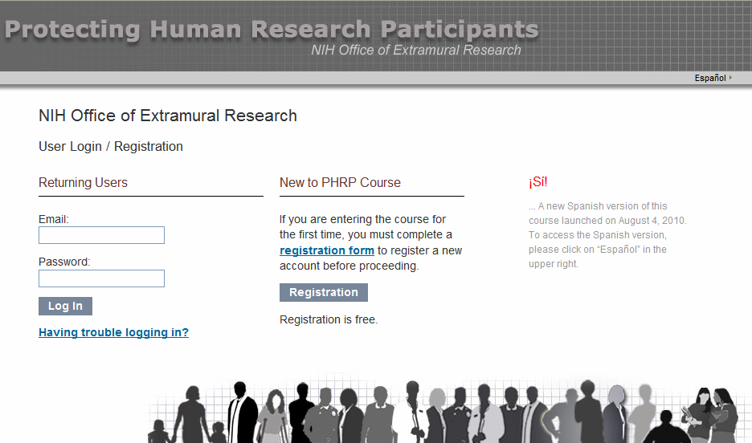
National Institute of Health (NIH) Mandatory Training!

Slide 13
National Institute of Health (NIH) Training!
US federal government requires us to provide training and education in the protection of human participants in research. All investigators and research personnel involved with human participants should be trained.
Free and takes about three hours online.
A copy of the training certification must be included in any submission.

Slide 14
Practice Version of HSC Submittal
Students must work with their faculty sponsor in learning how to use this transmittal form by using the practice version
PRACTICE Online Human Subjects Transmittal Form
When a student researcher completes this form and clicks on the submit button, a copy is sent electronically to the student and to his/her faculty sponsor.
The faculty sponsor then coaches the student as needed and ensures all necessary attachments are provided. The student researcher then submits online using the "real“ online transmittal form.
http://www.cs.oswego.edu/~dab/IRB/PracticeHSTForm.html
Notes:
You should open the HSC website prior to the presentation, and refer to it as needed.

Slide 15
Human Subjects Transmittal Form
YES | NO
 |  | 1. The attached application involves scientific investigation using human subjects and I have completed the mandatory training within the past two years
 |  | 2. The attached application uses human subjects below the age of 18. If yes, this must be discussed in the protocol and parental informed consent or consent of the subject’s legally authorized representative must be obtained in addition to the informed consent of the minor.
 |  | 3. The attached application involves experimental biomedical procedures, or use of drugs or toxic substances.
 |  | 4. The attached application involves the administration of questionnaires, inventories or personality tests.
 |  | 5. It is affirmed that the investigation will adhere to the policies and Procedures of the State University of New York for the study of human subjects.
 |  | 6. Additions to or changes in procedures involving human subjects that occur after review of the application will be brought to the attention of the review committee as will anticipated problems involving risks to subjects or others.

Slide 16
Human Subjects Transmittal Form
A. Brief description of the research (e.g., purpose, hypotheses). 125 words maximum
B. A description of the benefits of the research to the human subjects, if any, and of the benefits to human or scientific knowledge. 125 words maximum
C. Description of subjects, indicating especially whether any are minors or otherwise members of vulnerable populations (e.g., subjects under the age of 18, pregnant females, prisoners). 150 words maximum

Slide 17
Human Subjects Transmittal Form
D. Description of how the subjects will be used (e.g., how they are selected, what they will do - such as complete questionnaires or participate in a simulated task). 90 words
E. Description of the risks and discomforts, if any, to subjects. 75 words
F. Does the proposed research involve deception, e.g., through provision of misinformation, withholding information, etc.? 90 words.
If it does involve deception, explain why and how/when you will debrief your subjects.

Slide 18
Human Subjects Transmittal Form
G. Upload your NIH Certificate, the Informed Consent Form, followed by any surveys, questionnaires or other material that involves the subject. Please upload only Word, .rtf, or .pdf files. This includes a consent form! Before submitting this form, please review your entries to ensure that you have:
 entered your name and official Oswego email address
 entered your faculty sponsor's name
 correctly chosen yes/no for the six submission questions
 entered text into each of the boxes A through F
 uploaded a copy of your NIH certificate
 uploaded the subject's Informed Consent form
 uploaded an Informed Consent form for parents if the subject is a child or a member of a vulnerable population!
 uploaded any surveys or other instruments the subjects
will complete

Slide 19
Brief Description of Research and Subject’s Involvement
Confidentiality
Informed Consent Form
Voluntary
Withdraw without Penalty
Contact Information: researcher, faculty sponsor & HSC Chair
Signatures:
Researcher & Subject

