Slide 1
Welcome Electronic Time and Attendance – Training Module
FOR ALL EMPLOYEES AND SUPERVISORS INCLUDED WITHIN:
MANAGEMENT CONFIDENTIAL
UUP PROFESSIONALS (NON-HOURLY)
12-MONTH FACULTY
Human Resources – Revised March 21, 2012

Slide 2
Module Instructions
WHAT YOU’LL NEED TO GET STARTED
Your Laker ID user name and password, and
Your current time record.
IF YOU ARE UNSURE OF YOUR USER ID AND/OR PASSWORD
Contact the HELP DESK at X-3456 for assistance.
TRAINING INSTRUCTIONS
Please read through this brief, on-line training module before signing-in to the SUNY system.
Once complete, CONGRATULATONS! You are officially LIVE and will no longer need to submit hardcopy time records from this point forward.

Slide 3
Electronic Time and Attendance
Overview of the Monthly Process
for All Employees and Supervisors
MANAGEMENT CONFIDENTIAL
UUP PROFESSIONALS (NON-HOURLY)
12-MONTH FACULTY

Slide 4
Overview of the Monthly Process - All Employees
Credit Your Holidays
Give yourself credits for Holidays first.(Depending on contract affiliation and individual work schedule.)
THEN SAVE
Record Time Off Work
Any time you did not report to work should be reflected on the Calendar view in quarter day increments (.25, .50, .75 OR 1)
THEN SAVE
Certify and Submit
Certify (Your Electronic Signature)
Submit to Supervisor
Log-off AND Close Browser

Slide 5
Electronic Time and Attendance
ALL EMPLOYEES
STEP-BY-STEP

Slide 6
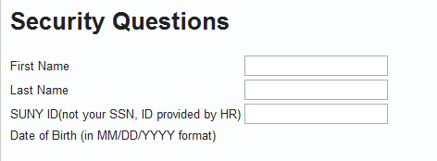
Access to SUNY HR will be found at: http://www.suny.edu/time
Suggested Bookmark
First, you will encounter a
Sign-on Screen
Next, you will come to a
One-time Security Screen
For security reasons your sign-in will be different the first time you enter the Time and Attendance System - use the SUNY ID provided by HR/ Payroll for the third question.
PODS User ID and PW

Slide 7
To Enter, Click on the “Time and Attendance” Tab
Your pay stub can be viewed through the “View Paycheck” feature as of the Monday preceding pay day.
In addition, a two-year payroll history has been loaded for your information.
Bonus Feature

Slide 8
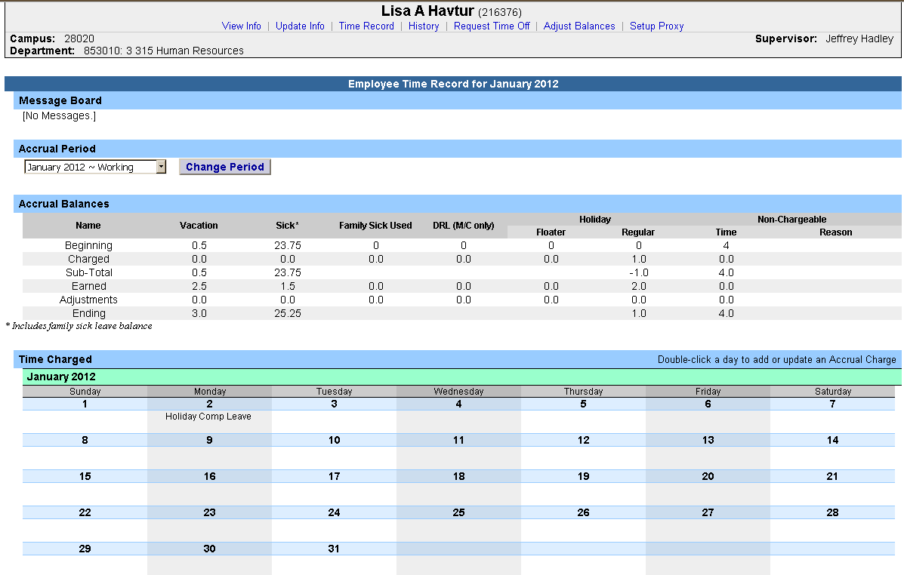
Next, Select Month(Accrual Period)
Current Month (or Accrual Period) Comes Up Automatically
The status of any given month is reflected here in the above drop-down:
Working: Open for you to make entries
Pending: Submitted to your supervisor
Approved: Reflected once Supervisor has signed-off

Slide 9
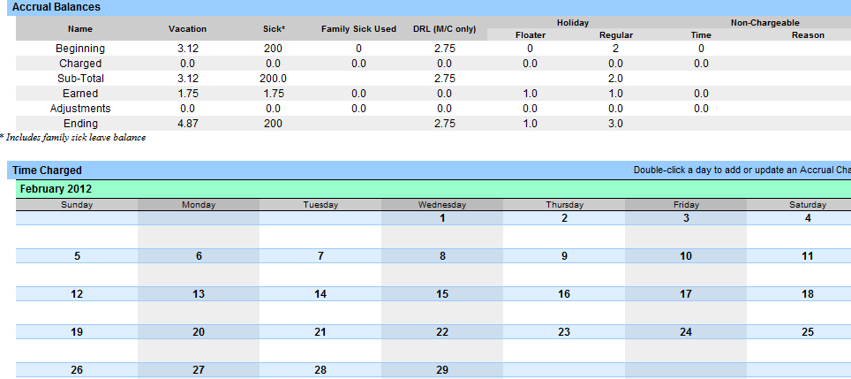
A Few Notes About Accrual Balances
30 days contractual
Family Sick Leave
Tracked Here, Deducted from Sick. Family Sick charges relate to the medical care of a direct family member.
Floater PLUS Regular
EQUALS
Your Holiday Total
Non-Chargeable Time ( Such as conferences, jury duty, off-site meetings, etc.)
Tracked Here, Not Deducted

Slide 10
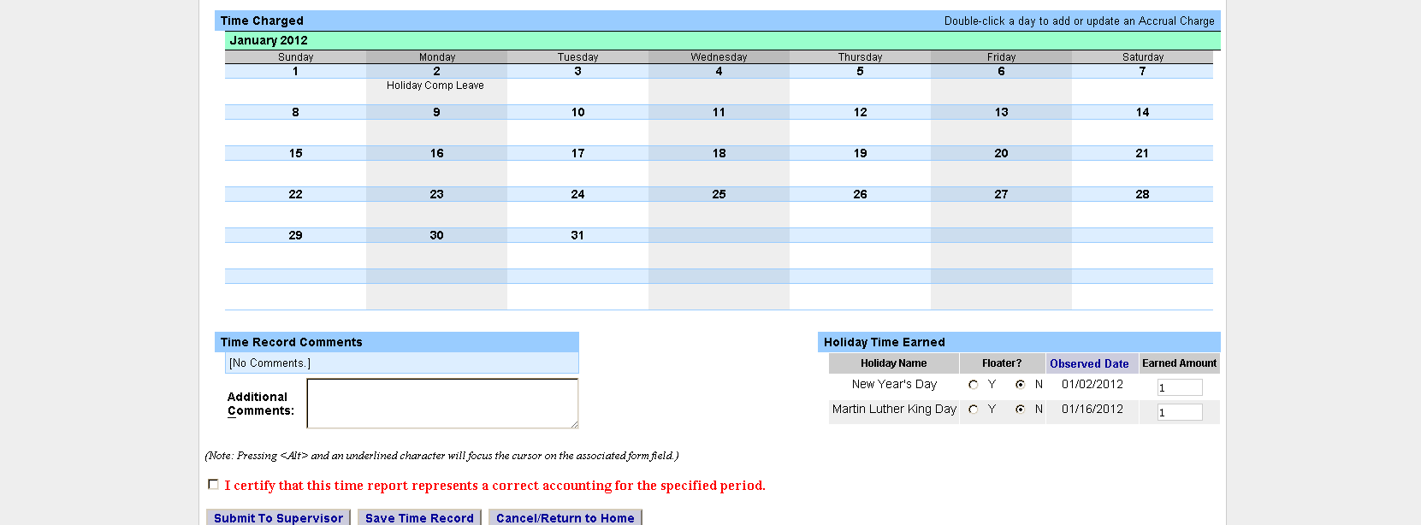
Enter Holiday Credits First – Every Month, Every Time. THEN SAVE!
The system does not automatically enter Holiday credits, please enter them and then ‘SAVE.”
(As a rule: Full-time enters“1”, Part-time is dependent on work schedule and/or percentage of time worked.)
1) Enter Credit Due For Each Eligible Holiday.
2) Then Save

Slide 11
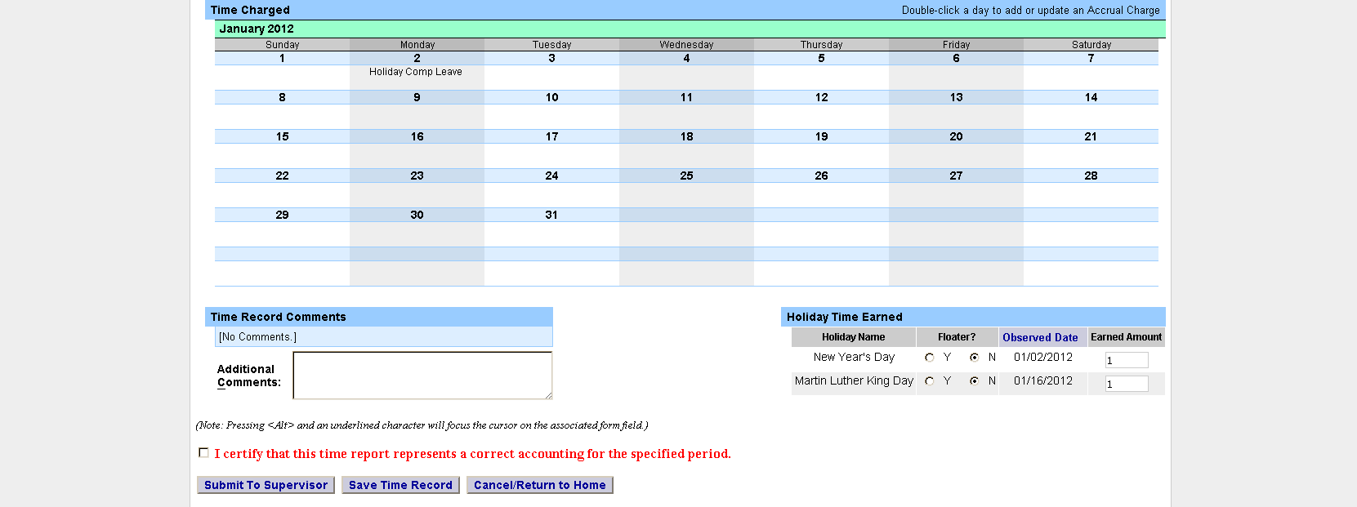
Enter Charges for Vacation, Sick, or Other. THEN SAVE!
1) Enter Charges for Time Used
Any time away from work, when you are scheduled to be working, should be reflected on the monthly calendar view.
Quarter-day increments ONLY may be used:
.25
.50
.75
2 )Then Save

Slide 12
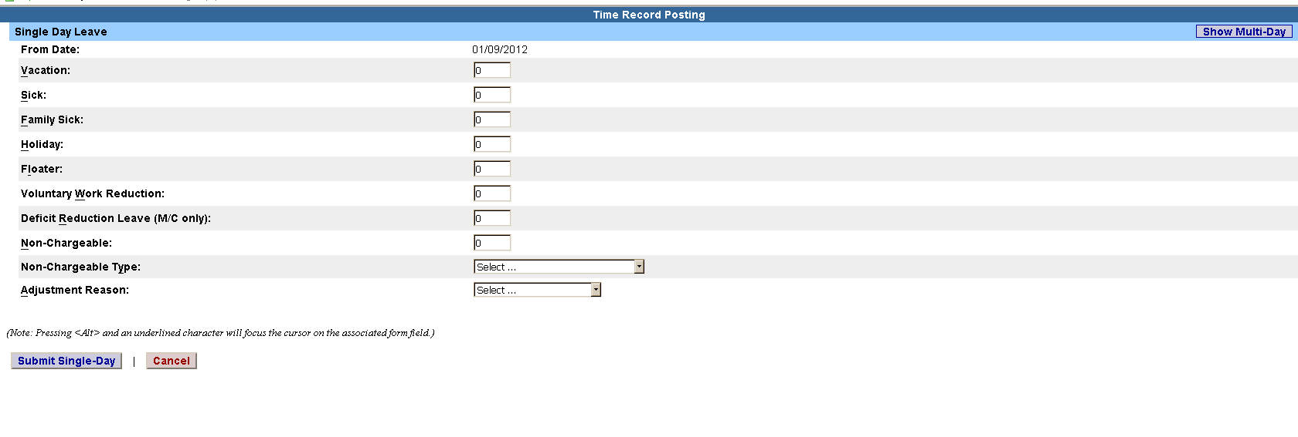
A) View of Sub-Menu Produced by Clicking on Individual Calendar Dates – Single-Day Entries
SINGLE DAY
View
Click Here to Change to MULTI-DAY View
Single Day Entry: Best used for absences of 1 day or less (.25, .50, or .75)
Multi-Day Entry: Best used for absences of two or more days, for the same reason code and within the same month.

Slide 13
B) View of Sub-Menu Produced by Clicking on Individual Calendar Dates – Multiple Day Entries, Same Reason Code
MULTI-DAY
View
Click Here to change to SINGLE DAY View
Single Day Entry: Best used for absences of 1 day or less (.25, .50, or .75)
Multi-Day Entry: Best used for absences of two or more days, for the same reason code and within the same month.

Slide 14
About “TIME RECORD COMMENTS”
Part Timers: Use this box to indicate your set schedule. (Mandatory for calculation of holidays earned.)
All Employees: Use this box to indicate any items you’d like noted on your record for your supervisor or for audit purposes. (Examples might be Advocacy Day, Conferences, Dental Appointments, etc.)
Example of PT monthly entry:
90% M-F

Slide 15
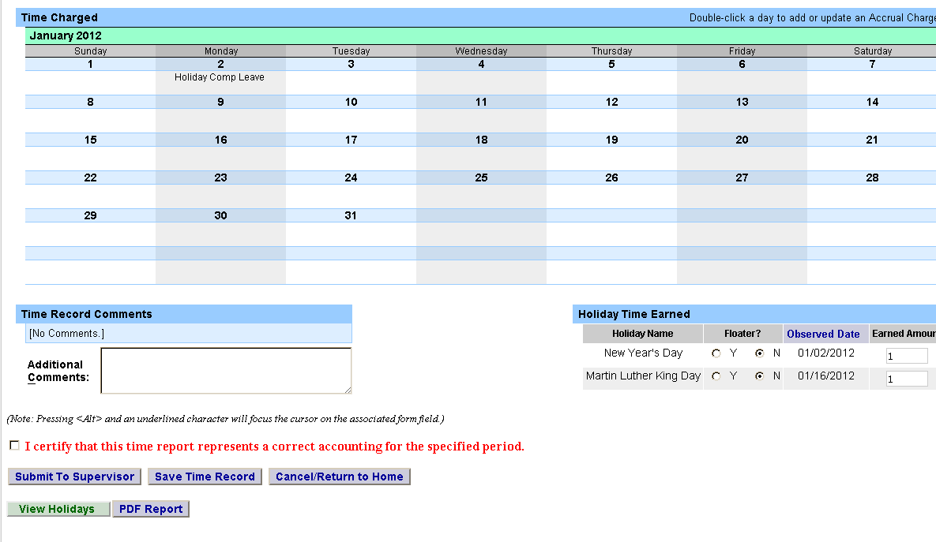
LAST STEPS: Review Entries for Accuracy, Certify (Sign), and lastly, Submit to Supervisor.
1) Review Your Entries for Accuracy
2) Certify
NOTE: THE SYSTEM WILL NOT ALLOW SUBMISSION OF A MONTH UNTIL YOUR SUPERVISOR HAS APPROVED THE PREVIOUS MONTH.
3) Submit

Slide 16
Sign out of the SUNY browser AND close.
CURRENT USER STAYS LOGGED-IN FOR UP TO 20 MINUTES. To ensure your privacy and system security, in addition to “Logging Off,” you will also need to “X” out of the SUNY browser. (You can do this by clicking on the box in the upper right hand corner of your screen).
Step 2:
Close Browser
Step1:
Log-Off

Slide 17
OPTIONAL FEATURES AND NOTES

Slide 18
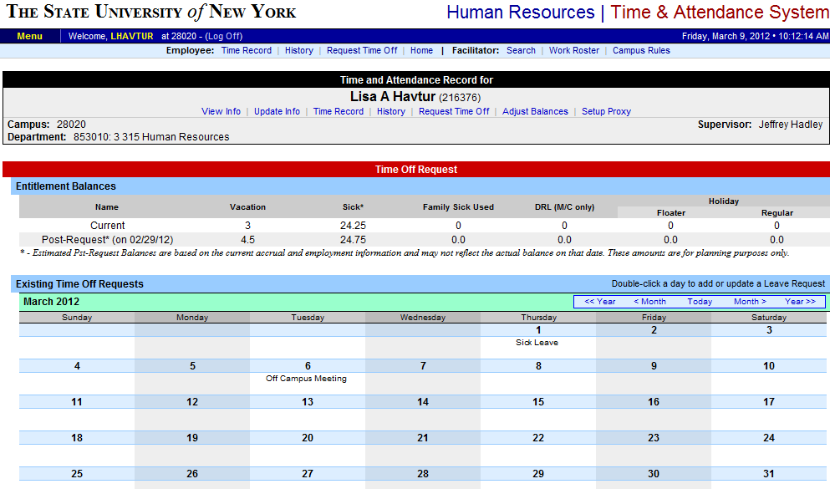
SUPERVISOR’S OPTION: Electronically Requesting Time Off
REQUEST TIME OFF
Selection
Click on TIME RECORD to return to the MAIN SCREEN
This feature is to be used or not, at the discretion of individual supervisors.

Slide 19
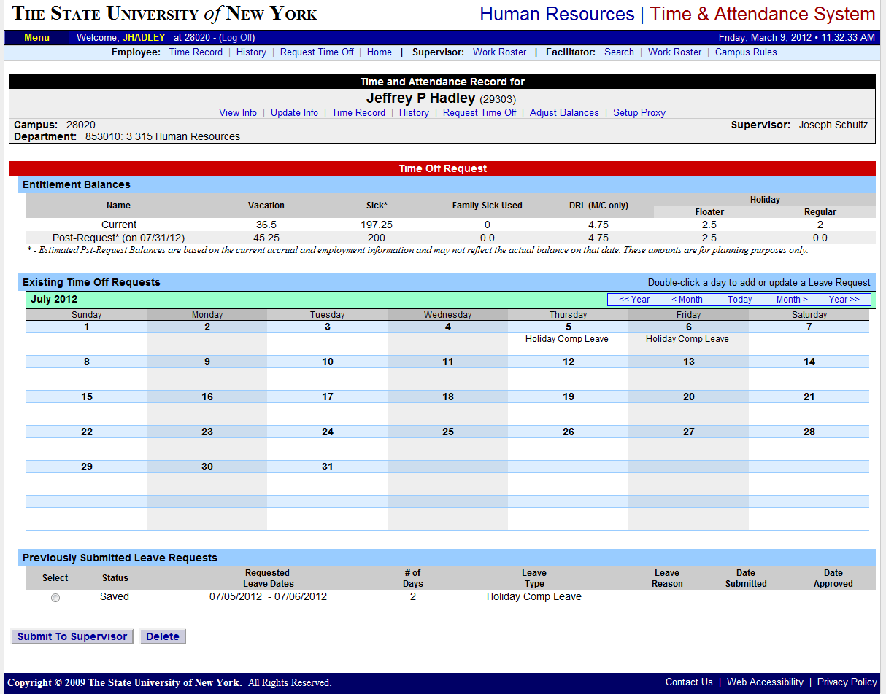
When using this Optional Feature, Remember to “SUBMIT” Your Request
Once an employee has submitted a request to their supervisor, it will reflect on their calendar with a “P” for pending.
Once the supervisor has approved the request, it automatically populates on the employee’s screen without the “P,” without the need to re-enter the time.
Changes, additions, deletions can be made at any point, this isn’t a “contract.”
Be aware that unresolved requests can prevent your successful monthly-time record submittal.
Remember to “SUBMIT” your request

Slide 20
ABOUT FLOATERS
NEW WAY OF THINKING: “Y” and “N” indicators ARE NOT ASKING IF YOU DID OR DID NOT WORK and no action is required on your part, other than entering your earned Holiday credits.
Be sure to enter “Earned Amount” and SAVE
No Action Needed for Floaters “Y” or “N”

Slide 21
ABOUT E-MAIL NOTIFICATIONS
Time record submission is now officially a MONTHLY process.
System-generated e-mail reminders will be available once the majority of our campus is trained and transitioned – right now that feature is turned off.
E-mail reminders are currently being sent manually.

Slide 22
ABOUT LEAVE DONATIONS
FOR THOSE DONATING VACATION DAYS:
Your generous Leave Donations will continue to be administrated through Human Resources, following the current process.
Upon receipt of your Leave Donation Form, a member of the TAS Team will make the necessary electronic transactions.

Slide 23
Electronic Time and Attendance
Supervisors
IF YOU DO NOT A SUPERVISE AN MC, NON-HOURLY UUP, OR 12-MONTH FACULTY MEMBER, YOU MAY CONTINUE DIRECTLY TO SLIDE #31.

Slide 24
Overview of the Monthly Process - SUPERVISORS
View Work Roster
View Time Information of your Direct Reports using the “Work Roster”
Review and Approve
Review Employee’s Time Record - then select “Approve,” “Deny,” or even “Ignore”
Submit
Submit, Log-off, and Close Browser

Slide 25
Supervisors
Step-by-Step

Slide 26
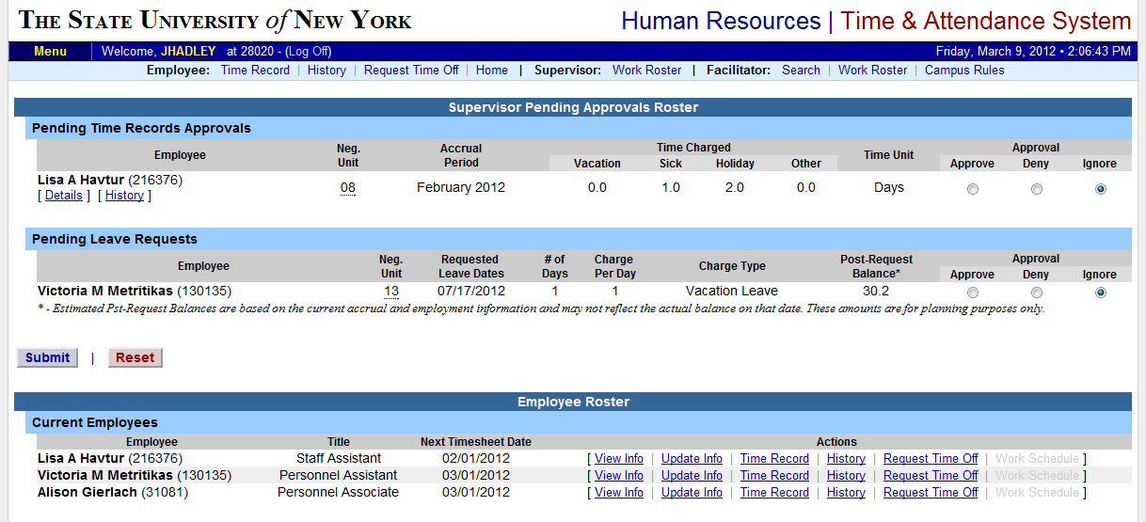
Supervisors will have a “Work Roster” selection to view and approve the electronic record status of direct reports.
Enter Here
SUBMIT when COMPLETE
Employee List – Contact HR for any corrections.
For PENDING TIME APPROVALS OR LEAVE REQUESTS – Supervisors should select an action: APPROVE, DENY, OR IGNORE. THEN SUBMIT.

Slide 27
Your Turn!
BEFORE YOU SIGN-IN AND BEGIN ENTERING, IT WILL BE HELPFUL TO HAVE:
YOUR SUNY ID, AS PROVIDED BY HUMAN RESOURCES
This is for use on the one-time security screen and is not a number you will need to remember or use again for this purpose.
YOUR LAKER ID and PASSWORD
LAKER USER ID is generally the same as your e-mail account name
LAKER ID PASSWORD is generally the same as your email sign-in password
IF YOU ARE UNSURE OF YOUR LAKER USER ID AND/OR PASSWORD, YOU MAY:
Contact the HELP DESK at X- 3456 for assistance.
WHEN YOU ARE READY TO BEGIN, RETURN TO SLIDE #6 AND WORK FORWARD. Congratulations on your transition to the paperless environment!

Slide 28
Contact Information
HR Time and Attendance Implementation Team:
John Trombly | John.Trombly@Oswego.edu | X - 2227
Maura Caughey | Maura.Caughey@Oswego.edu | X - 3641
Marta Santiago | Marta.Santiago@Oswego.edu | X - 3702

Slide 29
Thank You!
Your support of this worthwhile campus initiative is appreciated.
Please contact any member of the HR Time and Attendance implementation team if we can be of further assistance.

