Slide 1
Safety Training
For SUNY Oswego Summer Staff

Slide 2
Agenda
Hazard Communication
(Material) Safety Data Sheets
Asbestos
Personal Protective Equipment
Fire Safety
Heat Stress
Confined Space
Lockout/ Tag Out
Fall Protection/Ladders/Scaffolds
Slips, Trips, Falls
Bloodbourne Pathogens
General & Questions
https://www.osha.gov/dep/fatcat/fy15_federal-state_summaries.pdf

Slide 3
Facility Services Org Chart
AVP
EHS
MP
M&O

Slide 4
Facility Services Safety

Slide 5
FS Reporting Safety Concerns
AVP
EHS
MP
M&O
Notes:
Chain of Command
Check with Supervisor
Check with Their Supervisor
Director – Mary then me, then Mitch,
Then OSHA (PESH)

Slide 6
Format for Safety Topics
Regulatory Overview
What you need to know

Slide 7
Hazard Communication Regulations
“Employees have both a need and a right to know the hazards they are exposed to when working”
Components of HAZCOM – OSHA 29CFR 1910.1200
Written program - https://www.oswego.edu/facilities-services/programs-and-policies
Labeling of Chemical Substances
Chemical Inventory
Safety Data Sheets
Hazard Identification
Employee information and training

Slide 8
Hazard Communication What you need to Know
SOME EXAMPLES OF HAZARDS ARE:
Corrosive (Acid/Base) – Irritates or burns skin or eyes
Toxic – May cause illness or death
Flammable - Readily catches on fire
Reactive – May react dangerously when mixed with incompatible substances
Compressed gas –Extreme pressure may be released
Carcinogen – May cause cancer

Slide 9
Hazard Communication What you need to Know
Routes of entry
Ingestion, Inhalation, Absorption, and Injection
All containers must be labeled
Health Hazards – acute vs. chronic
Safety Data Sheets
New GHS system has 16 sections
https://www.oswego.edu/facilities-services/environmental-health-and-safety

Slide 10
Any Questions Understanding SDS?

Slide 11
Asbestos
Regulated by:
OSHA – 29 CFR part 1910.1001
EPA – 40 CFR part 763
DOT – 49 CFR part 173
DEC – 6 NYCRR part 364
DOH – 10 NYCRR part 73
DOL – 12 NYCRR part 56

Slide 12
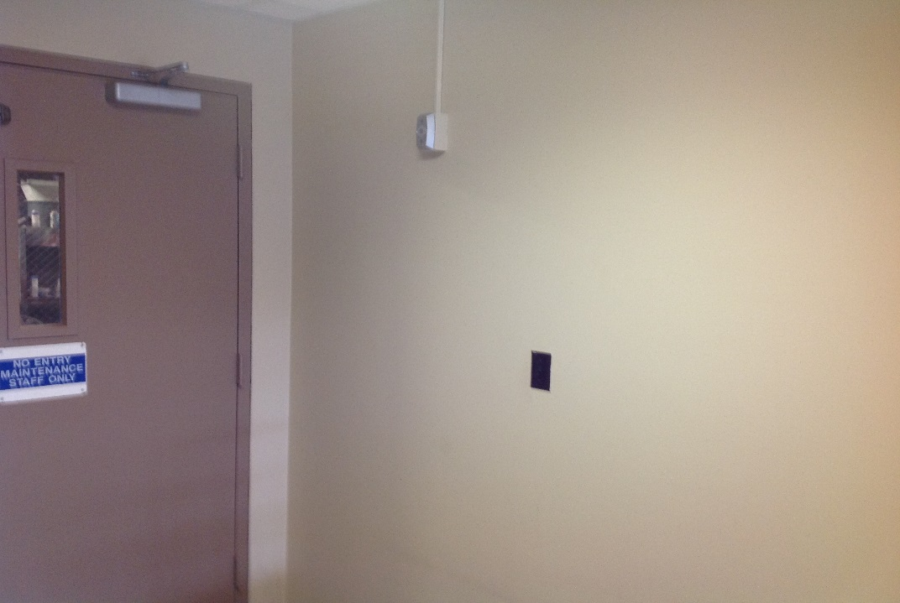
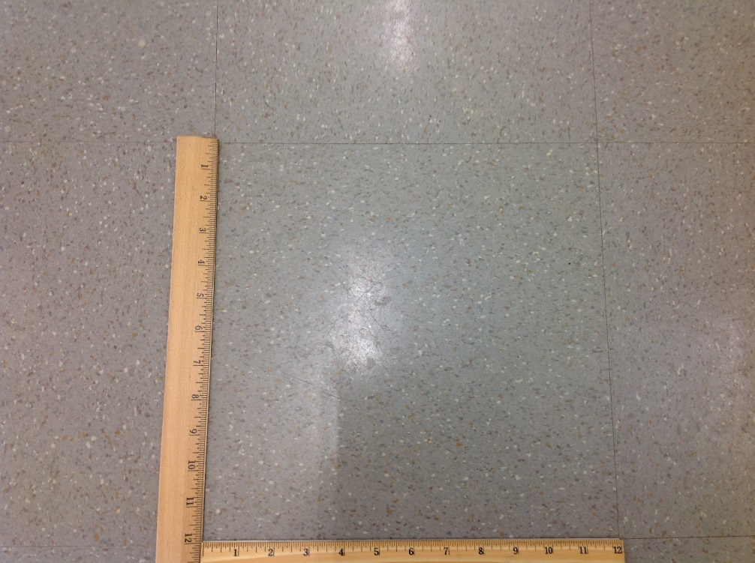
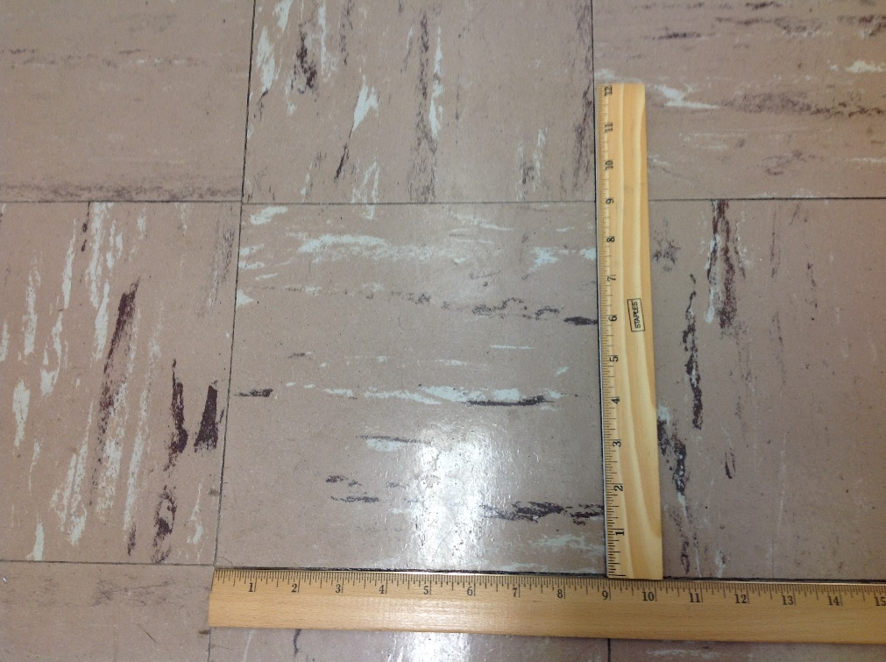
Which of these is Asbestos?

Slide 13
Asbestos The Good, The Bad, The Ugly, The Good
Strong, durable mineral resistant to fire and chemicals
Like many facilities built in the late 60’s early 70’s, present in some older buildings on campus
Long term exposure can cause asbestosis, lung cancer, mesothelioma
Latency period is 15-40 years
We have a management plan

Slide 14
Asbestos
Regulated in materials > 1% asbestos
Can only be confirmed in a certified laboratory
Asbestos fiber 100 times smaller than the diameter of a human hair
Can be suspended in the air for up to 3 days
If the material is in good condition e.g. sealed, painted, it is not a risk to your health.
Two forms:
Friable – easily pulverize in you hand (insulation)
Non-Friable – unable to pulverize in your hand (floor tile)

Slide 15
KNOW YOUR SUSPECT MATERIALS
Floor Tiles
Joint Compounds
Ceiling Tiles
Caulk
Spray-on Insulation
Wall and Ceiling Plaster
Mastic (glue)
Roofing materials
Wall and Ceiling Textures
Pipe Insulation

Slide 16
Joint Compound

Slide 17
Spray-on Fireproofing

Slide 18
Signage

Slide 19
Custodial Cleaning Activities Floors
Allowed
Wet scraping wax removal
Wet stripping/buffing
Waxing
NOT Allowed
Dry buffing
Sanding, cutting, grinding
Removal of loose tiles (STOP: Contact Supervisor)

Slide 20
Custodial Cleaning Activities Textured Ceilings
Allowed
Light wet wash
Item removal if paint does not lift
Routine lamp maintenance
Smoke alarms (Maint. team only)
NOT Allowed
Scraping loose material (STOP: Contact Supervisor)
* If you see material that may have come from the ceiling, let your supervisor know.

Slide 21
Custodial Cleaning Activities Walls
Allowed
Washing painted surfaces
Light wet scraping
Adhesive hook removal (STOP if paint lifts, Contact Supervisor)
NOT Allowed
Digging into substrate, gouging, sanding

Slide 22
Asbestos Exposure – by the Numbers
OSHA Permissible Exposure Limit – 0.1 f/cc
Breathing Rate – 10 L air/min (8 L at rest 60 L during a run)
X 60 min = 600 L/hour
X 8hr shift = 4800 L/day
Convert to cubic centimeters X 1000 = 4,800,000 cc/day
X OSHA PEL of 0.1f/cc = 480,000 f/day

Slide 23
Any Questions on Asbestos?

Slide 24
Personal Protection Equipment
OSHA – 29 CFR 1910, 1915, 1926
Eyes/ face
Head
Foot
Hand
Hearing
Respiratory

Slide 25
Basic PPE
Office
Business casual
Grounds
Sturdy leather work boots/shoes & long pants
Custodial
Closed-toed shoes. No tank tops.
Head phones – At the discretion of the supervisor.

Slide 26
Noise in Your Work Environment
OSHA Designated Exposure Limits
85 dBA - Action Level for HCP
90 dBA - Permissible 8-hr. TWA
Two-Foot Rule (Arms Length)
Wear Hearing Protection when doing loud tasks – ask your supervisor where to get some earplugs

Slide 27
Grounds – Hazard Analysis for Trimmer (Weed-Eater)
Eyes (glasses)
Ears (plugs)
Feet (work shoes)
Legs (long pants)
Head (hard hat)
Vibration (gloves/ alternate hands)
Heat exhaustion (fluids)
Sun (sun screen)
Traffic (vest)
Bees/Ticks (repellent)
Poison Ivy (clothing)
Pollen (dust mask)
Lightening

Slide 28
Custodial – Hazard Analysis for Cleaning
Eyes (splash goggles)
Hands (gloves)
Nitrile for chemicals
Canvas or leather for general purpose
Heat Exhaustion (fluids)
Not PPE, but ensure lifting with legs, not back

Slide 29
Fire Safety
Annual testing of Fire Alarms, Detectors, Sprinklers
Do you still need to evacuate if there is a Drill?
YES!

Slide 30
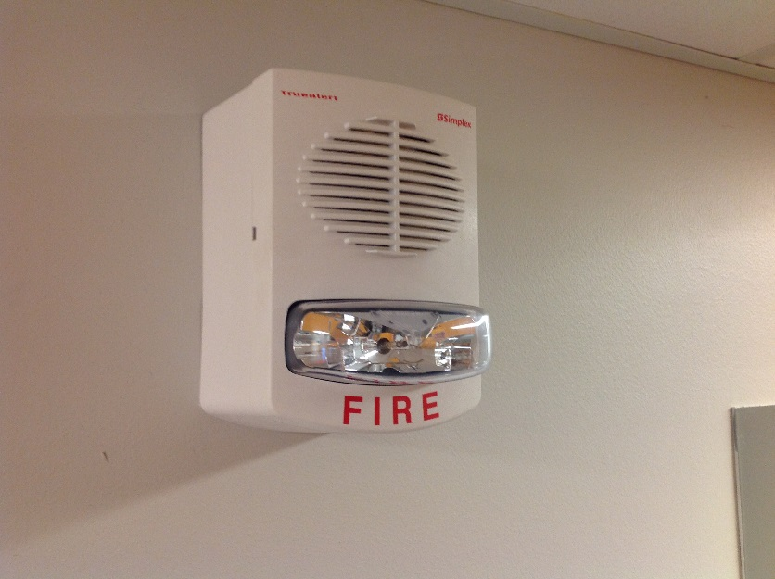
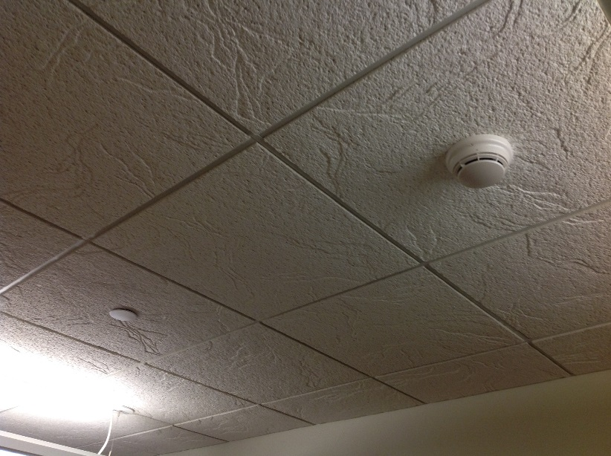
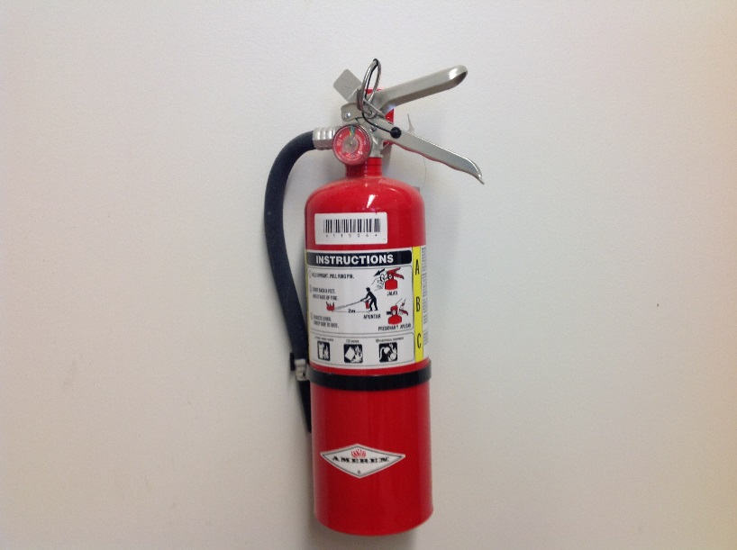
Fire – Basic Systems

Slide 31
Fire Emergency Response
Rescue – rescue other in immediate danger
Alert – Shout Fire! Or Pull fire alarm and Dial Emergency Phone number
312-5555 from a cell or 911 from a campus phone
Contain – Close all doors
Evacuate – not Extinguish. Get out!

Slide 32
Fire – Blocked Exit

Slide 33
Heat Stress
Exposure to heat can cause illness an death.
Risks
High temps, low breeze, direct sun
Heavy physical labor
Low water intake
Recent alcohol or caffeine consumption

Slide 34
Heat Exhaustion Symptoms
Headaches, dizziness, fainting
Weakness, cramps
Thirst, nausea, or vomiting

Slide 35
Heat Stroke Symptoms
Confused, unable to think clearly, pass out, collapse, or seizures
May Stop Sweating – Emergency!

Slide 36
Heat Stress Protection
Know symptoms; monitor yourself and others
Drink plenty of fluids before you are thirsty. Heat Index >100º F, have a pint of water per hour.
Minimize direct sun
Avoid beverages containing alcohol or caffeine
Wear lightweight, light colored, loose-fitting clothing

Slide 37
Confined Space
OSHA 29CFR 1910.146
Area not designed for continuous occupancy
Limited egress
Dangerous atmosphere
Extraction plan and Attendant
Examples:
Crawl spaces
Manholes
Ductwork

Slide 38
Confined Space
Summer Students: Do not Enter !!

Slide 39
Excavating/Trenching
OSHA 29CFR 1926.651
Excavations >4’ require:
Competent Person
Trench box or sloping
Means of Egress

Slide 40
Excavation/Trenching
Summer Students: Do not Enter or go near trench!

Slide 41
Lockout/ Tagout
OSHA 29CFR 1910.147
Control of Hazardous Energy
Electrical, mechanical, thermal, hydraulic, gravity
Isolates the energy during service

Slide 42
Lockout/ Tagout
NEVER Remove!
Find a tag on floor, report it!

Slide 43
Fall Protection
OSHA 29CFR 1926
Scaffolds
Extension Ladders
Step Ladders
Slips, Trips, Falls

Slide 44
Scaffolds
Summer Students not allowed on scaffolding without additional training.
Coordinate with supervisor if necessary.

Slide 45
Ladder Basics
Ladders must be inspected before each use.
Face the ladder when ascending or descending.
While climbing, maintain three points of contact at all times.
Keep your body centered on the ladder.
Never let your belt buckle pass either side rail.
Avoid setting ladders up in high traffic areas or barricade the area around ladder.
Do NOT use metal or aluminum ladders near exposed energized electrical equipment.

Slide 46
Extension Ladders
Inspect for good condition
Ensure placement has good footing
4:1 Ratio
Falls — 349 out of 874 total deaths in construction in CY 2015 (39.9%)

Slide 47
Step Ladders
Only use in the fully open position on firm level ground.
Do not use a stepladder that is folded or in a leaning position.
Never sit/stand on the top two rungs.
Consider work height when selecting a stepladder
Falls — 349 out of 874 total deaths in construction in CY 2015 (39.9%)

Slide 48
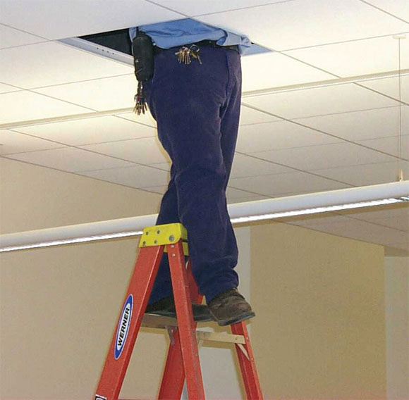
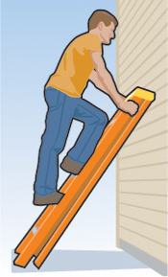
Step Ladders

Slide 49
Slips, Trips, Falls
Eliminate Hazards – If you see something, correct it or talk to your supervisor
Common Sense
Warn others
Don’t climb on shelving or chairs

Slide 50
Slips
Weather conditions and cleaning may cause floors to be wet.
Clean up spills immediately
Use signage and caution tape

Slide 51
Trips
Eliminate clutter, cords
Be aware of uneven surfaces

Slide 52
Bloodbourne Pathogens
OSHA 29CFR 1910.1030
Pathogens are infectious microorganisms in human blood that can cause disease – Hepatitis B, Hepatitis C, and HIV
Regulation developed mainly for healthcare personnel and first responders

Slide 53
Bloodbourne Pathogens
Training provided to full time Custodial and Plumbing staff, NOT Summer Students
Program requires a series of shots and medical documentation
Summer Student Custodial staff will still be able to clean bathrooms but are prohibited from cleaning up visible blood. Contact supervisor if you encounter visible blood.
Do not treat someone who is bleeding

Slide 54
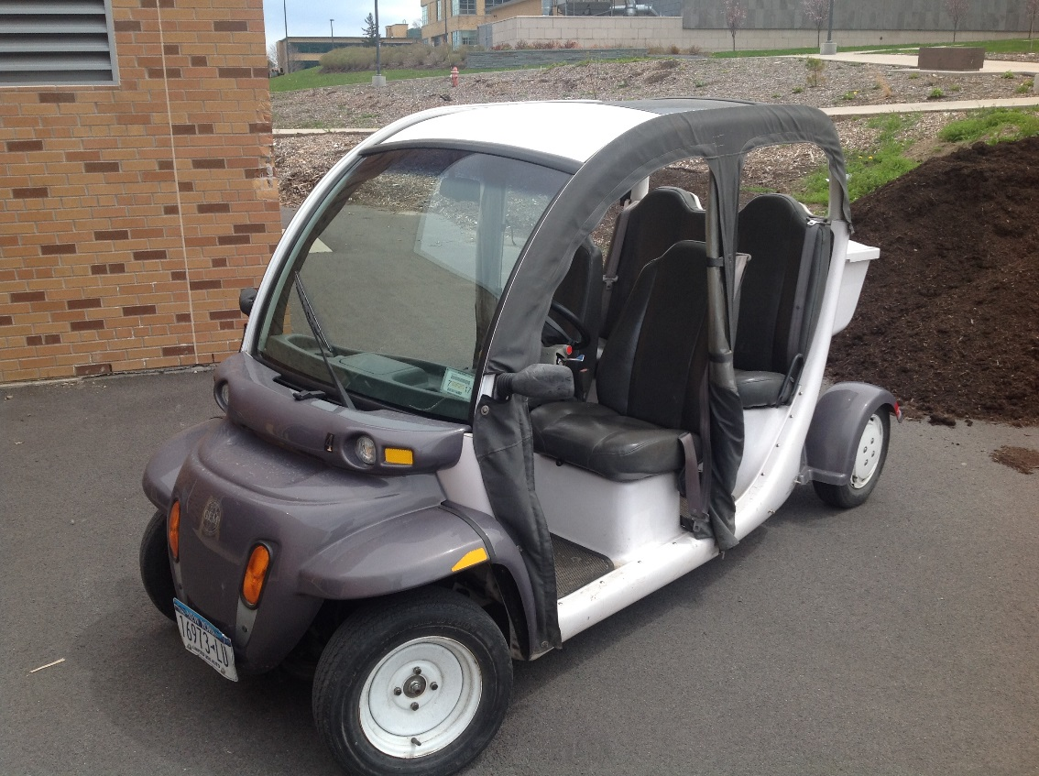
Vehicles – Seat Belts

Slide 56
Facility Services Safety It begins with YOU!

Slide 57
Questions
EHS – 110 Lee Hall x 3157

