Slide 1
WELCOME TO FACILITIES SERVICES
Notes:
Mitch Fields

Slide 2
WHO’s WHO in FACILITIES SERVICES
Associate Vice President of Facilities Services
Mitch Fields
Director of Major Projects
Allen Bradberry
Director of Maintenance & Operations
Mary DePentu
Director of Environmental Health & Safety
Eric Foertch
Notes:
Mitch Fields

Slide 3
GUESTS
John Trombly
Becky Nardzadi
Eric Foertch
Notes:
Mitch Fields

Slide 4
PAYROLL
John Trombly
Timesheets
I-9 Forms
Tax Forms
Notes:
Mitch Fields Introduces
John Trombly Presents

Slide 5
I-9 Form (Proof of Citizenship)

Slide 9
W-4 Form (Tax Withholding)

Slide 11
IT-2104 (Tax Withholding)

Slide 13
Student Payroll Calendar

Slide 15
Direct Deposit Form

Slide 17
Retirement System Option

Slide 19
Temporary Service Time Sheet

Slide 21
TITLE IX
Becky Nadzadi
Title IX
Violence Against Women Act
Reporting an Incident
Notes:
Mitch Fields Introduces
Lisa Evaneski Presents

Slide 23
RIGHT TO KNOW
Christine Body
HazCom
Right to Know
Ladder Safety
Notes:
Mitch Fields Introduces
Christine Body Presents

Slide 24
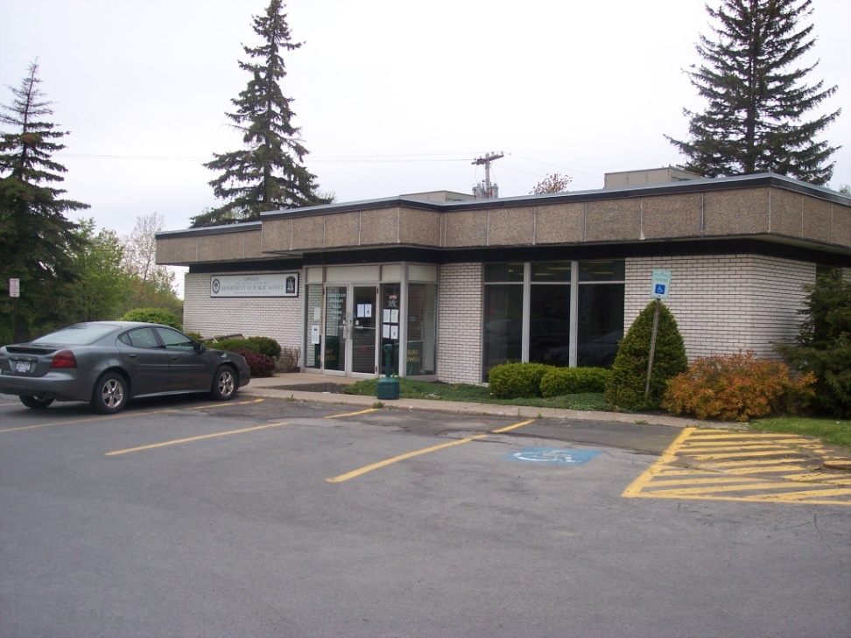
PARKING
Hours 7:30am – 4:00pm
Monday-Friday
Parking permits must be obtained by end of first week of employment
There is NO FEE for student employees unless taking classes
Parking tickets are $20.00 per violation so get your free permit
Notes:
Mary Depentu

Slide 25
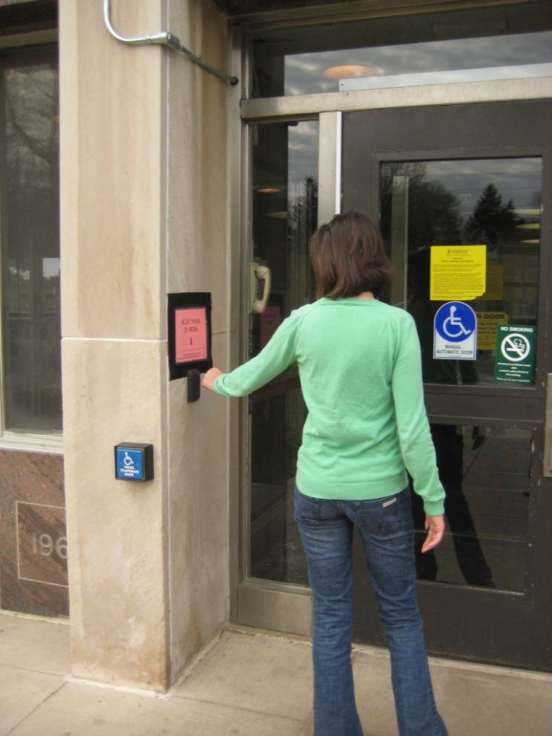
CARD ACCESS
All student employees are required to carry their fob to gain access to Residence Halls.
$25.00 fee for all fobs lost or not turned in
ID required
Notes:
Mary Depentu

Slide 26
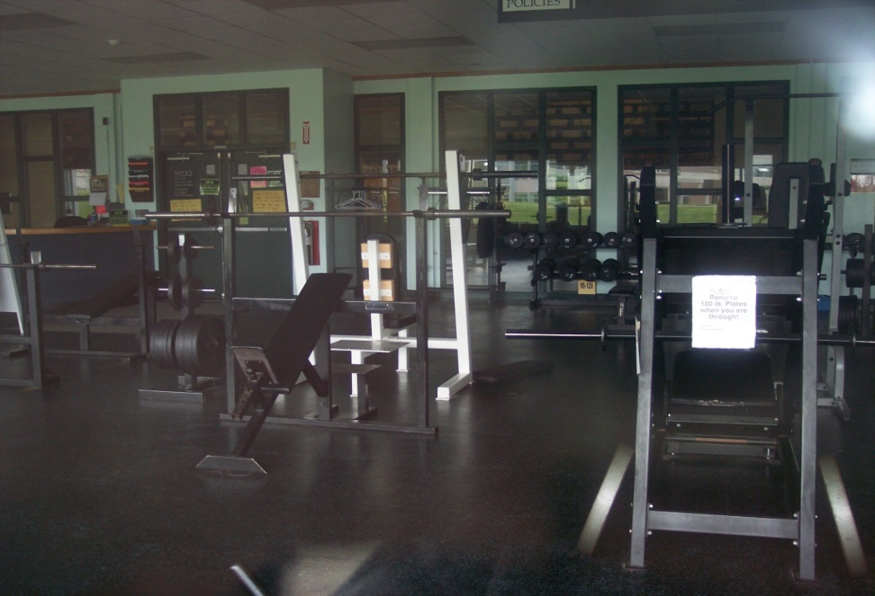
FITNESS CENTER MEMBERSHIP
Student employees can get a summer fitness membership:
SUNY Oswego
Students - $50.00
Non-SUNY Oswego /Off-campus Students -$55.00
Memberships can be obtained at Res Life & Housing Office in 303 Culkin Hall
Notes:
Mary Depentu

Slide 27
WAGE RATES
All students, no matter how many years they have worked for Facilities Services, will be paid $9.75 per hour, up to 29 hours per payroll week.
Payroll weeks run from Thursdays to Wednesdays.
Notes:
Mary Depentu

Slide 28
STUDENT BEHAVORIAL STANDARDS
Follow all safety rules and guidelines. Immediately report any injuries or unsafe conditions to your supervisor.
Wear appropriate clothing at all times. Always be prepared by having sturdy leather work boots/shoes, long pants, long sleeve shirt, and jacket/sweatshirt in your locker or car. Workers may be asked to perform varying job duties as priorities dictate. (**open toed shoes and tank tops are not considered appropriate clothing).
Act in a mature, respectful, and responsible manner. Insubordination, being under the influence of drugs and/or alcohol, inappropriate language, stealing, sleeping, fighting, or any other inappropriate behavior is not acceptable.
Personal cell phones usage is permitted during break and lunch times only.
Notes:
Mitch Fields

Slide 29
STANDARDS CONTINUED…
Report to work on time and be prepared to begin work at the established start time.
Remain on the job until end of shift unless prior authorization from supervision has been obtained.
Workers are allotted a maximum of 29 hours without pay during summer employment. All time off must be taken in half day increments. Time off requests must be submitted, in writing, to your supervisor no less than 2 days prior to the date being requested off, unless extenuating circumstances.
Excessive absence without prior written approval of supervisor is not acceptable.
If you cannot come to work call the appropriate number within ½ hour of scheduled shift. If no one answers leave a message. You can obtain the phone number from your supervisor.
Notes:
Mitch Fields

Slide 30
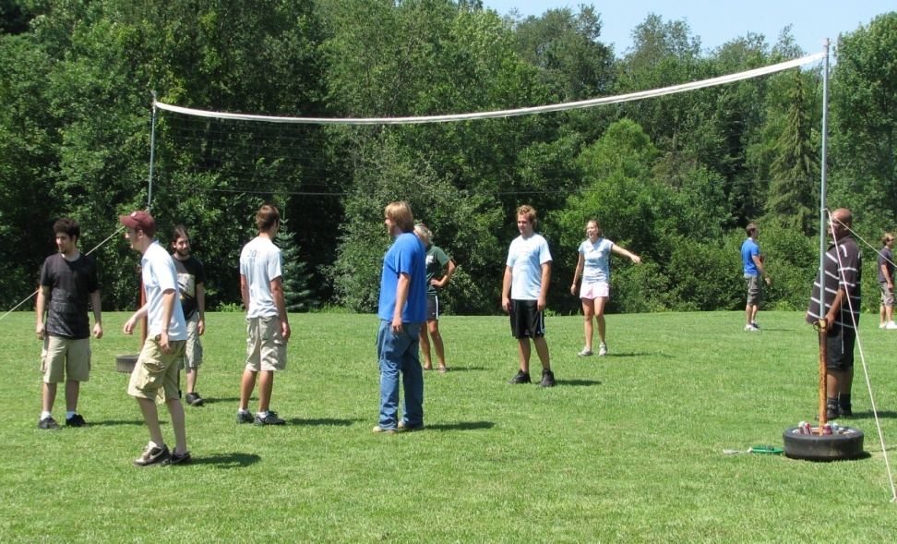
EMPLOYMENT NEXT YEAR?
Make good decisions.
When in question, ask your supervisor.
All applications are completed through Interview Exchange.
Interview Exchange posting will be available January 15, 2017.
If you receive a positive evaluation, most likely you will be here next year.
Notes:
Mitch Fields

Slide 31
QUESTIONS?
Notes:
Mitch Fields

Slide 32
WHAT HAPPENS FROM HERE ?
Your supervisor is here to greet you.
You report to your assigned area.
Your supervisor will review shop procedures which may include: assigning a locker, PPE and provide training for your assigned work.
Notes:
Allen Bradberry
Each office organizational chart will be shown and the Director and Supervisor introduced. Dismiss everyone at the end of all introductions.

Slide 33
ENVIRONMENTAL HEALTH & SAFETY
Associate Vice President of Facilities Services
Mitch Fields
Director of Environmental Health & Safety
Eric Foertch
Notes:
Allen Bradberry

Slide 34
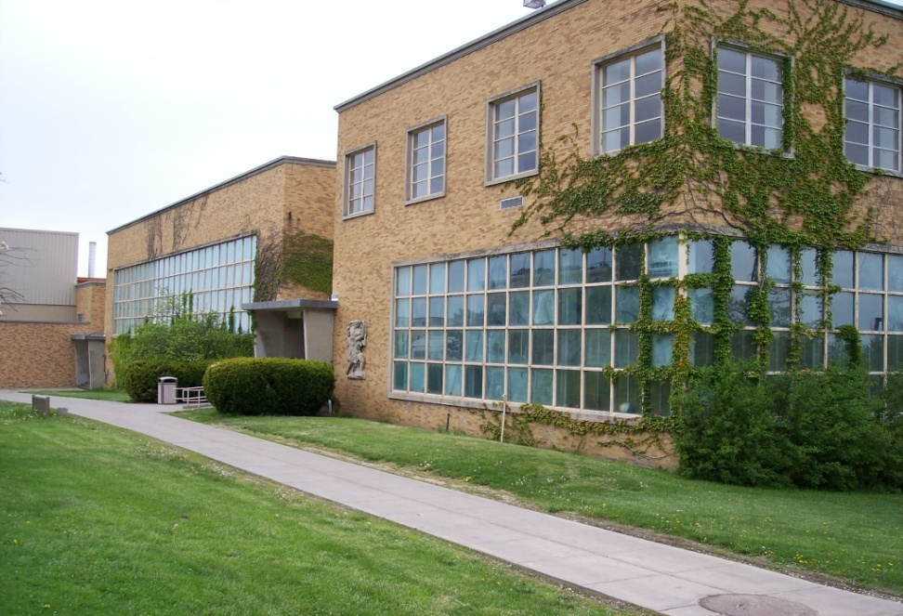
ENVIRONMENTAL HEALTH & SAFETY
SUPERVISOR:
Eric Foertch
Environmental Health and Safety Director
BUILDING: Lee Hall
LOCATION: Centennial Road
PARKING LOT #: E-23
Notes:
Allen Bradberry

Slide 35
MAJOR PROJECTS
Associate Vice President of Facilities Services
Mitch Fields
Director of Major Projects
Allen Bradberry
Notes:
Allen Bradberry

Slide 36
MAJOR PROJECTS
SUPERVISOR:
Allen Bradberry
Director of Major Projects
BUILDING: FS Triple Wide Trailer
LOCATION: Rudolph Road
PARKING LOT #: E-1
Notes:
Allen Bradberry

Slide 37
OFFICE of the ASSOCIATE VICE PRESIDENT
Associate Vice President of Facilities Services
Mitch Fields
Notes:
Allen Bradberry

Slide 38
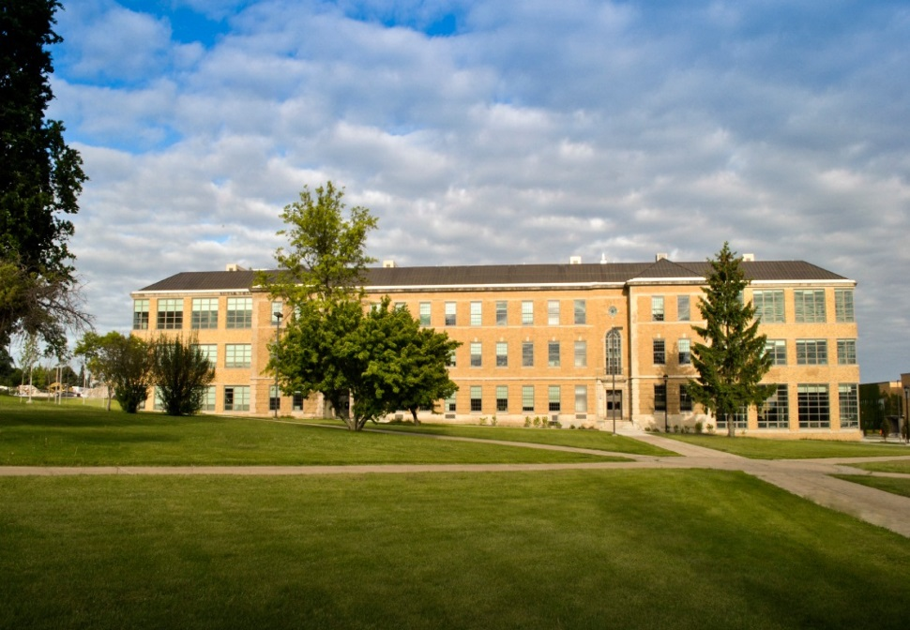
OFFICE of the ASSOCIATE VICE PRESIDENT
SUPERVISOR:
Linda Paris
Planning Coordinator
BUILDING: Park Hall
LOCATION: Sheldon Avenue
PARKING LOT #: E-27
Notes:
Allen Bradberry

Slide 39
MAINTENANCE & OPERATIONS
Associate Vice President of Facilities Services
Mitch Fields
Associate Director of Operations
Becky Kempney
Associate Director of Trades
Utilities
Manager
John Bricker
Director of Maintenance & Operations
Mary DePentu
Notes:
Mary Depentu

Slide 40
MAINTENANCE & OPERATIONS UTILITIES
SUPERVISOR:
Candy Malone
Asset Inventory Supervisor
BUILDING: Lee Hall
LOCATION: Centennial Road
PARKING LOT #: E-23
Notes:
Mary Depentu

Slide 41
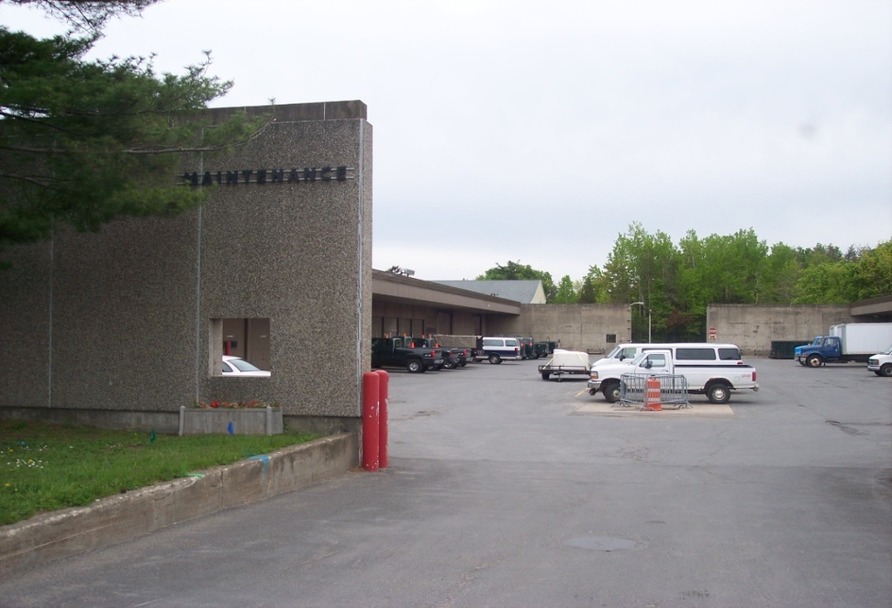
MAINTENANCE & OPERATIONS GROUNDS
SUPERVISOR:
Ron Randall
Grounds Supervisor
BUILDING: Maintenance #12
LOCATION: Johnson Road
PARKING LOT #: E-5
Notes:
Mary Depentu

Slide 42
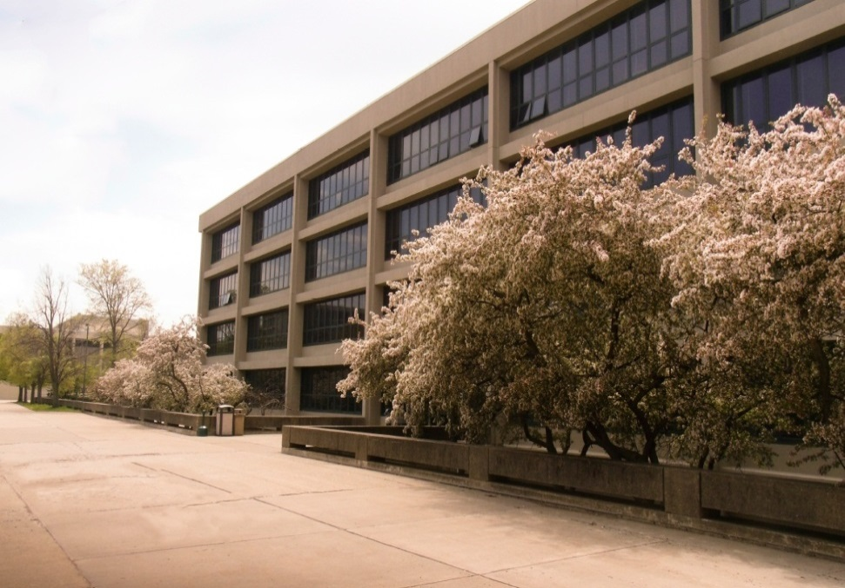
MAINTENANCE & OPERATIONS ACADEMIC CUSTODIAL
SUPERVISOR:
Lori Cook
Academic Custodial Supervisor
BUILDING: Various
LOCATION: Various
PARKING LOT #: Various
Notes:
Mary Depentu

Slide 43
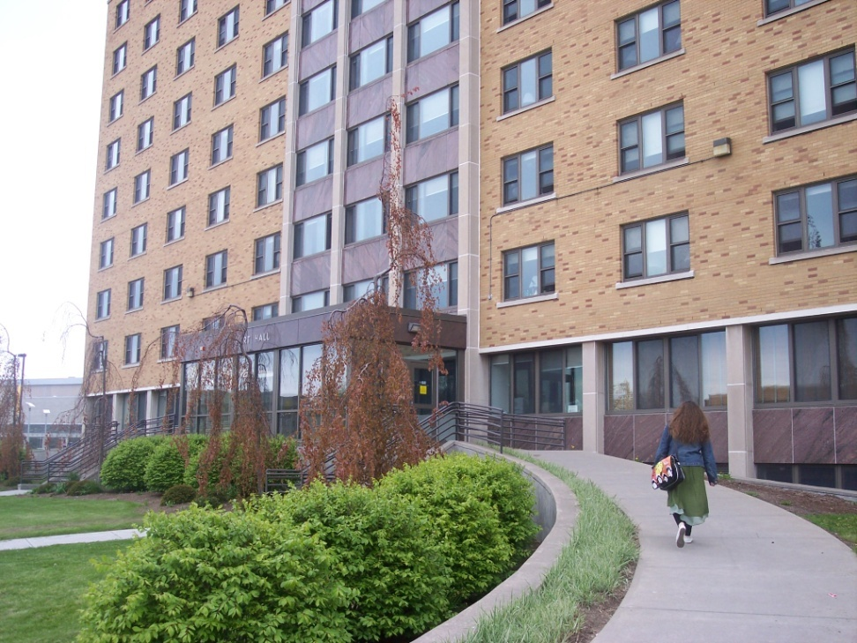
MAINTENANCE & OPERATIONS HOUSING CUSTODIAL
SUPERVISOR:
Aaron Johnson
Housing Custodial Supervisor
BUILDING: Various
LOCATION: Various
PARKING LOT #: Various
Notes:
Mary Depentu

