Slide 1
Facilities Services
2017
FA Update

Slide 2
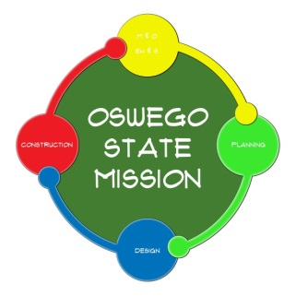
Facilities Services: 2017 FA Update
NYS Budget/SUNY Capital
Projects Under Construction
Projects in Design
Projects in Planning

Slide 3
Facilities Services: 2017 FA Update
2017 – 2022 SUNY Capital Plan
SUNY- Wide Allocation $2,750,000,000 (5 years)
$550.0M/ Year SUNY - Oswego
$ 150.0M Critical Maintenance (SUBOA) $5.97M/YR
$ 100.0M Program Addition/Upgrade (SOBOA) $3.97 M/YR
$ 300.0M SUCF/DOB Discretionary Assignment $16.4 M/YR*
Oswego Annual Total $ 26.34M/YR
5 Year Grand Total - $131.7M (+/-)

Slide 4
Facilities Services: 2017 FA Update
Projects Under Construction
Scales Hall $14.0M
Tyler Phase 2.1 (Art/Photography) $ 2.5M
Lee Hall Exterior $ 3.1M
OBCR Relocation $ 0.1M
Culkin Data Center $ 0.3m
Sub-Total $20.0M

Slide 5
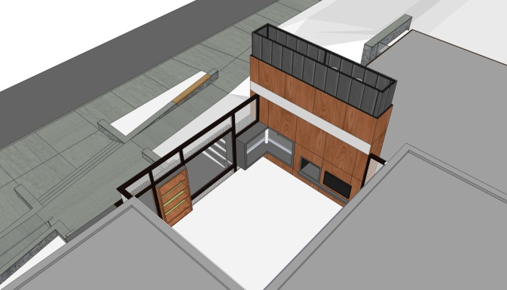
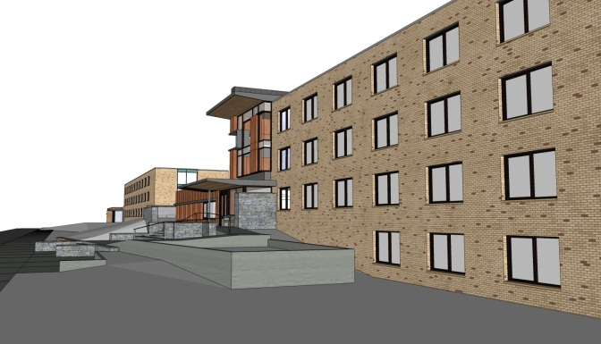
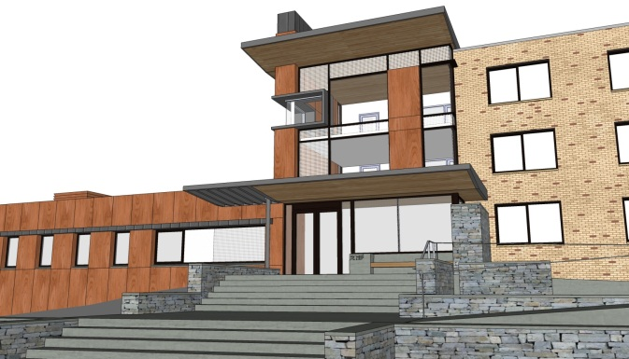
Facilities Services: 2017 FA Update
Scales Hall

Slide 6
Facilities Services: 2017 FA Update
Tyler Phase 2.1

Slide 7
Facilities Services: 2017 FA Update
Projects in Design
Tyler Phase II Rehab $13.0M
Student Multipurpose Space $ 1.0M
(Swetman Locker Rooms)
Mary Walker Health Center Rehab $ 4.5M
SOE Phase III (Wilber Tower) $12.0M
Sub – Total $30.5M

Slide 8
Facilities Services: 2017 FA Update
Tyler Phase 2.2

Slide 9
Facilities Services: 2017 FA Update
Student Multi – Purpose Space(Swetman Locker Rooms)

Slide 10
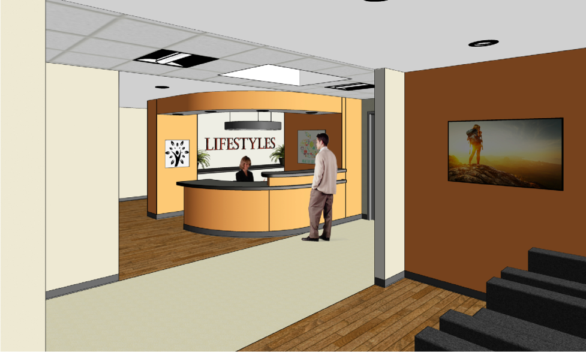
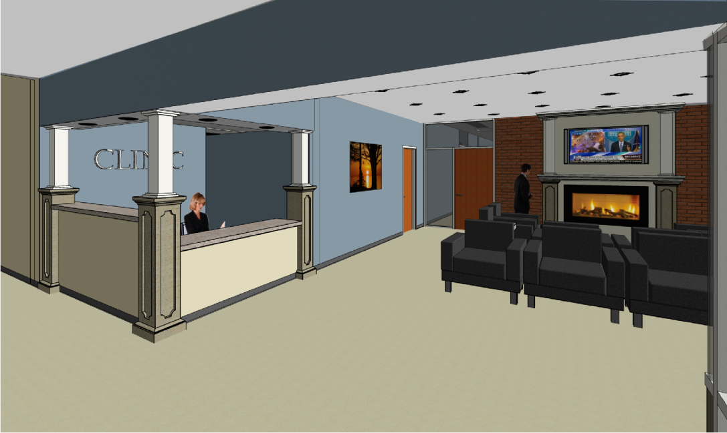
Facilities Services: 2017 FA Update
Mary Walker Health Center

Slide 11
Facilities Services: 2017 FA Update
Projects in Planning
Rehab Hewitt Hall Art & Communication
Rehab Hewitt Quad Site
Tyler Phase III Rehab Exterior
Penfield Library Libraries
Lanigan Hall TBD/ Lecture Center
Laker Hall Intercollegiate Athletics
Lee Hall Intermural & Recreation
Future Res. Halls Residence Life

Slide 12
Facilities Services: 2017 FA Update
Facilities Services - Web Page
Monthly Project Updates
by
Facility

Slide 13
Facilities Services: 2017 FA Update
Questions?
AVP Office:
J. Mitchell Fields
303a Park Hall/ X2861

