Slide 1
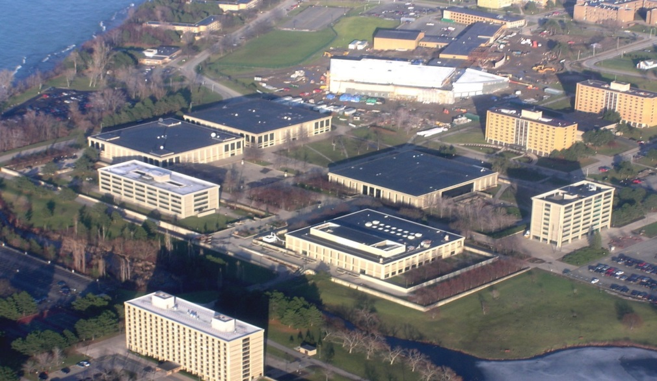
Facilites Services
Summer Projects Update
Environmental Health & Safety, Maintenance and Operations; Major Projects; Sustainability

Slide 2
Construction
  Construction:
        Wilber Hall for Education Phase 2.1 (Aug.16)
        Tyler Hall for Communication, Media & Arts
        Culkin Data Center
        Rich Hall for Business & OCBR
        Hewitt Union (Hall) for Communications & Cont. Ed/Ext. Learning
        Marano Campus Center for Cont. Ed/Ext. Learning
        ADA Signage/ Exterior Wayfinding Signage
        Upgrades to Vehicular & Pedestrian Surfaces II, Ph. V

Slide 3
Facilites Update
  Construction:
        Wilber Hall for Education
        Tyler Hall for Communication, Media & Arts (Jul. 16)
            Phase I: Waterman Theater; Art Gallery; Recital Hall; & Offices
            Phase I.I: Choral Room; Theater Rigging
            Phase 2.0: 2nd Floor Art, Printmaking; Photography, & Offices
        Culkin Data Center
        Rich Hall for Business & OCBR
        Hewitt Union (Hall) for Communications & Cont. Ed/Ext. Learning
        Marano Campus Center for Cont. Ed/Ext. Learning
        ADA Signage/ Exterior Wayfinding Signage
        Upgrades to Vehicular & Pedestrian Surfaces II, Ph. V

Slide 4
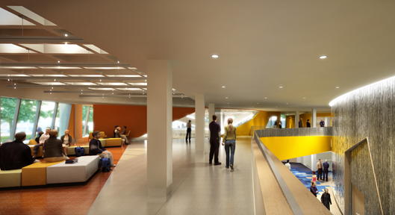
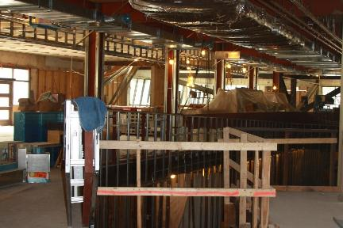
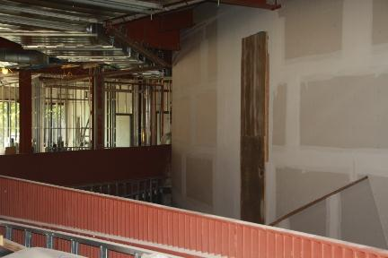
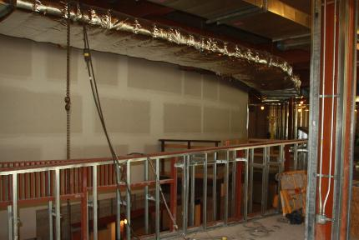
Facilities Update
Tyler Hall Phase I

Slide 5
Facilities Update
Choral Room

Slide 6
Facilities Update
  Construction:
        Wilber Hall for Education
        Tyler Hall for Communication, Media & Arts
        Culkin Data Center (Aug. 16)
            Ground Floor behind CTS Office.
            Reduce Floor Space and energy
        Rich Hall for Business & OCBR
        Hewitt Union (Hall) for Communications & Cont. Ed/Ext. Learning
        Marano Campus Center for CE-EL, Athletics, & SUMS
        ADA Signage/ Exterior Wayfinding Signage
        Upgrades to Vehicular & Pedestrian Surfaces II, Ph. V

Slide 7
Facilities Update
  Construction:
        Wilber Hall for Education
        Tyler Hall for Communication, Media & Arts
        Culkin Data Center
        Rich Hall for School of Business & OBCR
            OBCR to Relocate to Downtown Location (7/16)
            Business to Repurpose and Occupy Vacated Space (8/16)
        Hewitt Union (Hall) for Communications & Cont. Ed/Ext. Learning
        Marano Campus Center for Cont. Ed/Ext. Learning
        ADA Signage/ Exterior Wayfinding Signage
        Upgrades to Vehicular & Pedestrian Surfaces II, Ph. V

Slide 8
Facilities Update
  Construction:
    Wilber Hall for Education
    Tyler Hall for Communication, Media & Arts
    Culkin Data Center
    Rich Hall for Business & OCBR
    Hewitt Union for SCMA Surge (Aug 16)
    Selected Art and Theater Programs & Faculty to Vacate to Tyler
    Selected Communication Faculty to Relocate from Lanigan
    Selected Phoenix Center Programs to be Relocated to Main Campus
    Marano Campus Center for Cont. Ed/Ext. Learning, Athletics
    ADA Signage/ Exterior Wayfinding Signage
    Upgrades to Vehicular & Pedestrian Surfaces II, Ph. V
    Lakeside Streamline Replacement – East Section

Slide 9
Facilities Update
  Construction:
    Wilber Hall for Education
    Tyler Hall for Communication, Media & Arts
    Culkin Data Center
    Rich Hall for Business & OCBR
    Hewitt Union for Communication & Cont. Ed/Ext. Learning
    Marano Campus Center for Extended Learning, SUMS
    and Athletics (Aug 16)
      Repurpose Copy Center for Continuing Ed./Extended Learning
      SUNY Undergraduate Mathematics Success (SUMS) in Poucher Hall
      History of Oswego Hockey Exhibit
    ADA Signage/ Exterior Wayfinding Signage
    Upgrades to Vehicular & Pedestrian Surfaces II, Ph. V
    Lakeside Streamline Replacement – East Section

Slide 10
Facilities Update
  Construction:
    Wilber Hall for Education
    Tyler Hall for Communication, Media & Arts
    Culkin Data Center
    Rich Hall for Business & OCBR
    Hewitt Union for Communication & Cont. Ed/Ext. Learning
    Marano Campus Center for Cont. Ed/Ext. Learning, Athletics, SUMS
    ADA Signage/ Exterior Wayfinding Signage (Aug. 16)
      Interior Phase IV – Service Building, Commissary, Bldg. 20, Marano Campus Ctr.
      Exterior - Parking Lot , Tobacco Free Signs
    Upgrades to Vehicular & Pedestrian Surfaces II, Ph. V
    Lakeside Streamline Replacement – East Section

Slide 11
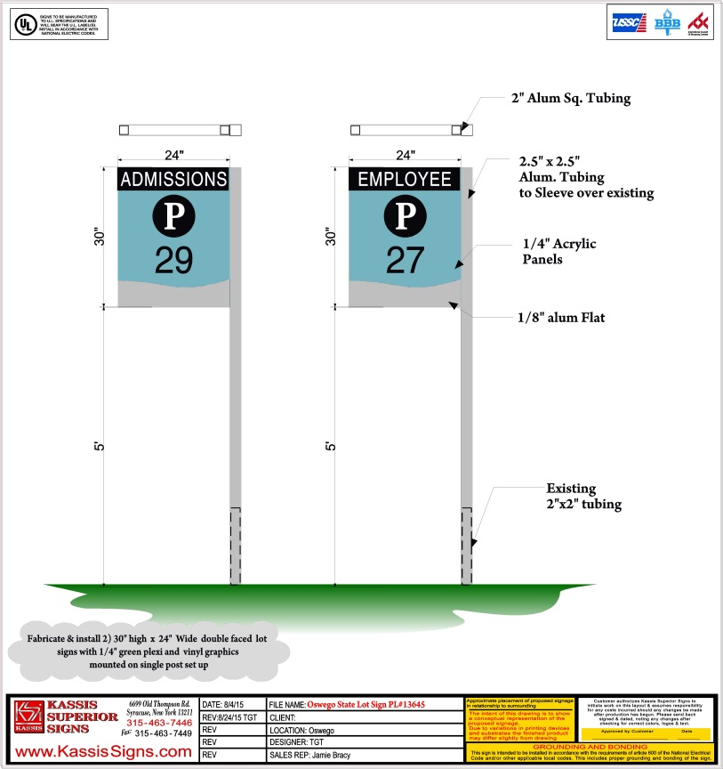
Facilities Update
Exterior Wayfinding
Exterior Wayfinding

Slide 12
Facilities Update
  Construction:
    Wilber Hall for Education
    Tyler Hall for Communication, Media & Arts
    Culkin Data Center
    Rich Hall for Business & OCBR
    Hewitt Union for Communication & Cont. Ed/Ext. Learning
    Marano Campus Center for Cont. Ed/Ext. Learning, Athletics, SUMS
    ADA Signage/ Exterior Wayfinding Signage
    Upgrades to Vehicular & Pedestrian Surfaces II, Ph. V
      Molison Road, Barns Road, & Commuter Parking Lot. 7 (Aug. 16)
    Lakeside Streamline Replacement – East Section

Slide 13
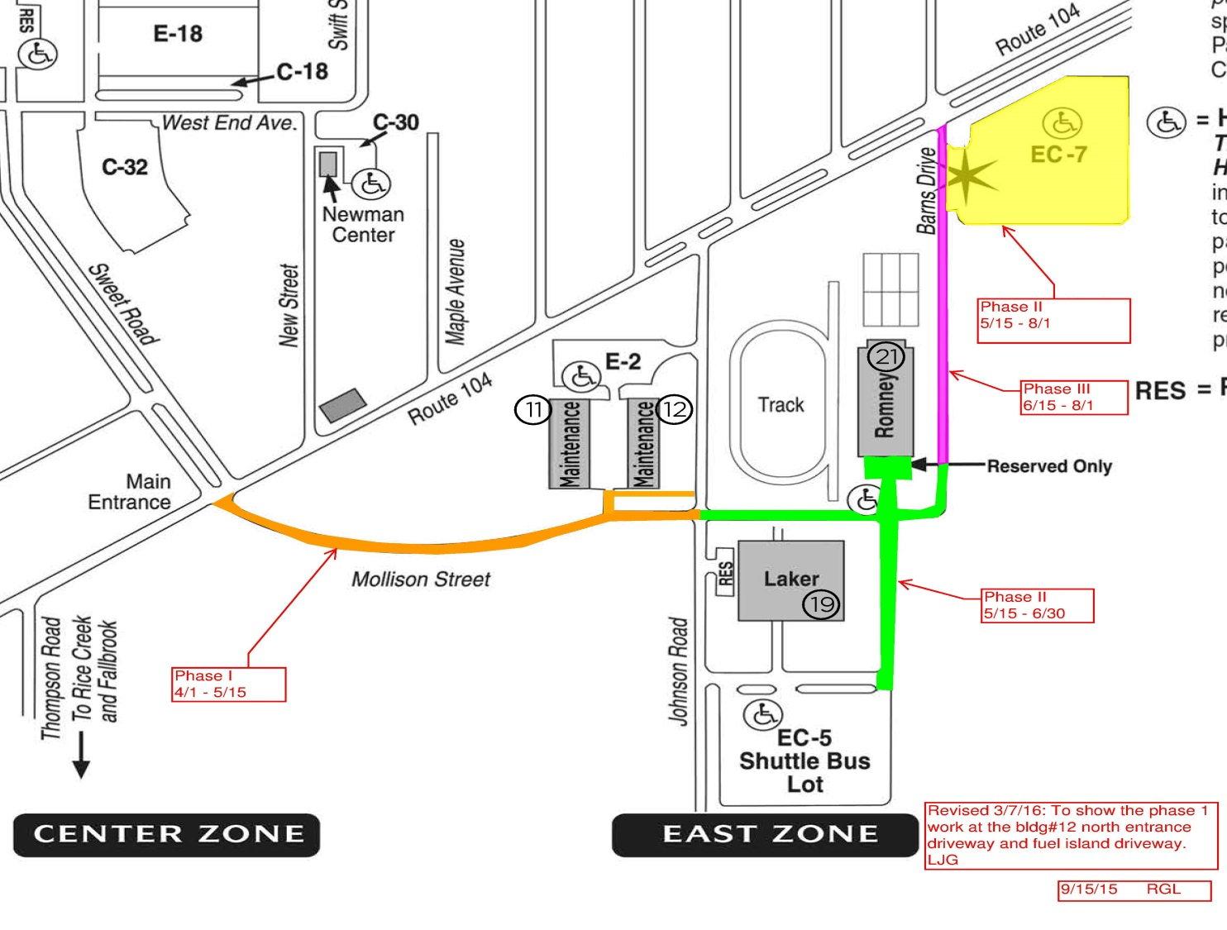
Facilities Update

Slide 14
Facilities Update
    Wilber Hall for Education
    Tyler Hall for Communication, Media & Arts
    Culkin Data Center
    Rich Hall for Business & OCBR
    Hewitt Union for Communication & Extended Learning
    Marano Campus Center for Extended Learning, Athletics, SUMS
    ADA Signage/ Exterior Wayfinding Signage
    Upgrades to Vehicular & Pedestrian Surfaces II, Ph. V
    Lakeside Streamline Replacement – East Section (Aug. 16)
    Rudolph Road from Centennial Drive to Johnson Hall Loop

Slide 15
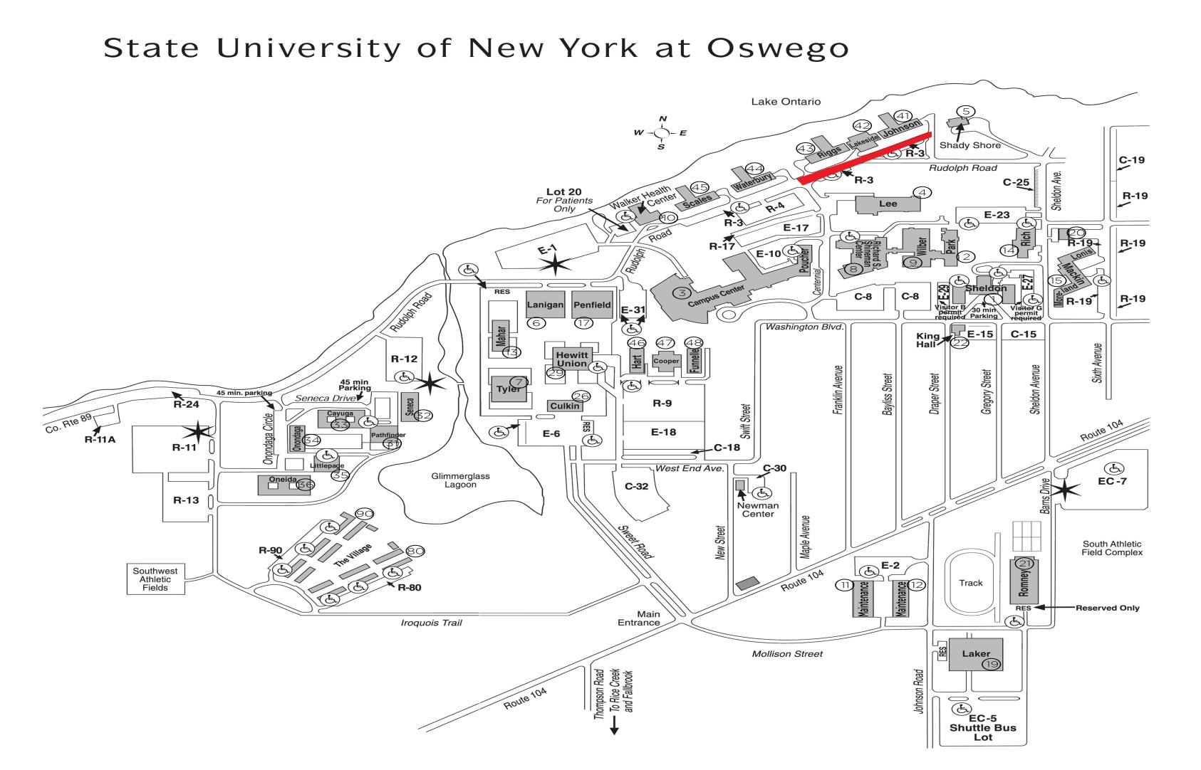
Facilities Update

Slide 16
Facilities Update
  Design:
    SOE Phase III for School Education
    Tyler Hall Phases 2.1…. for Art, Theater, & Music
    Marano Campus Center ( Swetman Hall) for Campus Life
    Rehab Mary Walker Health Center
    Lee Hall Window & Door Replacement
Planning:
    Hewitt Union: Communication, Graphic Design, and Cinema & Screen Studies
    Lee Hall: Intramurals & Recreation
    Laker Hall: Intercollegiate Athletics

Slide 17

Facilities Update
  Questions?
  Thank You!

Slide 18
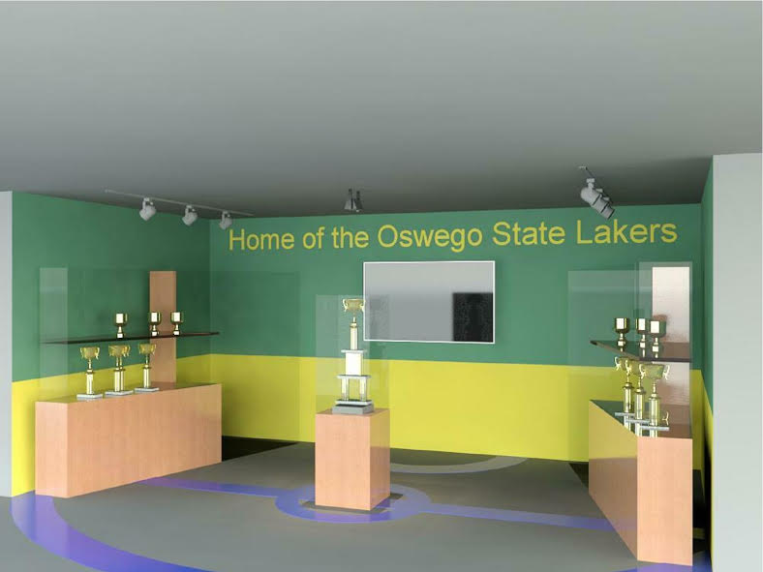
Facilities Update
History Of Hockey

Slide 19
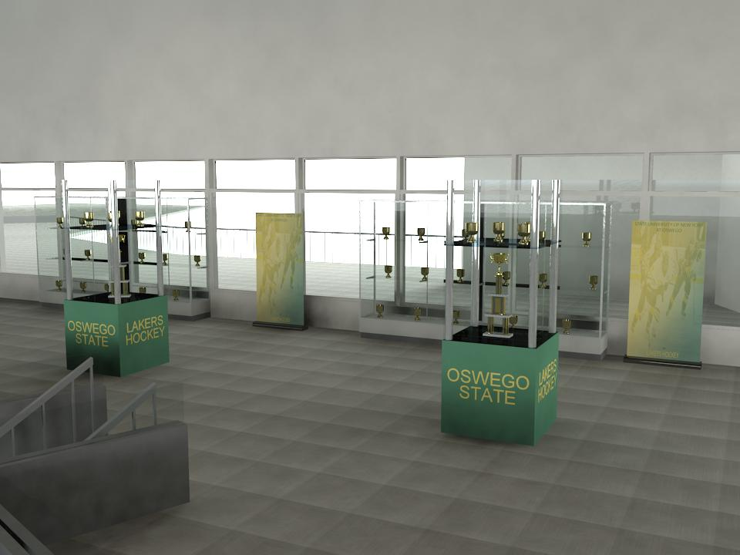
Facilities Update
History Of Hockey

