Slide 1
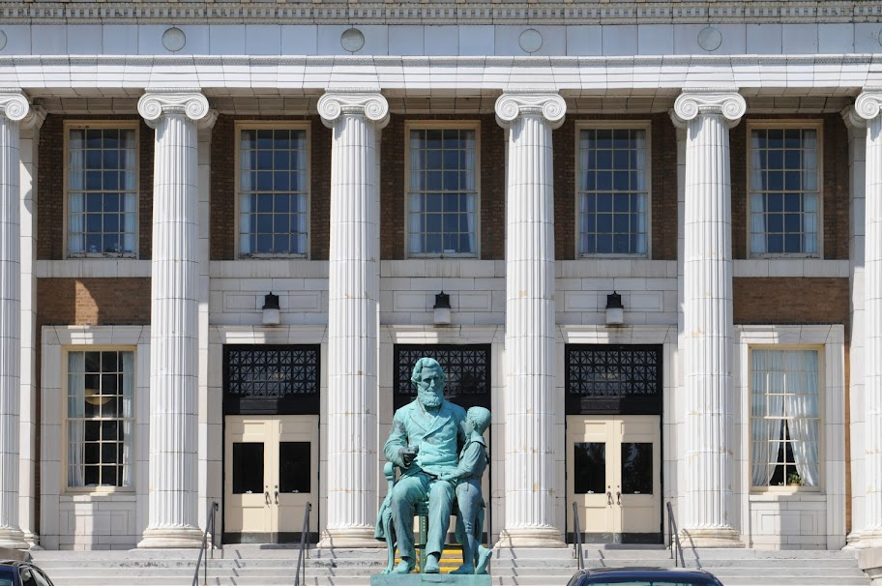

Tenure and Promotion
Workshop
October 4, 2012

Slide 2
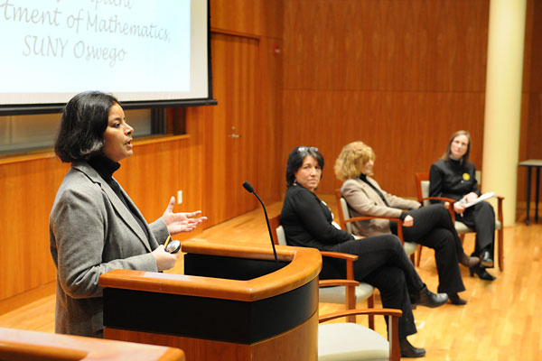
Today’s Agenda
Execution of Mission, Vision and Goals
Criteria for Tenure and Promotion
FAQ’s
E-Faculty Portfolios
Tenure and Promotion Expectations by School

Slide 3
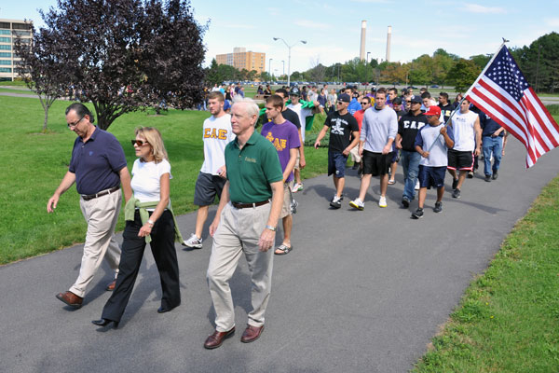
SUNY Oswego’s Mission
Expresses what we do:
Our mission is to contribute to the common good by lighting the path to wisdom and empowering women and men to pursue meaningful lives as productive, responsible citizens.

Slide 4
SUNY Oswego’s Mission
e common good by lighting the path to wisdom n empowering women and men meaningful lives as productive, responsible citizens.

Slide 5
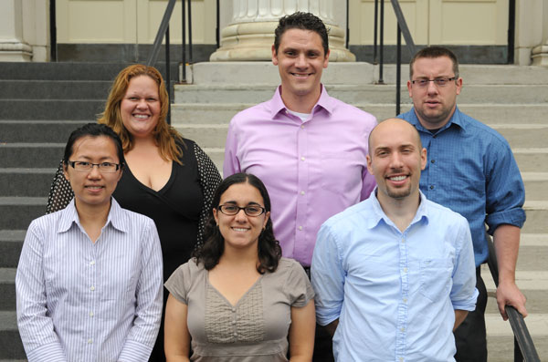
Your contribution to the College’s Mission
The mission of the College is translated into work performance standards and expectations (set out in tenure and promotion criteria).
It is important to understand how your efforts contribute to our mission– a commitment to student success.

Slide 6
Our Operational Plan
Our paramount goal is to attract and retain talented faculty that begins during the search process. We hire assistant professors who show great promise. Our promise is to help you succeed.
Clearly communicate general performance standards (criteria) that apply across the institution for making decisions about tenure and promotion.
Establish a mentoring process to assure faculty get good advice.
Provide institutional and departmental level support for teaching, research, and access to networks and resources in the community and organization.
Follow a clear, fair, and respectful review process to guide faculty to the level of performance expected at a student-centered premier institution with a commitment to teaching, scholarship and creative accomplishment, and service to meet our institutional mission.

Slide 7
General Criteria for Tenure and Promotion
(Policies of the Board of Trustees, Article XII, Title A (1989))
Mastery of Subject Matter
Effectiveness of Teaching
Scholarly Ability
Effectiveness of University Service
Continuing Growth

Slide 8
Mastery of Subject
Terminal degree in field
Licenses, honors, awards in field

Slide 9
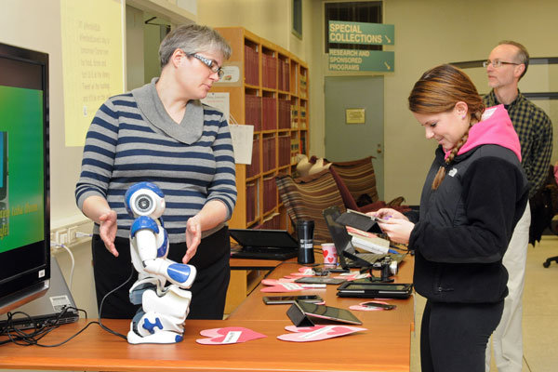
Teaching Effectiveness
Teaching is the primary responsibility for faculty at SUNY Oswego- we value strong teaching
Campus is committed to learner-centered principles
Strong teaching demonstrated broadly:
  Involvement of students in scholarly/creative
  activities
  Teaching and learning in formal and
  informal settings, new modes of
  instruction--use of technology, online, etc.
  Incorporation of global and cultural
  diversity in curricula and programs
  Curriculum development, revision, & review

Slide 10
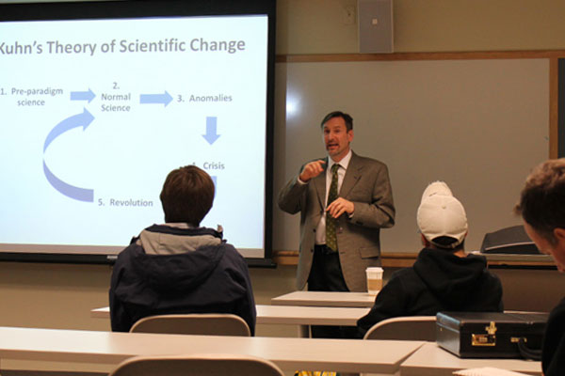
Teaching Effectiveness Con’t
Quality of Teaching
  Quantitative record of teaching effectiveness
  Qualitative evidence of concern with teaching
  Peer judgment of classroom teaching required
  Teaching awards and recognitions, grants for curricular development
  Mentoring and advisement of students

Slide 11
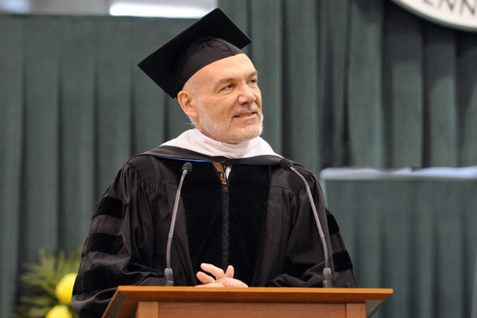
Scholarly and Creative Activities
Evidence of a productive and creative mind in scholarly activities
Quality and quantity defined by department and disciplinary criteria
Scholarly contributions will be evaluated for evidence of growth, professional recognitions, citations, and continued promise
Extramural funding to support scholarship
growing in importance.
Faculty-mentored student research

Slide 12

Effectiveness in Service
Contribution to the College and community
  Support of campus community
  Share expertise with community
  Engagement & collaboration w/
  communities beyond campus
Increasing levels of leadership and mentorship in service for promotion to advanced ranks

Slide 13

Continuing Growth
Professional reflection and development to keep current in the field.
Participation in workshops, webinars, conferences.
How has participation led to improvements in teaching, advancement in scholarship, or effectiveness in service

Slide 14
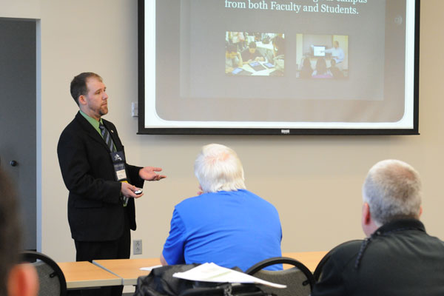
FAQ’s
What is expected in the first year review?
What is expected in the continuing appointment review?
Can I get prior credit toward tenure?
Can I apply for early Tenure and Promotion?
Is there a required minimum period of time to be in rank as an associate prior to promotion review to full professor?

Slide 15
Closing Thoughts
Most important level of review is departmental
Seek out good role models as mentors
Take early reviews and DSI process seriously
Keep good records- remain organized
Be proactive- seek assistance/ ask questions.

Slide 16
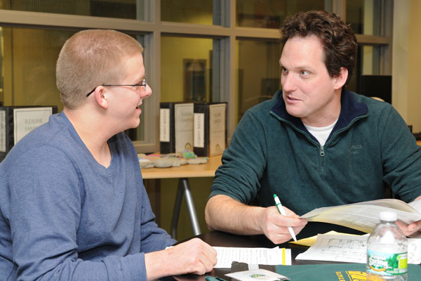
Tenure and Promotion Workshop Con’t
E-Faculty Portfolios
  Mark Springston, Dept. of Tech.
  School of Education
School level discussion of expectations:
  Fritz Messere- SCMA – 206 Campus Center
  Richard Skolnik, SOB – 205 Campus Center
  Pam Michel, SOE – 201 Campus Center
  Richard Back, CLAS – 114 Campus Center
  Barbara Shaffer, Library – 133 Campus Center

