Slide 1
Facilities Services
2017
End of Year Update

Slide 2
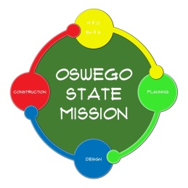
Facilities Services: 2017 End of Year Update
Current Activities
15 Major Projects in Design or Construction
17 Active Minor Projects
1,554 Current Active Work Orders

Slide 3
Facilities Services: 2017 End of Year Update
Current Minor Projects
Campus Wide – Installation of CO Detectors
Campus Wide – Replace and Upgrade Chemical Dispensers
Culkin Hall – HR Card Access
Culkin Hall – Lactation Room 212
Culkin Hall – Storage for President
Downtown – OBCR Relocation
Lanigan Hall – Room 25 Conversion
Lanigan Hall – VAT
Laker Hall – Trophy Space
Lee Hall – ADA Pool Lift
Mackin Hall – Office Complex, Bldg 12 Moves
Mail Room Stock Room Merge
Penfield Library – Classroom
Penfield Library – Vestibule
Shineman Center – Space Expansion Biology
Shineman Center – Wall Panel

Slide 4
Facilities Services: 2017 End of Year Update
Projects in Design
Const. Start* Est. Cost**
Campus Wide – Lighting Improvements Aug 2017 $0.33
Campus Wide – Projects for Energy Management Design Only $0.06
Commissary Cold Storage Rehab Apr 2018 $0.56
Culkin Hall – Elevator Upgrades Jul 2018 $0.75
MCC – Arena Ice Compressor Replacement May 2018 $0.57
MCC – Student Activity Center Feb 2018 $1.97
Mary Walker Health Center – Renovations May 2018 $2.45
Metro Center Renovations May 2018 $0.10
Pedestrian Pathway Lighting Improvements Jun 2018 $0.82
Shineman Office Study & Rehab TBD TBD
Tyler Hall – Phase II Mar 2018 $2.72
TOTAL $10.33 *Scheduled
**Cost shown in Millions

Slide 5
Facilities Services: 2017 End of Year Update
Commissary – Cold Storage Rehab

Slide 6
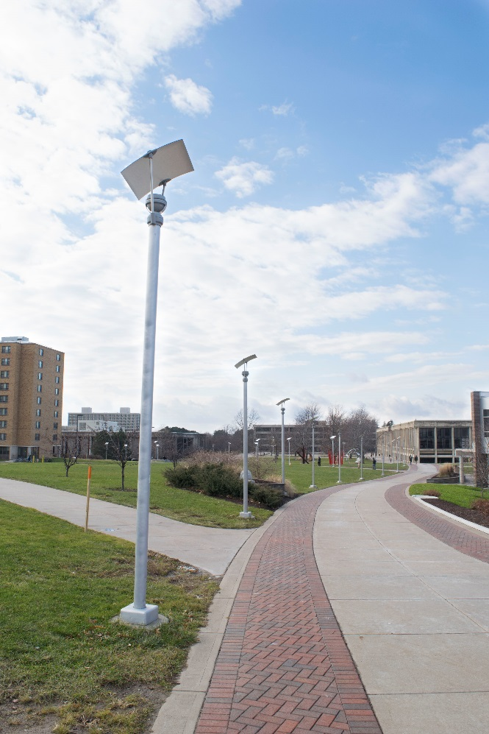
Facilities Services: 2017 End of Year Update
Pedestrian Pathway Lighting Improvements

Slide 7
Facilities Services: 2017 End of Year Update
Tyler Hall – Phase II Basement Floor Plan

Slide 8
Facilities Services: 2017 End of Year Update
Tyler Hall – Phase II Commons Level Floor Plan

Slide 9
Facilities Services: 2017 End of Year Update
Tyler Hall – Phase II Second Floor Plan

Slide 10
Facilities Services: 2017 End of Year Update
Projects in Construction
Const. End* Est. Cost**
Lee Hall – Window and Door Replacement Feb 2018 $2.92
Tyler Hall – Theatre Rigging – Phase II Sep 2018 $0.50
Waterbury Hall – Post Construction Aug 2018 $0.14
Follow-up Projects
Wilber Hall – SOE Phase III Jun 2018 $14.01
TOTAL $17.57 *Scheduled
**Cost shown in Millions

Slide 11
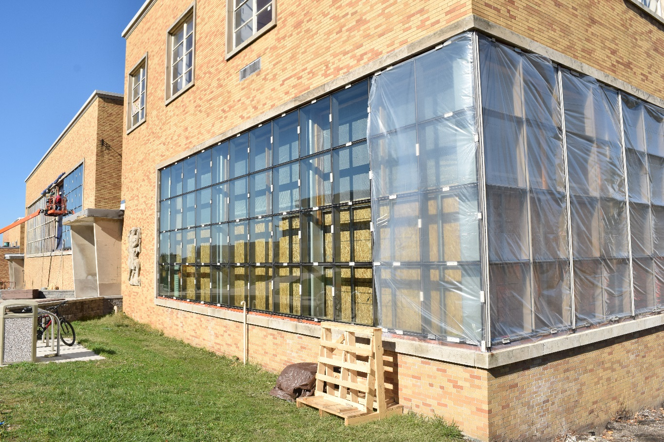
Facilities Services: 2017 End of Year Update
Lee Hall – Window and Door Replacement

Slide 12
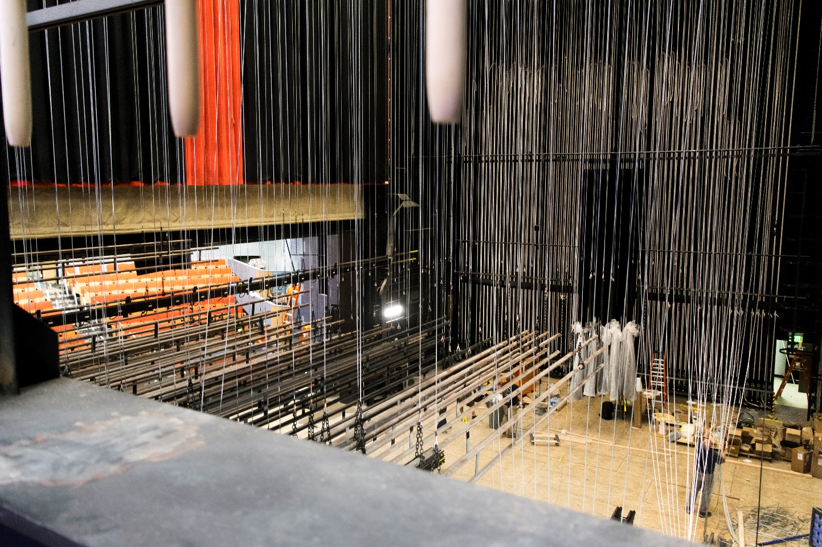
Facilities Services: 2017 End of Year Update
Tyler Hall – Theatre Rigging – Phase II

Slide 13
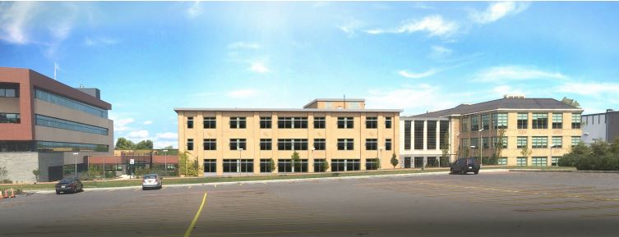
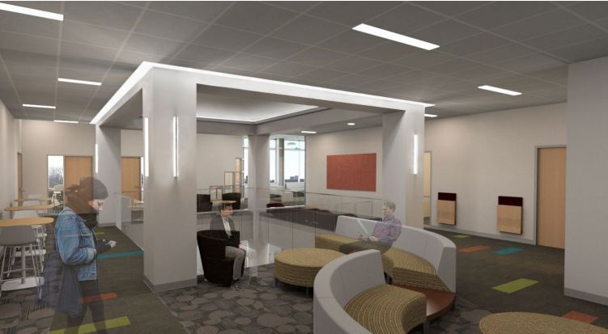
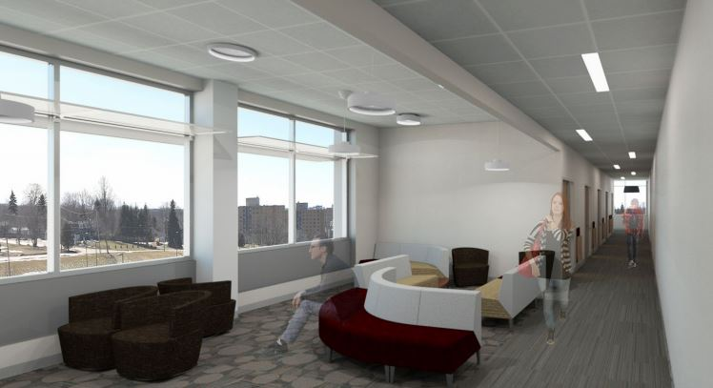
Facilities Services:
2017 End of Year Update
Wilber Hall
Exterior with New Windows
Interior Common Interior Lounge

Slide 14
Facilities Services: 2017 End of Year Update
Projects Recently Completed
Est. Cost**
Culkin Hall – Data Center $0.39
Tyler Hall – Phase 1A, 1C, & 1 D Offices, Conference Room, $2.70
and Drawing, Painting, Photo, and Printmaking Studios
Scales Hall – Rehab $16.12
Wilber Hall – Interior Demolition & Abatement $1.22
TOTAL $20.43
*Scheduled
**Cost shown in Millions

Slide 15
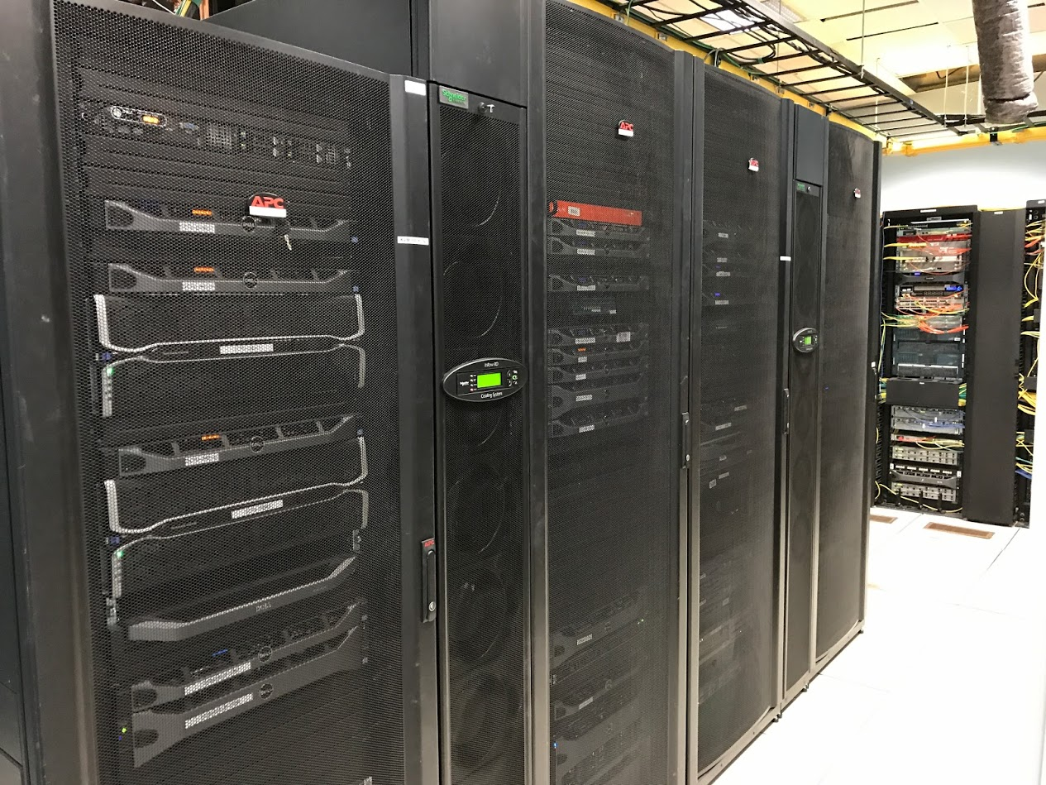
Facilities Services: 2017 End of Year Update
Culkin Hall – Data Center

Slide 16
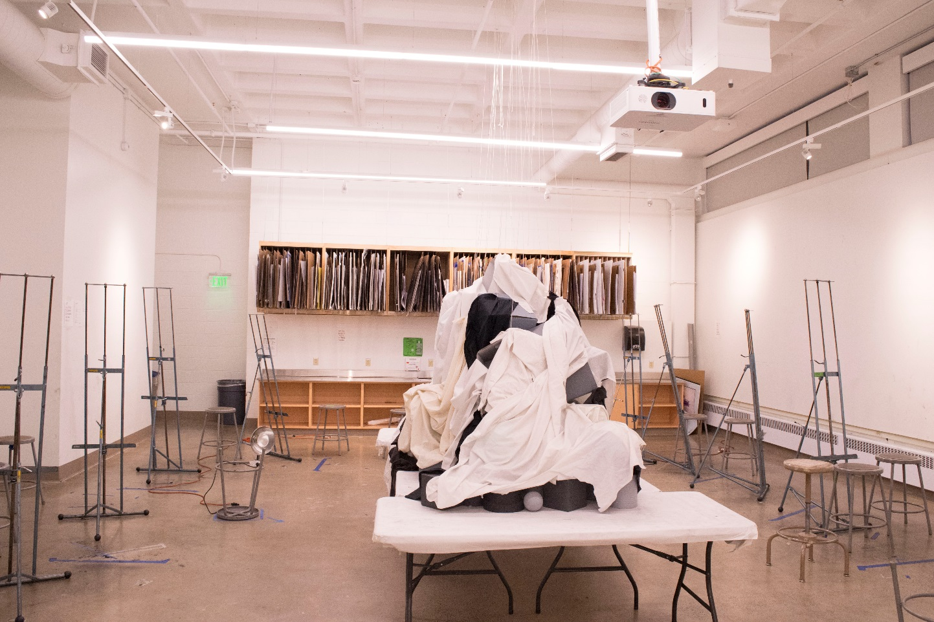
Facilities Services: 2017 End of Year Update
Tyler Hall 1A – Drawing Studio

Slide 17
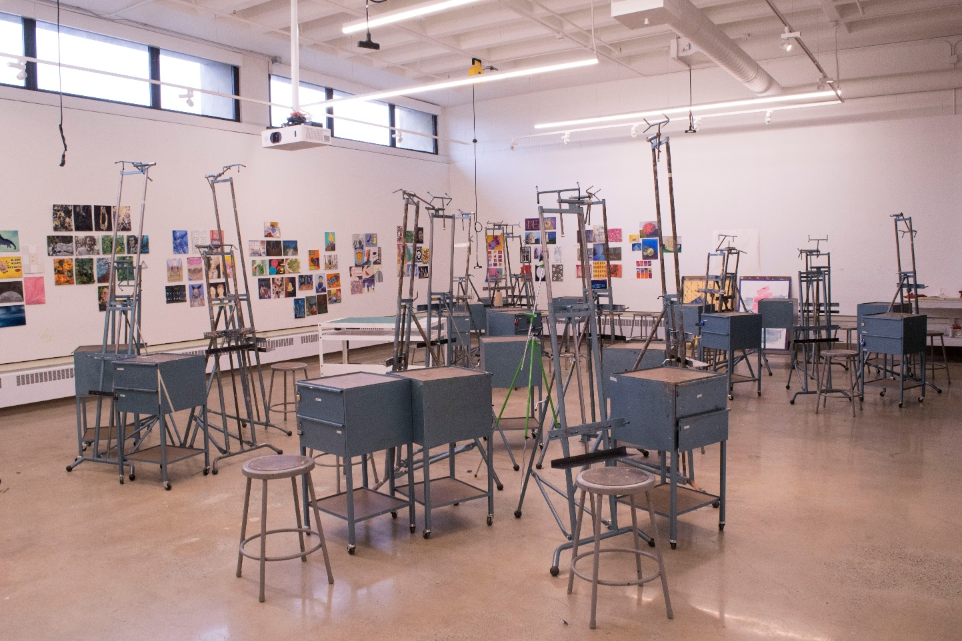
Facilities Services: 2017 End of Year Update
Tyler Hall – Painting Studio

Slide 18
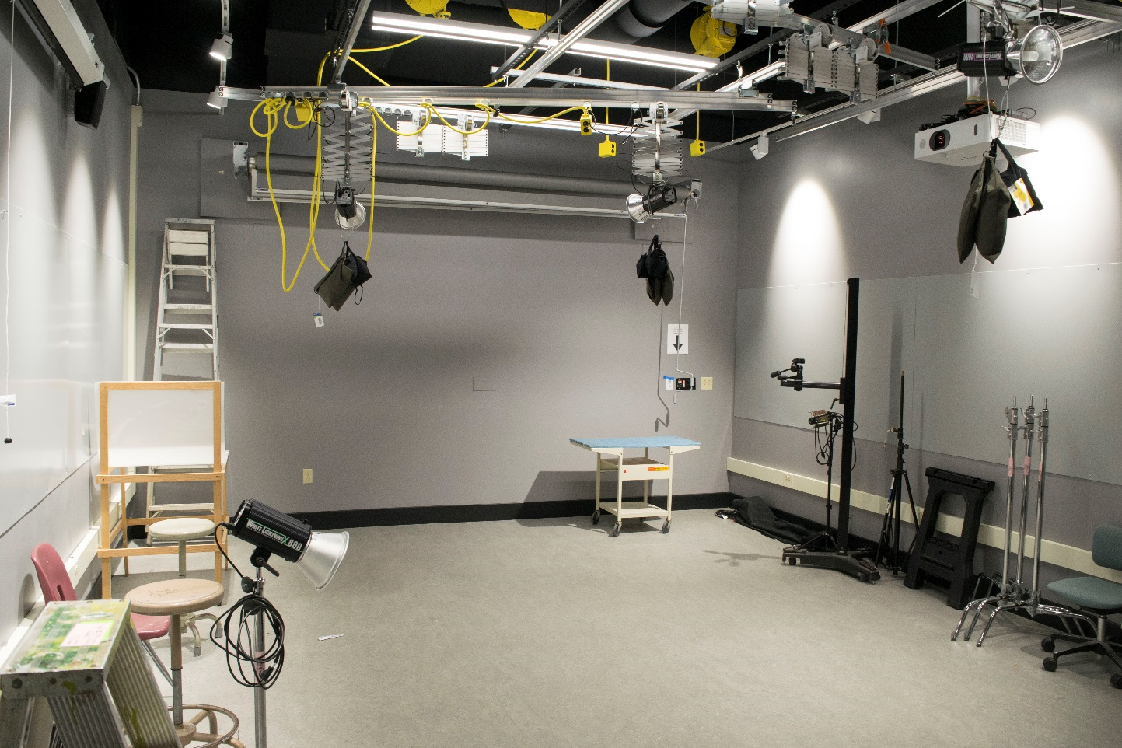
Facilities Services: 2017 End of Year Update
Tyler Hall 1C – Photo Studio

Slide 19
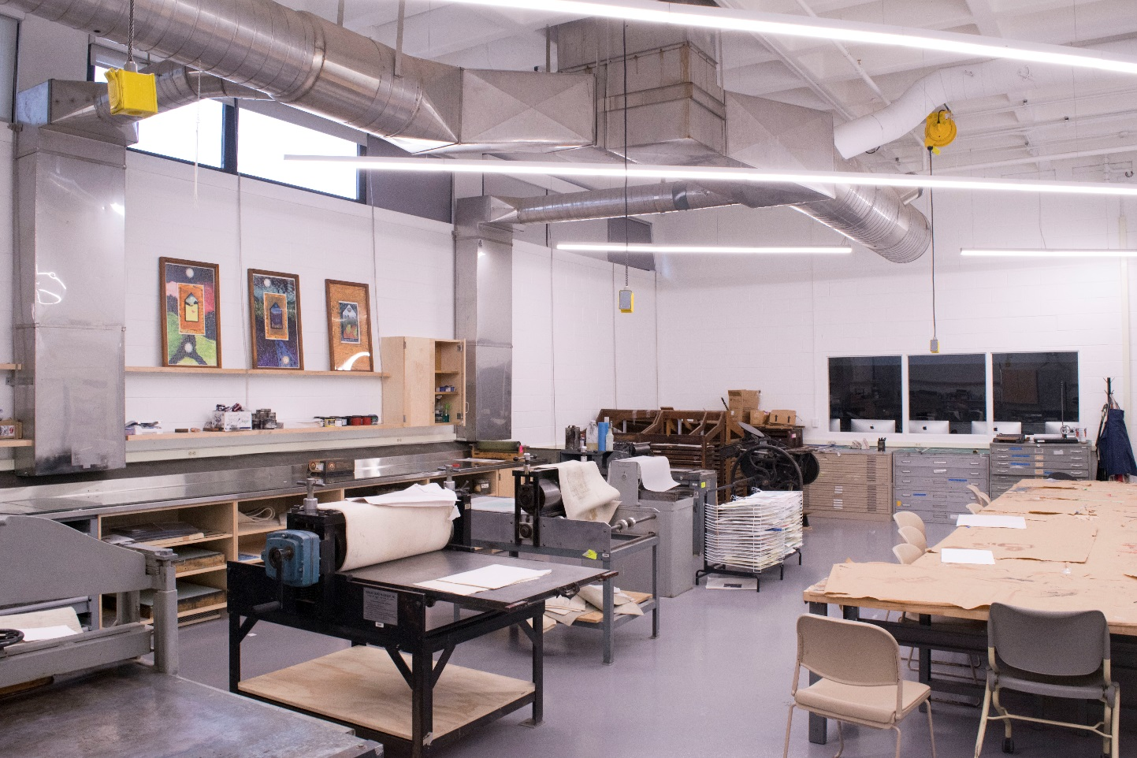
Facilities Services: 2017 End of Year Update
Tyler Hall 1D – Printmaking Studio

Slide 20
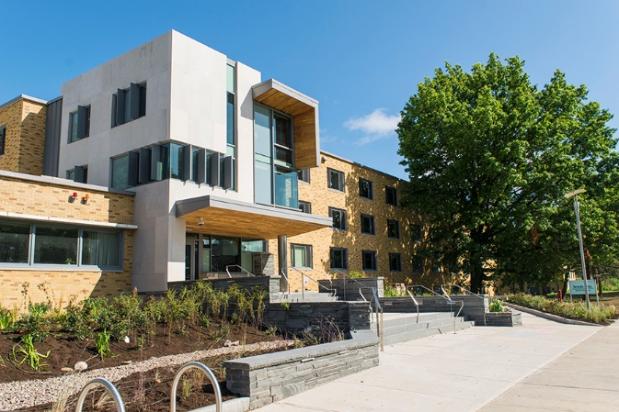
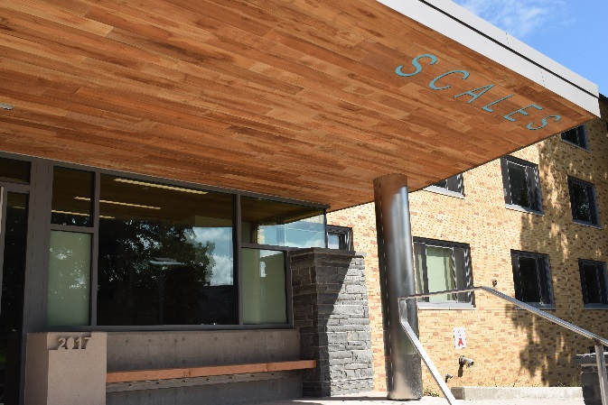
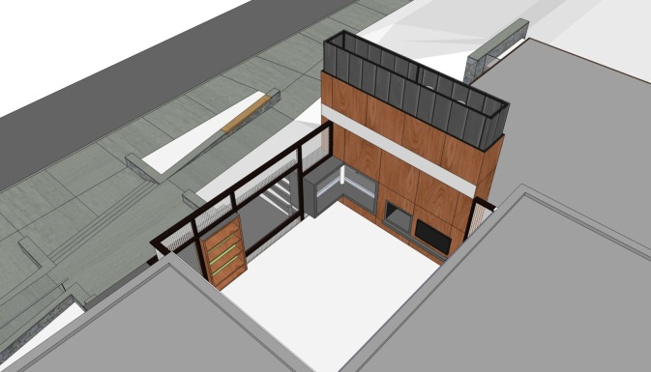
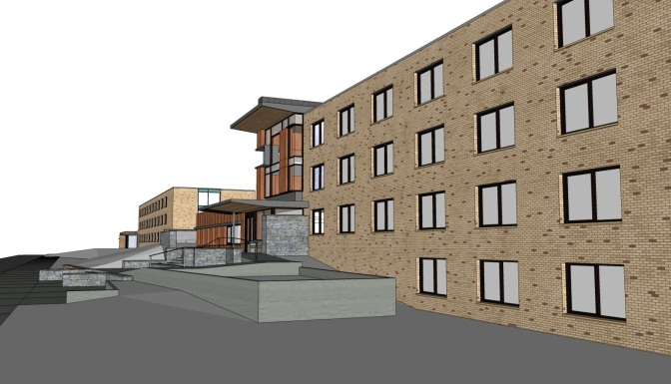
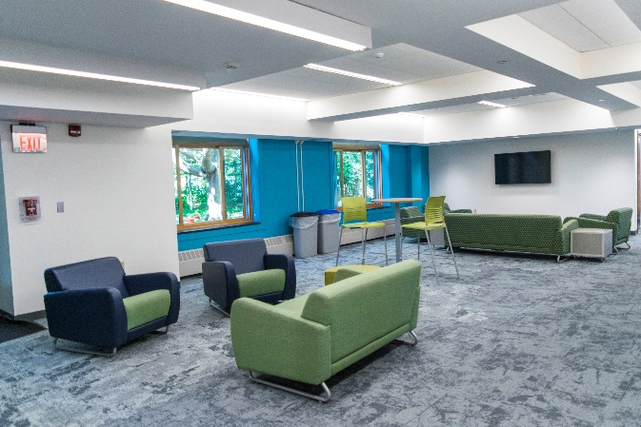
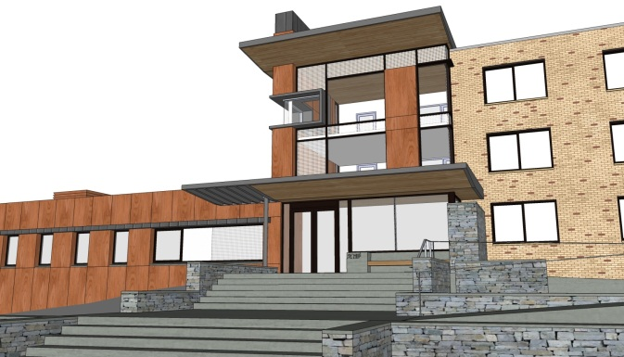
Facilities Services: 2017 End of Year Update
Scales Hall

Slide 21
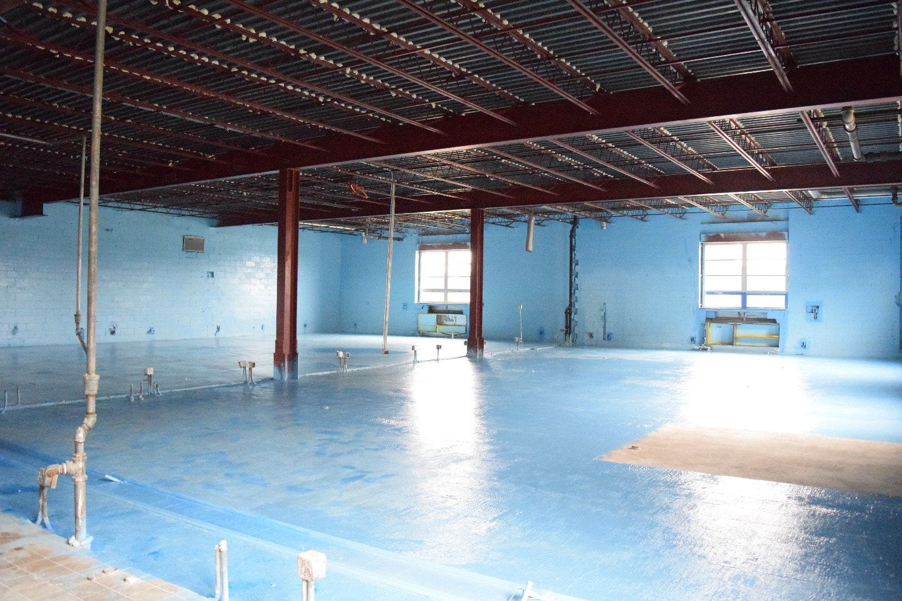
Facilities Services: 2017 End of Year Update
Wilber Hall – Interior Demolition & Abatement

Slide 22
Facilities Services: 2017 End of Year Update
Projects in Planning
Culkin Hall – 7th Floor Circulation & Provosts
Facilities Master Plan
Hewitt Hall – General Reconstruction
Rich Hall – Space Assessment
Sheldon Hall – Repair / Reconstruct Terracotta Frieze

Slide 23
Facilities Services: 2017 End of Year Update

